Slide 1
EE3122: Analogue Circuit Fundamentals
Miscellaneous
Department of Electrical Engineering
City University of Hong Kong
Prof. Arindam BASU

Slide 2
How to find resistance in a circuit
Disable all independent sources in the circuit (current source: open, voltage source: short)
Attach test voltage source Vx to the point where you want to measure resistance
Measure current Ix coming out of the voltage source
Resistance at that point is R = Vx/Ix

Slide 3
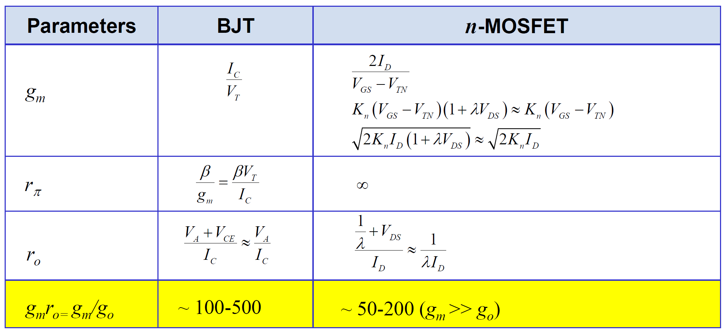
Summary of Small Signal Parameters

