Slide 1
Linear Regression and Maximum Likelihood Estimation
CS2402 Lecture 11

Slide 2
Revision

Slide 3
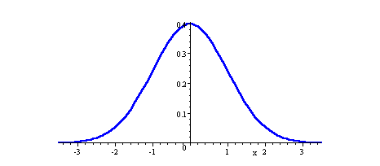
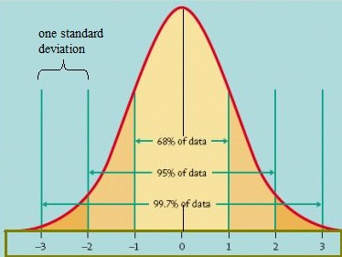
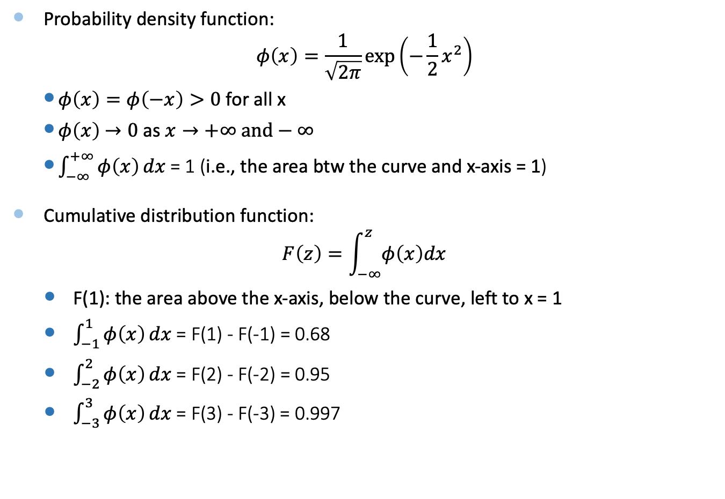
Standard Normal Distribution
Probability density function:
$$φ\left(x\right)=\frac{1}{\sqrt{2π}}\exp\left(−\frac{1}{2}x^{2}\right)$$
  $φ\left(x\right)=φ\left(−x\right)>0$for all x
  $φ\left(x\right)$ $→0 \text{as} x→+∞ and−∞$
  $\int_{−∞}^{+∞}{φ\left(x\right)}dx$= 1 (i.e., the area btw the curve and x-axis = 1)
Cumulative distribution function:
$$F\left(z\right)=\int_{−∞}^{z}{φ\left(x\right)dx}$$
  F(1): the area above the x-axis, below the curve, left to x = 1
  $\int_{−1}^{1}{φ\left(x\right)}dx$ = F(1) - F(-1) = 0.68
  $\int_{−2}^{2}{φ\left(x\right)}dx$ = F(2) - F(-2) = 0.95
  $\int_{−3}^{3}{φ\left(x\right)}dx$= F(3) - F(-3) = 0.997

Slide 4
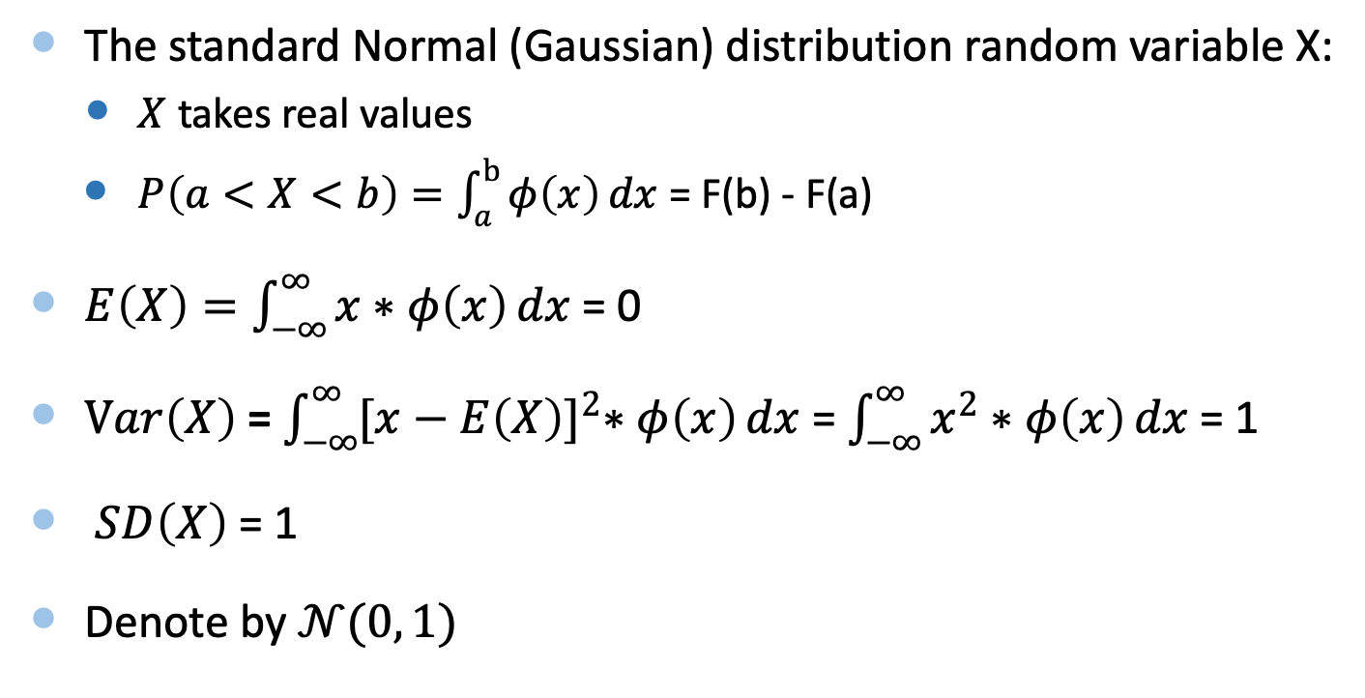
Standard Normal Distribution
The standard Normal (Gaussian) distribution random variable X:
  $X$ takes real values
  $P\left(a<X<b\right)=\int_{a}^{b}{φ\left(x\right)}dx$ = F(b) - F(a)
$E\left(X\right)=\int_{−∞}^{∞}{x∗φ\left(x\right)}dx$ = 0
$Var\left(X\right)$ = $\int_{−∞}^{∞}{{[x−E\left(X\right)]}^{2}∗φ\left(x\right)}dx$ = $\int_{−∞}^{∞}{x^{2}∗φ\left(x\right)}dx$ = 1
$SD\left(X\right)$ = 1
Denote by $𝒩(0, 1)$

Slide 5
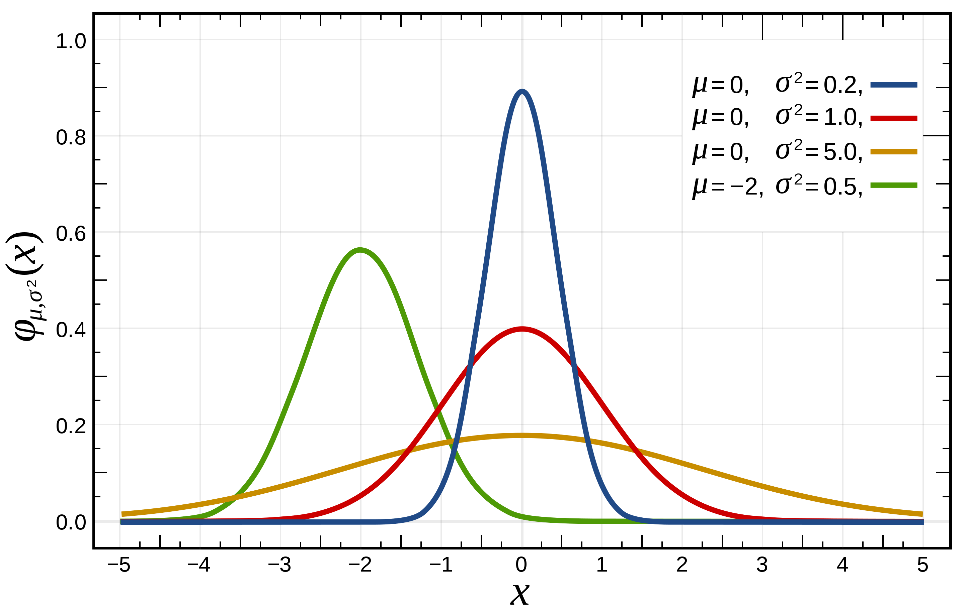
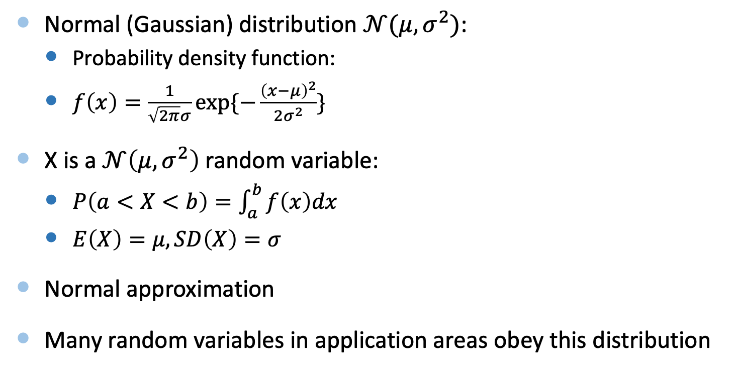
Normal Distribution
Normal (Gaussian) distribution $𝒩(μ, σ^{2})$:
  Probability density function:
  $f\left(x\right)=\frac{1}{\sqrt{2π}σ}exp⁡\{−\frac{{\left(x−μ\right)}^{2}}{2σ^{2}}\}$
X is a $𝒩\left(μ, σ^{2}\right)$random variable:
  $P\left(a<X<b\right)=\int_{a}^{b}{f\left(x\right)dx}$
  $E\left(X\right)=μ, SD\left(X\right)=σ$
Normal approximation
Many random variables in application areas obey this distribution

Slide 6
Bayes’ Rule
Goal: Use evidence to update the probability of hypotheses, i.e., compute the probability of hypotheses conditioned on evidence
Basic steps:
What are hypotheses? Make hypotheses
Compute prior odds (probability) of hypotheses (without evidence)
What’s evidence? Compute the likelihood of evidence under different hypotheses (conditional probabilities of evidence given hypotheses)
Compute the posterior odds of hypotheses (conditional probabilities of hypotheses under evidence)

Slide 7
Objectives
Linear Regression
Correlation
Maximum Likelihood Estimation

Slide 8
1. Linear Regression

Slide 9
Regression
Regression analysis generates a “best-fit” mathematical equation that can be used in predicting the values of the output variable as a function of the input variable
The output random variable Y depends on the input random variable X
  The price of the house, Y, depends on the area size, X
  The salary you earn, Y depends on the working hours, X
Cause and effect
  Cause -> input
  Effect -> output

Slide 10
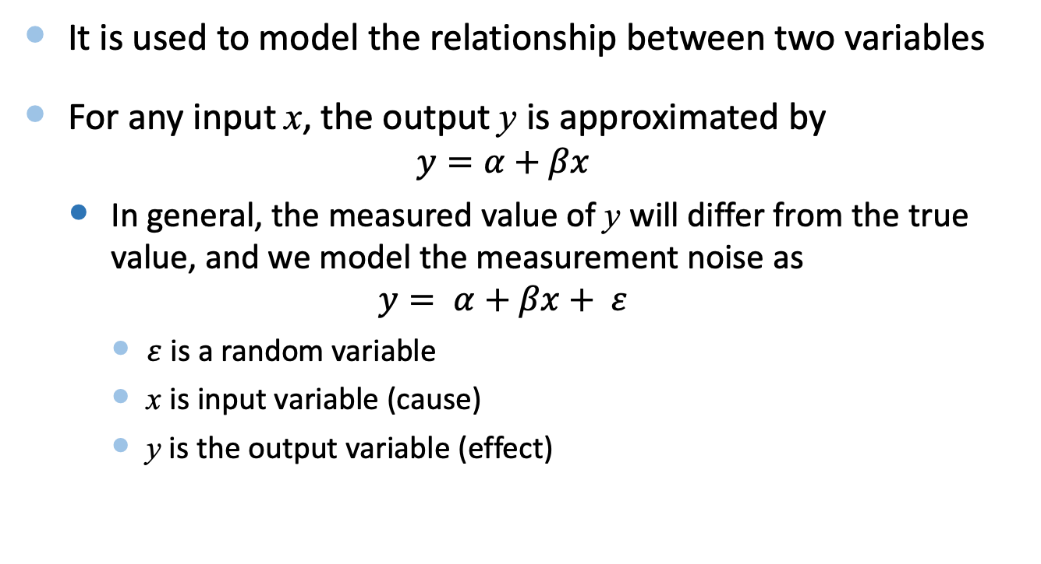
Linear Regression
It is used to model the relationship between two variables
For any input x, the output y is approximated by
  $$y=α+βx$$
  In general, the measured value of y will differ from the true value, and we model the measurement noise as
  $$y= α+βx+ ε$$
    $ε$ is a random variable
    x is input variable (cause)
    y is the output variable (effect)

Slide 11
Example 1
x | 1 | 2 | 3 | 4 | 5 | 6 | 7 | 8 | 9 | 10 | 11 | 12
y | 16 | 35 | 45 | 64 | 86 | 96 | 106 | 124 | 134 | 156 | 164 | 182

Slide 12
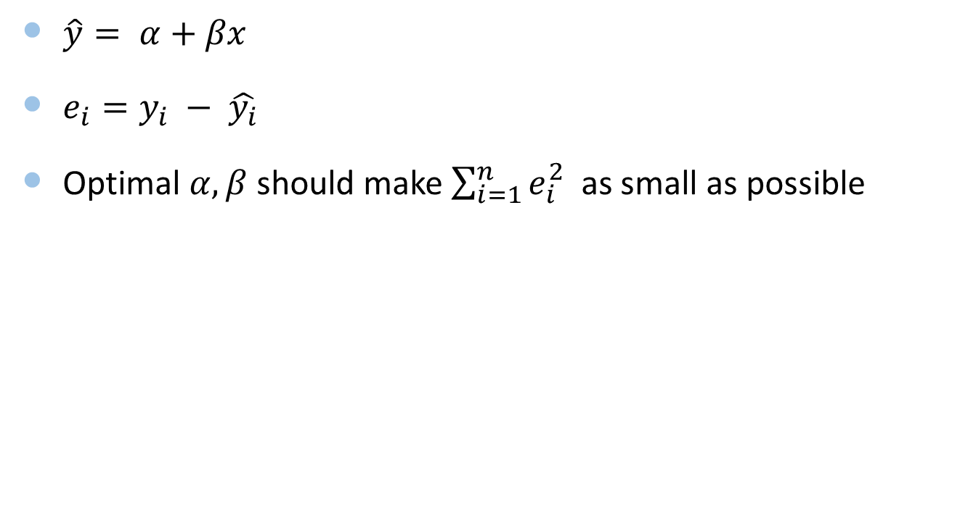
Principle of Least Squares
$\hat{y}= α+βx$
$e_{i}=y_{i} − \hat{y_{i}}$
Optimal $α, β$ should make $\sum_{i=1}^{n}{e_{i}^{2}}$ as small as possible

Slide 13
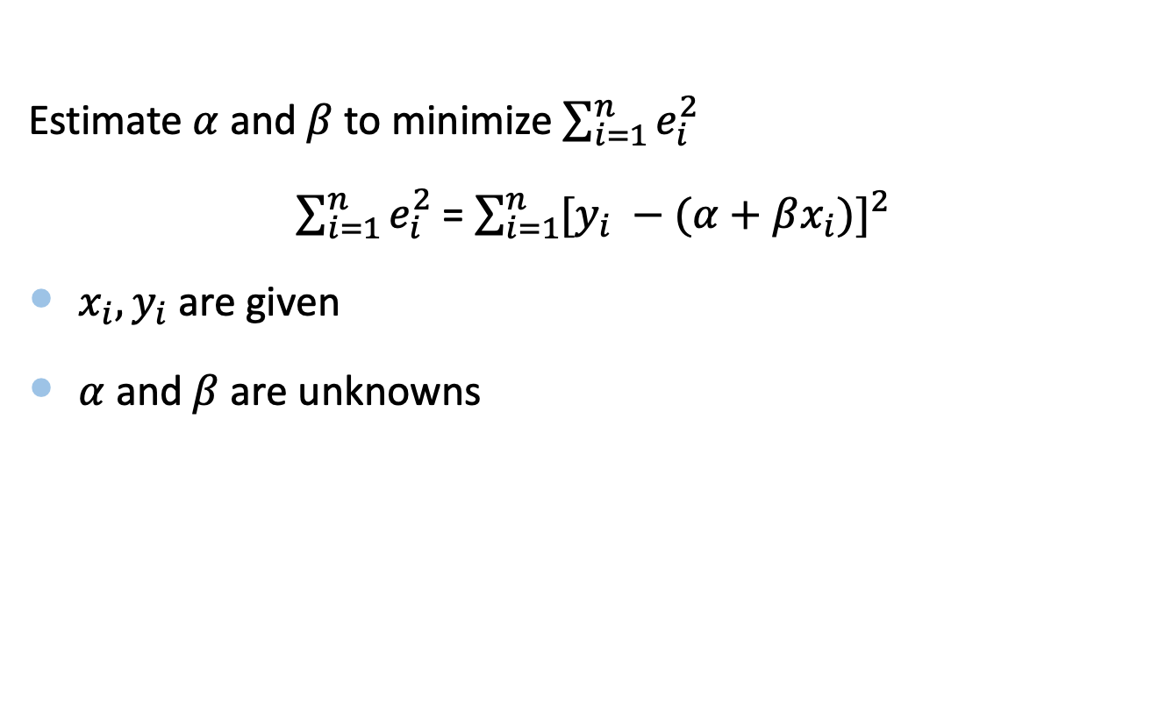
Principle of Least Squares
Estimate $α$ and $β$ to minimize $\sum_{i=1}^{n}{e_{i}^{2}}$
$\sum_{i=1}^{n}{e_{i}^{2}}$ = ${\sum_{i=1}^{n}{[y_{i} −(α+βx_{i})}]}^{2}$
$x_{i}, y_{i}$are given
$α$ and $β$ are unknowns

Slide 14
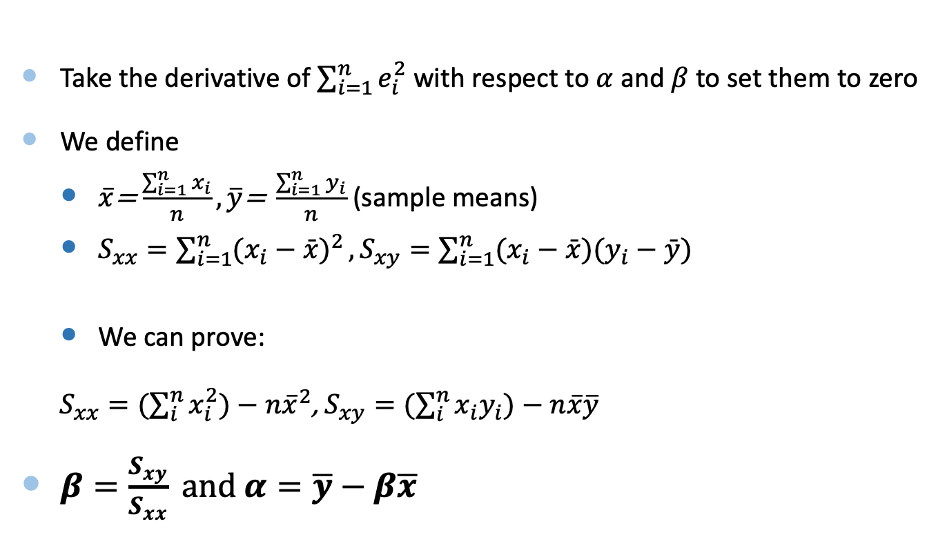
Least Squares Estimators
Take the derivative of $\sum_{i=1}^{n}{e_{i}^{2}}$ with respect to $α$ and $β$to set them to zero
We define
  $\overline{x}$= $\frac{\sum_{i=1}^{n}{x_{i}}}{n},\overline{y}\text{= }\frac{\sum_{i=1}^{n}{y_{i}}}{n}$ (sample means)
  $S_{xx}=\sum_{i=1}^{n}{(x_{i}−\bar{x})^{2}}, S_{xy}=\sum_{i=1}^{n}{(x_{i}−\bar{x})(y_{i}−\bar{y})}$
  We can prove:
$S_{xx}=(\sum_{i}^{n}{x_{i}^{2})−n{\overline{x}}^{2}}$, $S_{xy}=(\sum_{i}^{n}{x_{i}y_{i})−n{\overline{x}\overline{y}}^{}}$
$β=\frac{S_{xy}}{S_{xx}} and α=\overline{y}−β\overline{x}$
Notes:
scatter

Slide 15
Solution to Example 1
x | 1 | 2 | 3 | 4 | 5 | 6 | 7 | 8 | 9 | 10 | 11 | 12
y | 16 | 35 | 45 | 64 | 86 | 96 | 106 | 124 | 134 | 156 | 164 | 182

Slide 16

Example 2
The following data are for the number of computer jobs per day and the central processing unit (CPU) time required
  Number of jobs (X) CPU time (Y)
    1 2
    2 5
    3 4
    4 9
    5 10

Slide 17
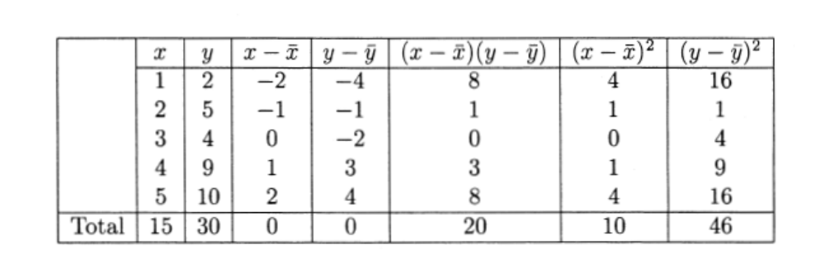
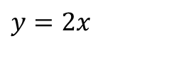
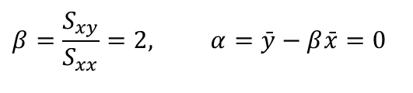
Solution to Example 2
Obtain a least squares fit of a line to the observations on CPU time
$$β=\frac{S_{xy}}{S_{xx}}=2, α=\bar{y}−β\bar{x}=0$$
$$y=2x$$

Slide 18
Example 3
You’re a marketing analyst for Hasbro Toys. You gather the following data:
  Ad $ Sales (Units)
    1 1
    2 1
    3 2
    4 3
    5 4

Slide 19
Solution to Example 3
What is the relationship between sales & advertising?

Slide 20
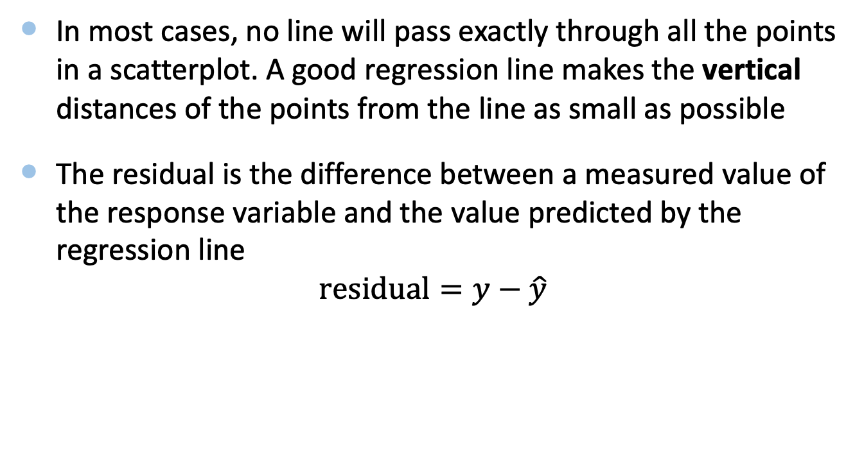
Residuals
In most cases, no line will pass exactly through all the points in a scatterplot. A good regression line makes the vertical distances of the points from the line as small as possible
The residual is the difference between a measured value of the response variable and the value predicted by the regression line
$$residual=y−\hat{y}$$

Slide 21
2. Correlation

Slide 22
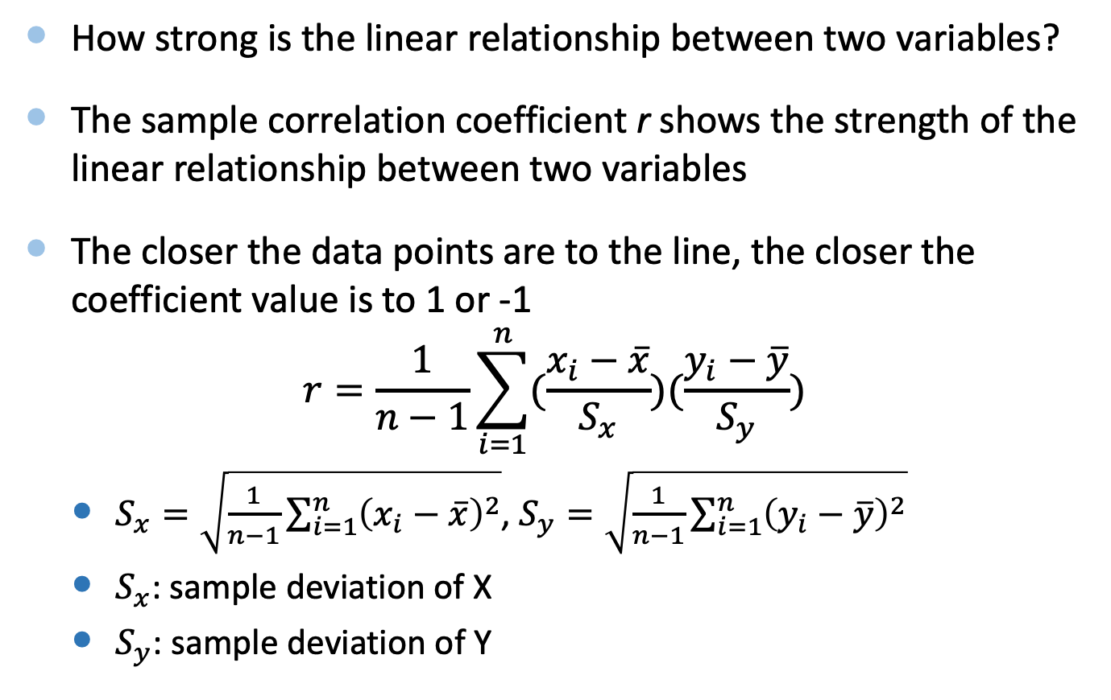
Correlation Coefficient (r)
How strong is the linear relationship between two variables?
The sample correlation coefficient r shows the strength of the linear relationship between two variables
The closer the data points are to the line, the closer the coefficient value is to 1 or -1
$$r=\frac{1}{n−1}\sum_{i=1}^{n}{(\frac{x_{i}−\overline{x}}{S_{x}})(\frac{y_{i}−\overline{y}}{S_{y}})}$$
  $S_{x}=\sqrt{\frac{1}{n−1}\sum_{i=1}^{n}{{\left(x_{i}−\overline{x}\right)}^{2}}}$, $S_{y}=\sqrt{\frac{1}{n−1}\sum_{i=1}^{n}{{\left(y_{i}−\overline{y}\right)}^{2}}}$
  $S_{x}$: sample deviation of X
  $S_{y}$: sample deviation of Y
https://en.wikipedia.org/wiki/Bias_of_an_estimator

Slide 23
Correlation Coefficient (r)
No Correlation
-1.0
-.5
0
+.5
+1.0
Increasing degree of negative correlation
Increasing degree of positive correlation

Slide 24
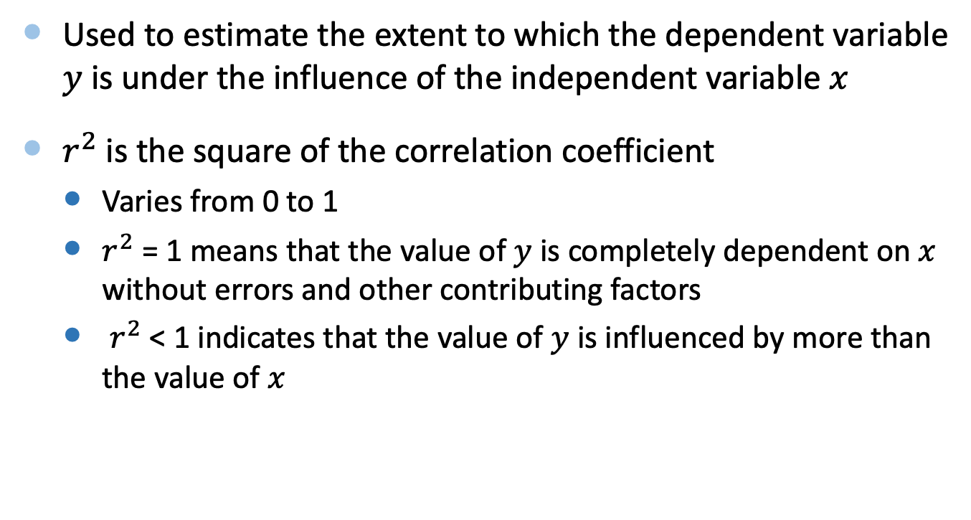
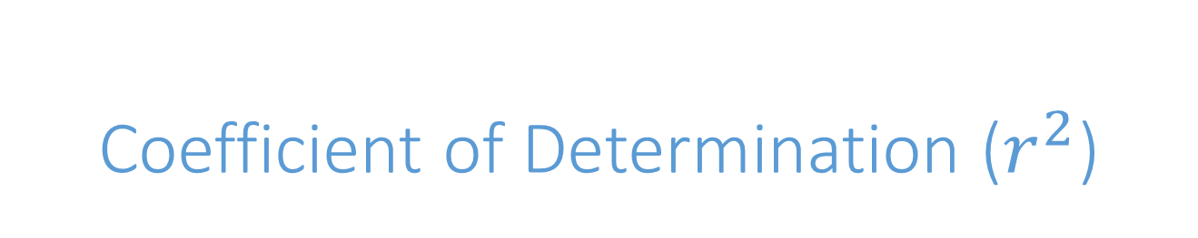
Coefficient of Determination ($r^{2}$)
Used to estimate the extent to which the dependent variable $y$ is under the influence of the independent variable $x$
$r^{2}$ is the square of the correlation coefficient
  Varies from 0 to 1
  $r^{2}$ = 1 means that the value of $y$ is completely dependent on $x$ without errors and other contributing factors
  $r^{2}$ < 1 indicates that the value of $y$ is influenced by more than the value of $x$

Slide 25
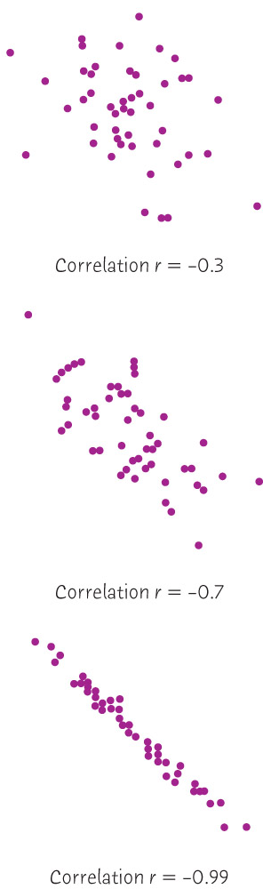
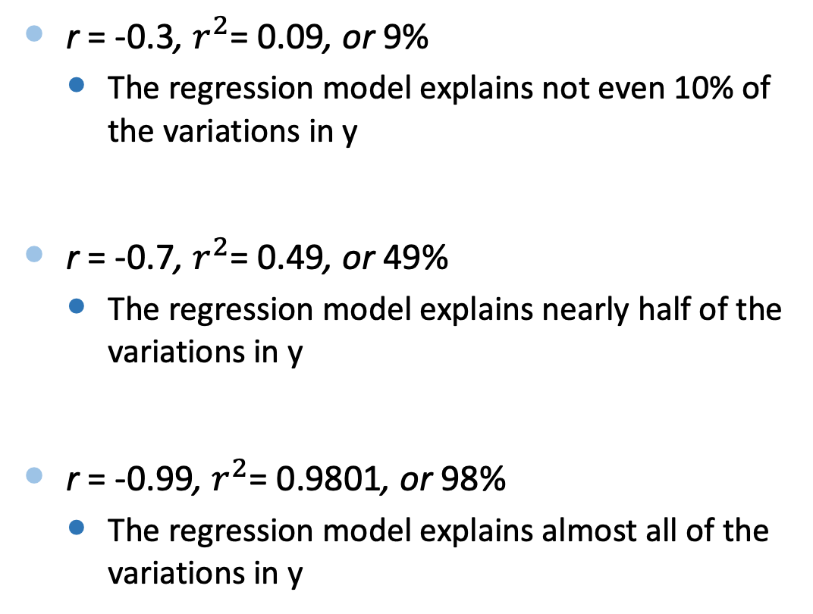
Examples
r = -0.3, $r^{2}$= 0.09, or 9%
  The regression model explains not even 10% of the variations in y
r = -0.7, $r^{2}$= 0.49, or 49%
  The regression model explains nearly half of the variations in y
r = -0.99, $r^{2}$= 0.9801, or 98%
  The regression model explains almost all of the variations in y

Slide 26
3. Maximum Likelihood Estimation

Slide 27
Concepts
Probability:
  Knowing probability model → distribution of outcomes
Maximum Likelihood
  Observation of data → Estimation of parameters in probability models
The aim of maximum likelihood estimation is to find the parameter values that make the observed data most probable (i.e., most likely)

Slide 28
Maximum Likelihood Estimation
We want to estimate the probability, p, that individuals are infected with a certain kind of virus. Binomial experiment
Index | Infected | Probability of observation
1 | 1 | p
2 | 0 | 1-p
3 | 1 | p
4 | 1 | p
5 | 0 | 1-p
6 | 1 | p
7 | 1 | p
8 | 0 | 1-p
9 | 0 | 1-p
10 | 1 | p

Slide 29
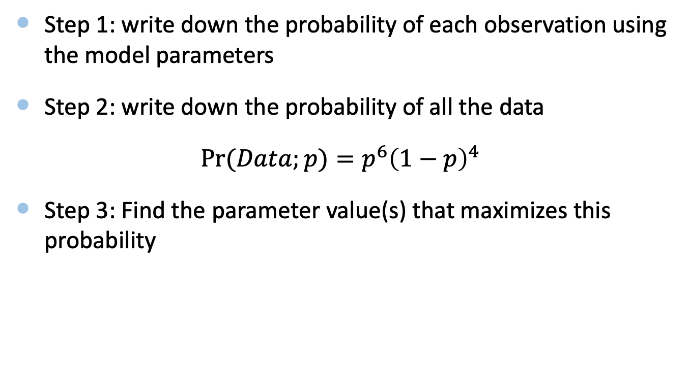
Maximum Likelihood Estimation
Step 1: write down the probability of each observation using the model parameters
Step 2: write down the probability of all the data
$\operatorname{Pr}{(Data;}p)=p^{6}{\left(1−p\right)}^{4}$
Step 3: Find the parameter value(s) that maximizes this probability

Slide 30
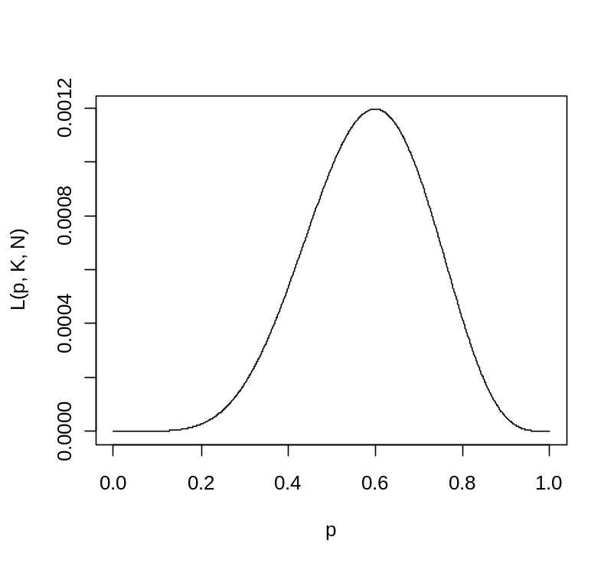

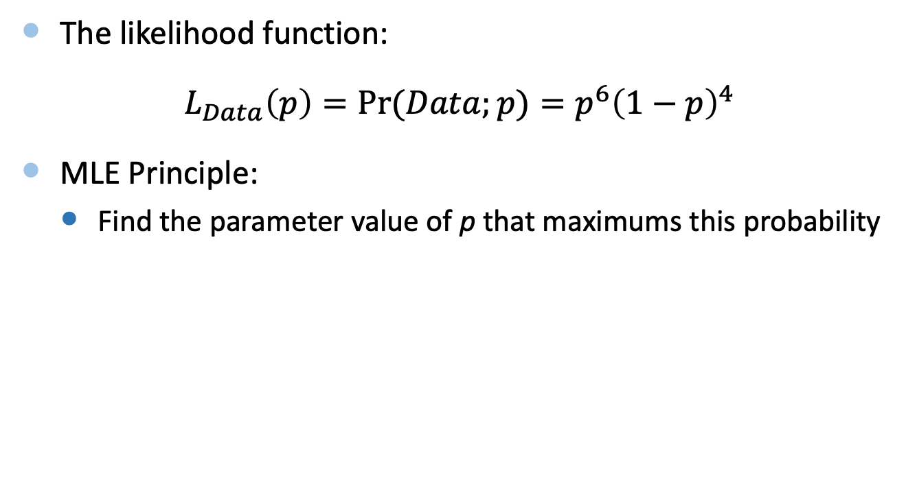

Maximum Likelihood Estimation
The likelihood function:
$L_{Data}\left(p\right)=\operatorname{Pr}{(Data;}p)=p^{6}{\left(1−p\right)}^{4}$
MLE Principle:
  Find the parameter value of p that maximums this probability
$$L_{Data}(p)$$

Slide 31
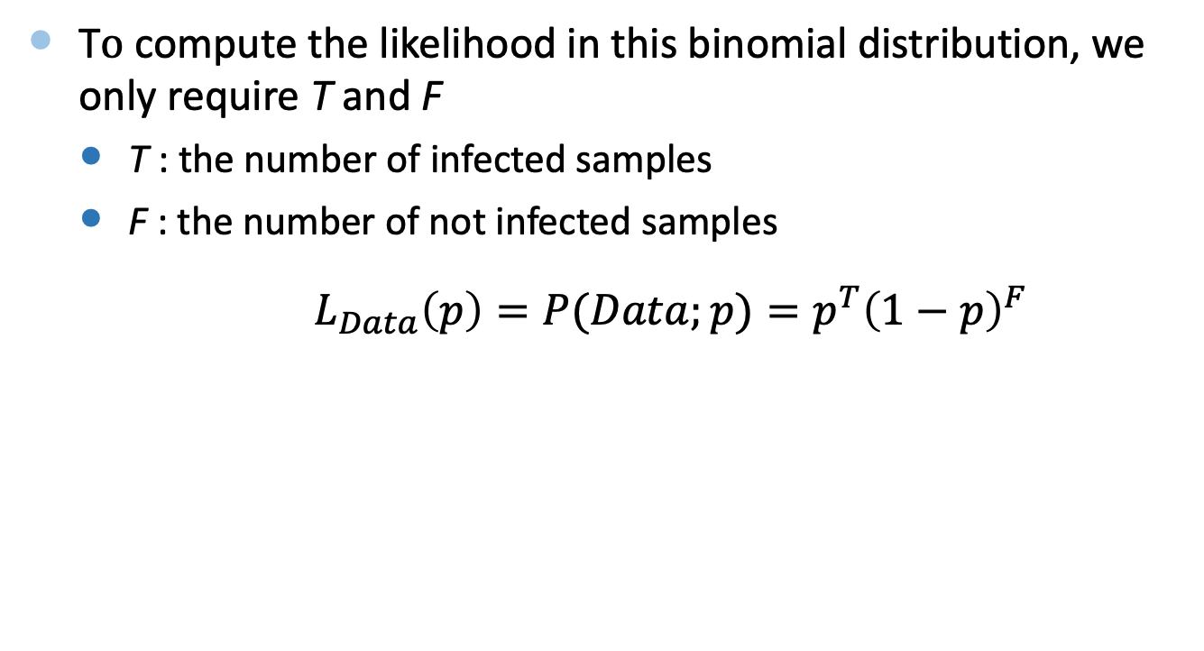
Maximum Likelihood Estimation
T$o$ compute the likelihood in this binomial distribution, we only require T and F
  T : the number of infected samples
  F : the number of not infected samples
$L_{Data}\left(p\right)=P(Data;p)=p^{T}{\left(1−p\right)}^{F}$

Slide 32
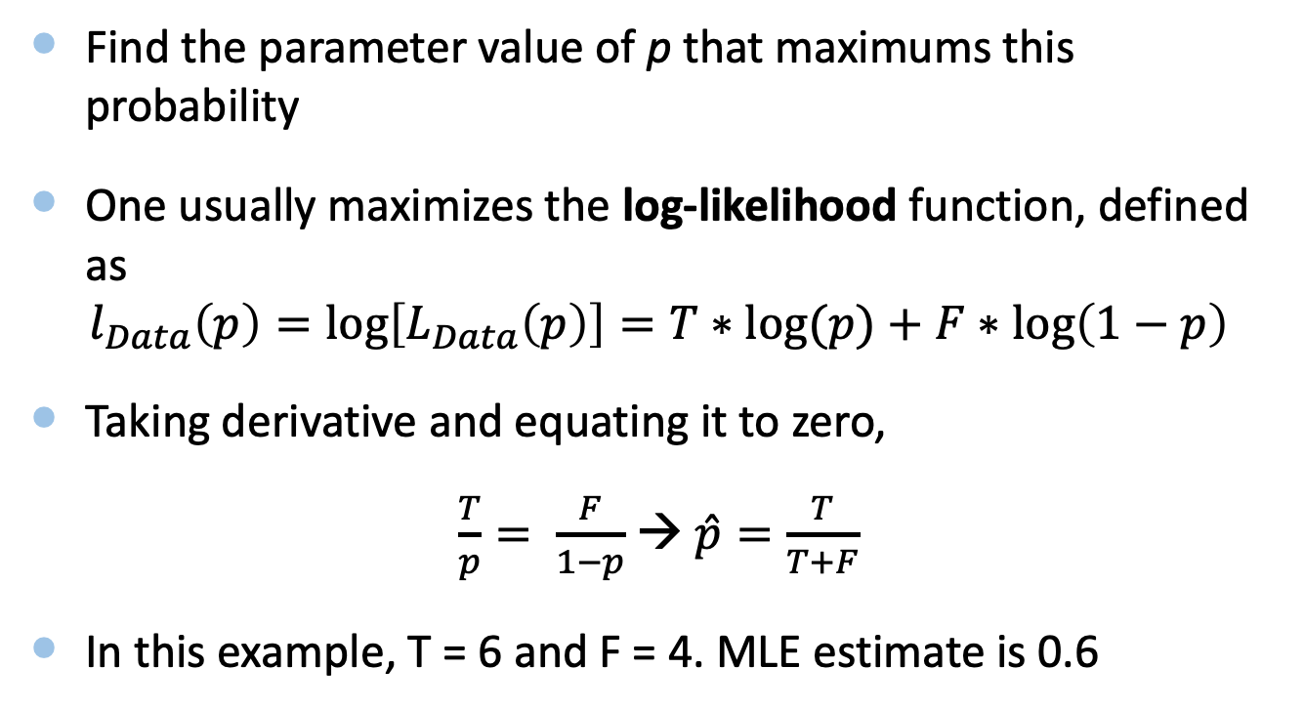
Maximum Likelihood Estimation
  Find the parameter value of p that maximums this probability
One usually maximizes the log-likelihood function, defined as
$$l_{Data}\left(p\right)=\log\left[L_{Data}\left(p\right)\right]=T∗log(p)+F∗log\left(1−p\right)$$
Taking derivative and equating it to zero,
$\frac{T}{p}= \frac{F}{1−p}$ → $\hat{p}=\frac{T}{T+F}$
In this example, T = 6 and F = 4. MLE estimate is 0.6

Slide 33
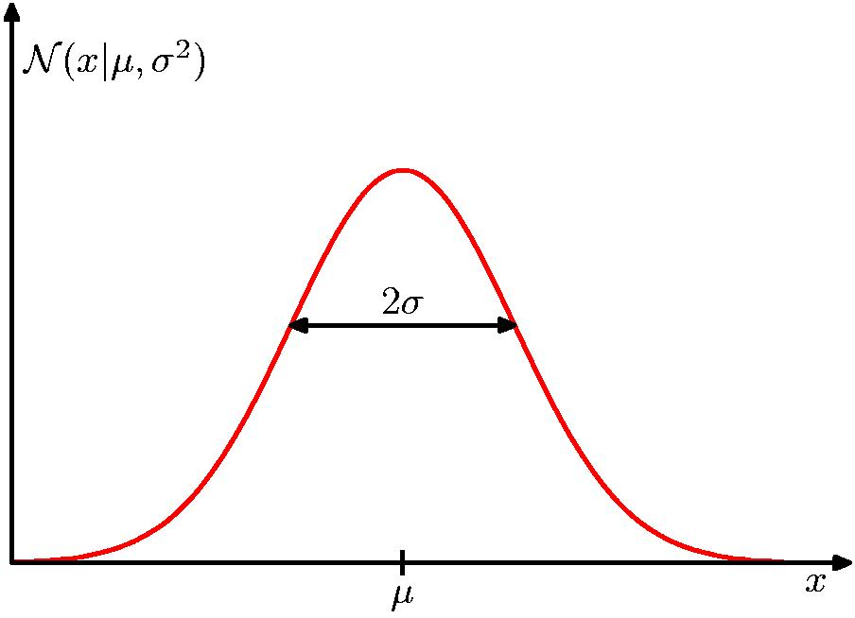
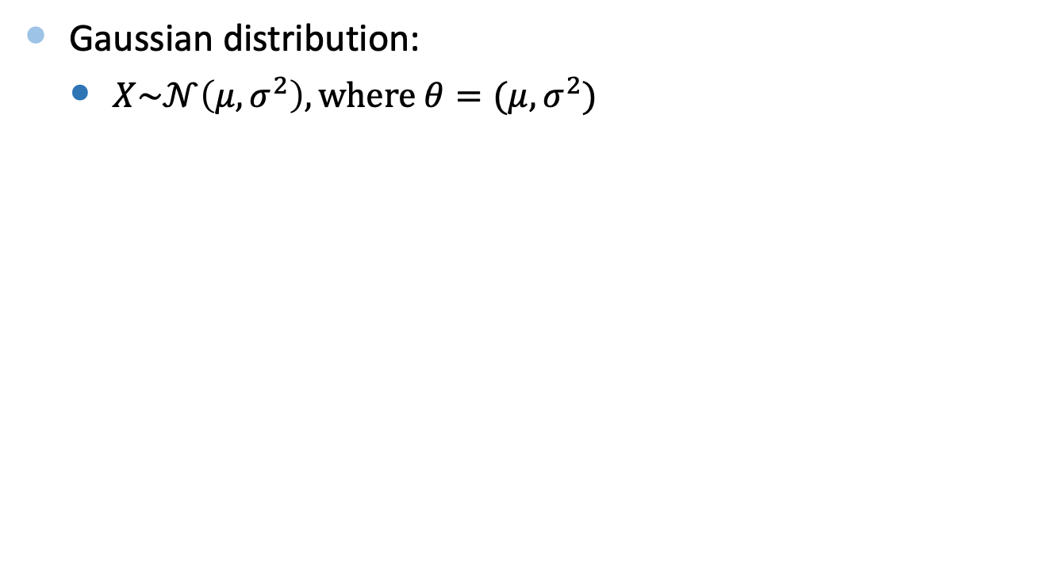
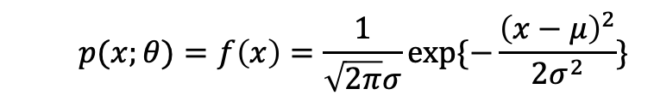
MLE for Gaussian Distribution
Gaussian distribution:
  $X\sim 𝒩\left(μ, σ^{2}\right), where θ=(μ, σ^{2})$
  $$p(x;θ)=f\left(x\right)=\frac{1}{\sqrt{2π}σ}exp⁡\{−\frac{{\left(x−μ\right)}^{2}}{2σ^{2}}\}$$

Slide 34
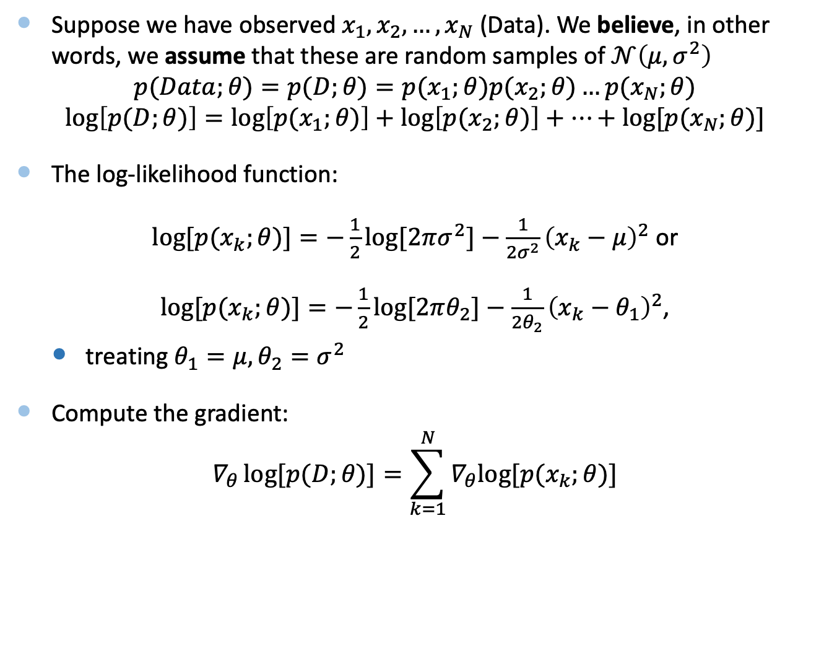
MLE for Gaussian Distribution
Suppose we have observed $x_{1},x_{2}, …, x_{N}$ (Data). We believe, in other words, we assume that these are random samples of $𝒩\left(μ, σ^{2}\right)$
$$p(Data;θ)=p(D;θ)=p(x_{1};θ)p(x_{2};θ)…p(x_{N};θ)$$
$$\log\left[p(D;θ)\right]=\log\left[p(x_{1};θ)\right]+\log\left[p(x_{2};θ)\right]+…+log[p(x_{N};θ)]$$
The log-likelihood function:
$log[p(x_{k};θ)]=−\frac{1}{2}log[2πσ^{2}]−\frac{1}{2σ^{2}}{\left(x_{k}−μ\right)}^{2}$ or
$log[p(x_{k};θ)]=−\frac{1}{2}log[2πθ_{2}]−\frac{1}{2θ_{2}}{\left(x_{k}−θ_{1}\right)}^{2}$,
  treating ${θ_{1}=μ, θ}_{2}=σ^{2}$
Compute the gradient:
$$∇_{θ}\log{[p(D;θ)}]=\sum_{k=1}^{N}{∇_{θ}log⁡[p(x_{k};θ)]}$$

Slide 35
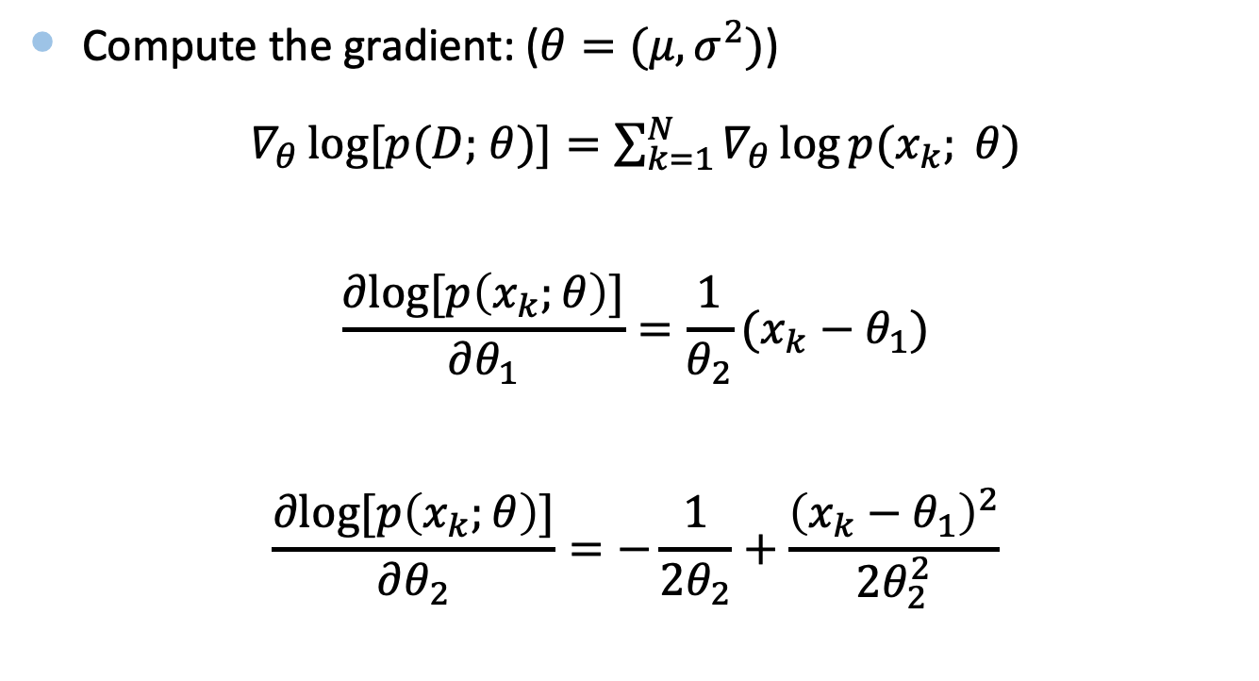
MLE for Gaussian Distribution
Compute the gradient: ($θ=(μ, σ^{2})$)
$∇_{θ}\log{[p(D;}$ $θ)]=\sum_{k=1}^{N}{∇_{θ}\log{p(x_{k};} θ)}$
$$\frac{∂log[p\left(x_{k};θ\right)]}{∂θ_{1}}=\frac{1}{θ_{2}}(x_{k}−θ_{1})$$
$$\frac{∂log[p\left(x_{k};θ\right)]}{∂θ_{2}}=−\frac{1}{2θ_{2}}+\frac{{\left(x_{k}−θ_{1}\right)}^{2}}{2θ_{2}^{2}}$$

Slide 36
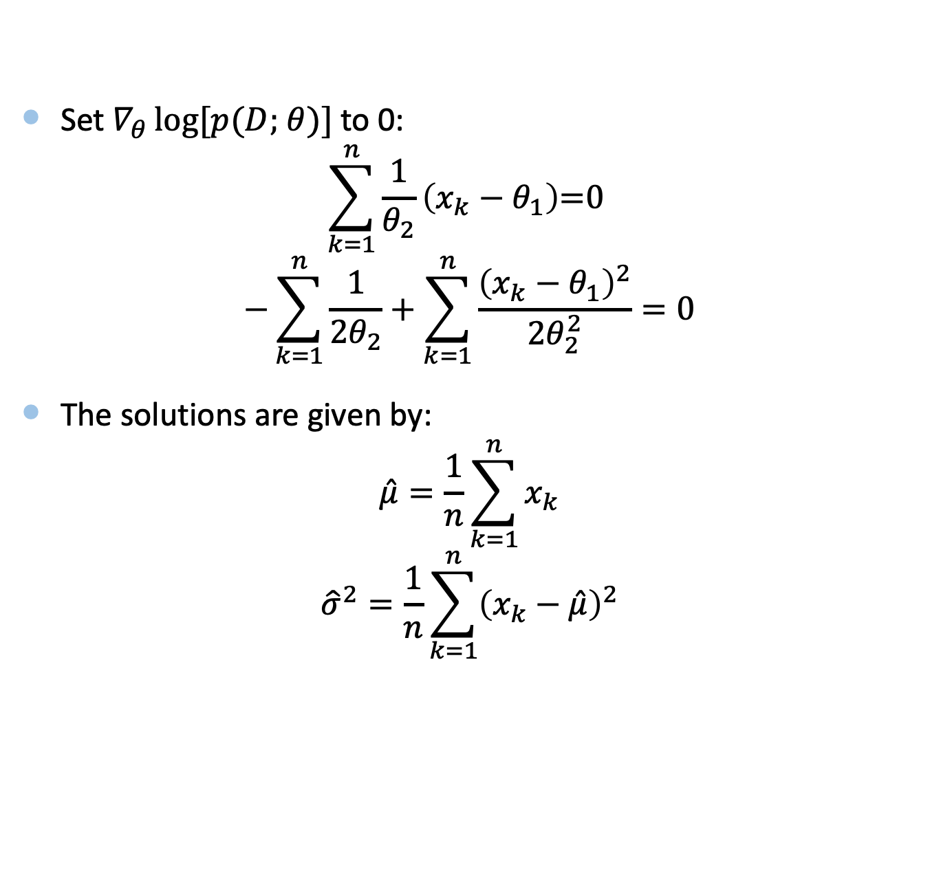
MLE for Gaussian Distribution
Set $∇_{θ}\log{[p(D;}$ $θ)]$ to 0:
$$\sum_{k=1}^{n}{\frac{1}{θ_{2}}\left(x_{k}−θ_{1}\right)\text{=0} }$$
$$−\sum_{k=1}^{n}{\frac{1}{2θ_{2}}}+\sum_{k=1}^{n}{\frac{{\left(x_{k}−θ_{1}\right)}^{2}}{2θ_{2}^{2}}}=0$$
The solutions are given by:
$$\hat{μ}=\frac{1}{n}\sum_{k=1}^{n}{x_{k}}$$
$${\hat{σ}}^{2}=\frac{1}{n}\sum_{k=1}^{n}{{\left(x_{k}−\hat{μ}\right)}^{2}}$$

Slide 37
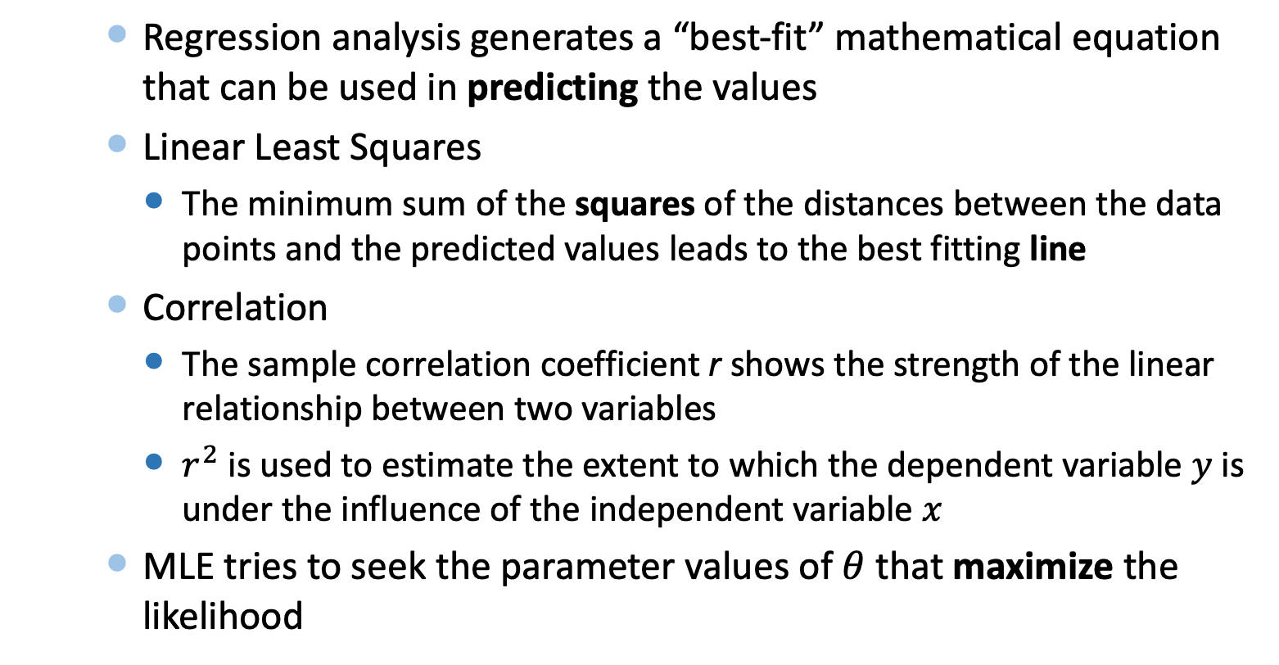
Summary
    Regression analysis generates a “best-fit” mathematical equation that can be used in predicting the values
    Linear Least Squares
      The minimum sum of the squares of the distances between the data points and the predicted values leads to the best fitting line
    Correlation
      The sample correlation coefficient r shows the strength of the linear relationship between two variables
      $r^{2}$ is used to estimate the extent to which the dependent variable $y$ is under the influence of the independent variable $x$
    MLE tries to seek the parameter values of $θ$ that maximize the likelihood

