Slide 1
EE2000 Logic Circuit Design
Combinational Functional Blocks

Slide 2
Outline
4.1 Equality Comparator
4.2 Arithmetic functional blocks
  - Half adder, Full adder, Ripple carry adder
  - Half subtractor, Full substractor, Ripple carry substractor
  - Carry-look-ahead adder
4.3 Logical functional blocks
- Decoder
- Encoder
- Multiplexer
- Demultiplexer

Slide 3
4.1 Equality Comparator
A circuit to compare two binary numbers to determine whether they are equal or not
The inputs consist of two variables: A and B
The output of the circuit is a variable E
E is equal to 1 if A and B are equal
E is equal to 0 if A and B are unequal

Slide 4
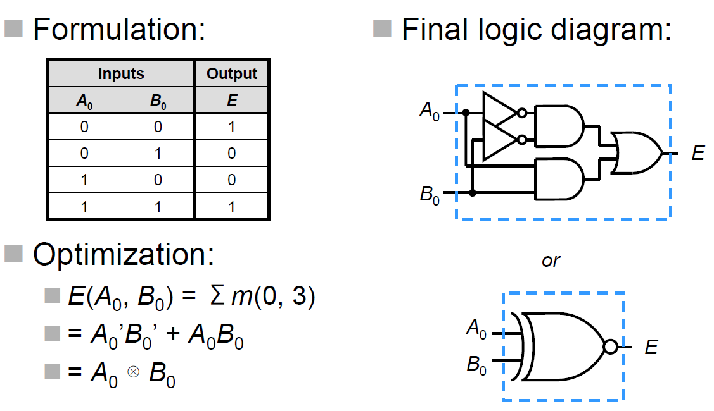
1-bit Equality Comparator

Slide 5
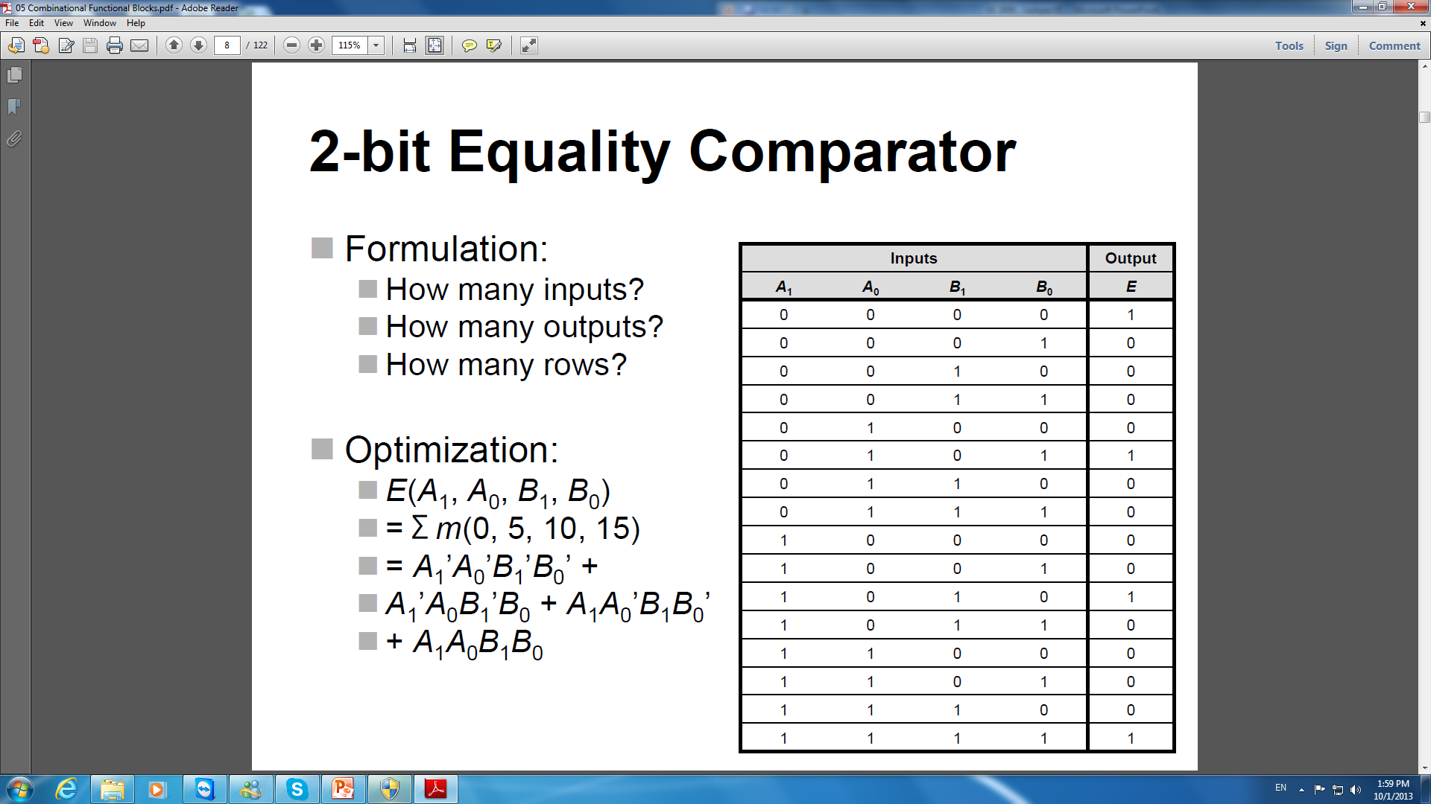
2-bit Equality Comparator

Slide 6
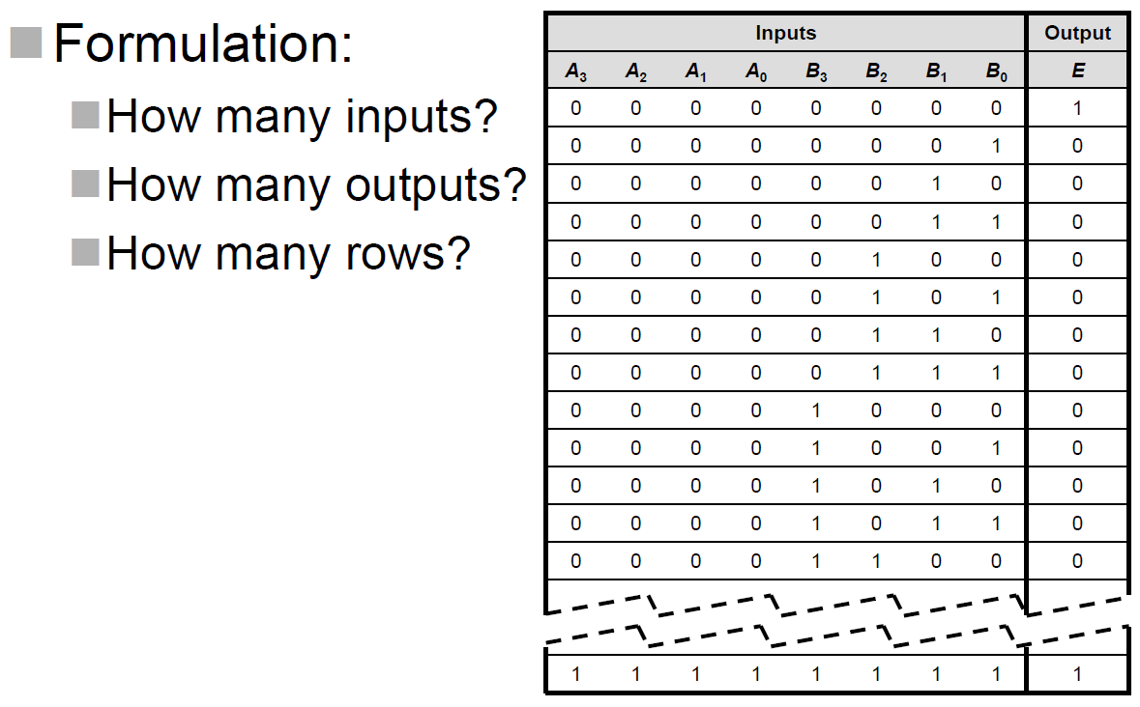
4-bit Equality Comparator
Problem:
Not easy to design
Difficult in simplification
K-map? QM ?
Solution:
Modular design
Functional circuit blocks

Slide 7
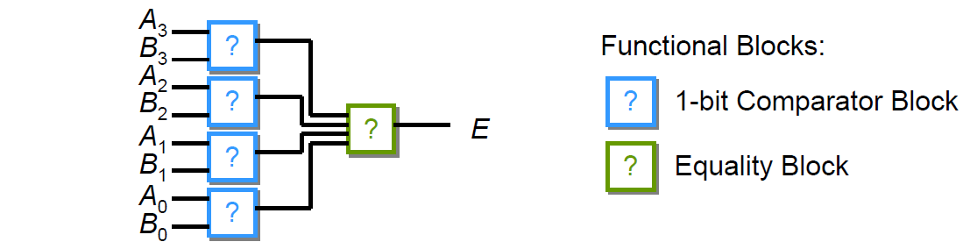
4-bit Equality Comparator
Modular design
- Decompose the problem into four 1-bit comparison circuits
- Compare bit by bit, then combine all results
Logic diagram

Slide 8
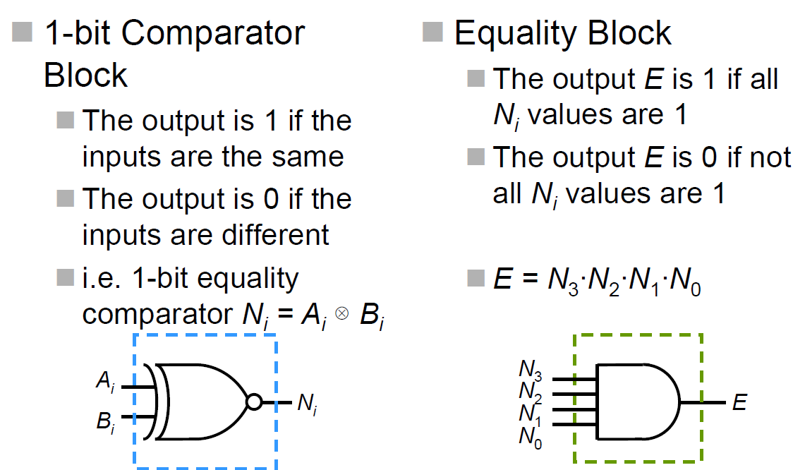
4-bit Equality Comparator

Slide 9
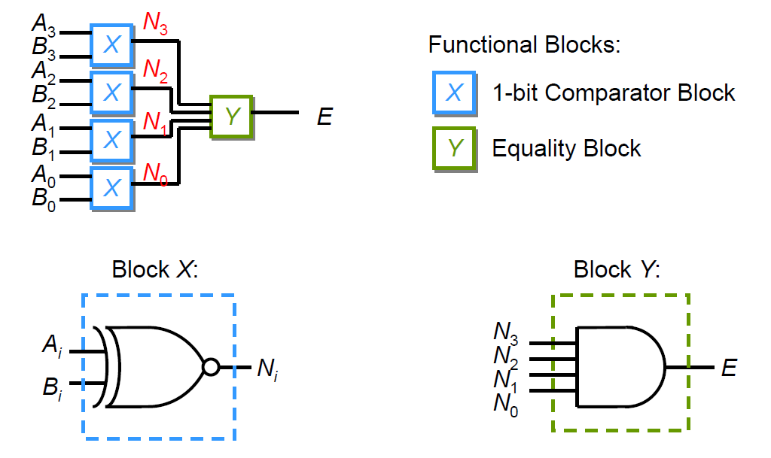
4-bit Equality Comparator
Final logic diagram

Slide 10
Summary of 4.1
Instead of designing a complex n-bit equality comparator circuit
Design only a 1-bit comparator block and a simple equality block
Re-use the 1-bit comparator block for n times
Reusable small circuits are called combinational functional blocks

Slide 11
4.2 Arithmetic functional blocks
Special class of functional blocks that perform arithmetic operations
Operate on binary numbers (input) and produce binary numbers (output)
Each bit position has the same sub-function
Design a functional block for the sub-function and use repeatedly for each bit position
Example arithmetic functional blocks
- Adders, subtractors

Slide 12
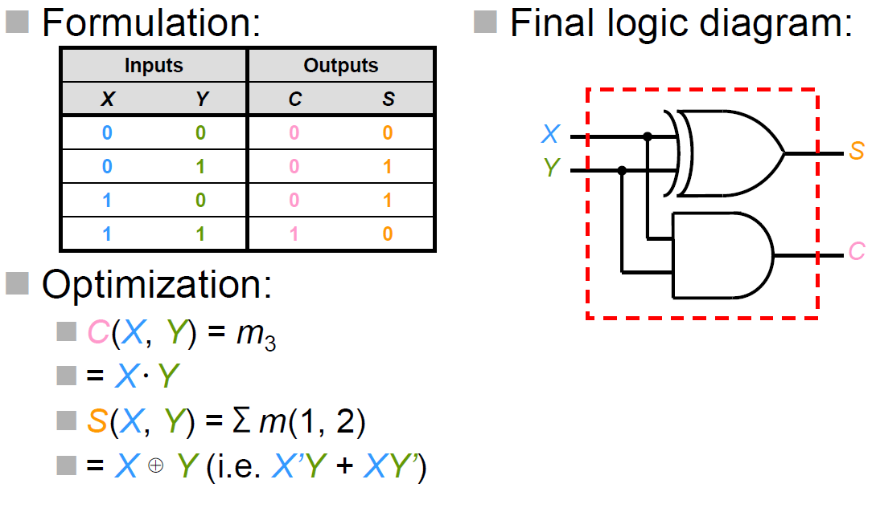
1-bit Adder
The outputs are
S (sum bit), and
C (carry-out bit)
As known as half adder (HA)

Slide 13
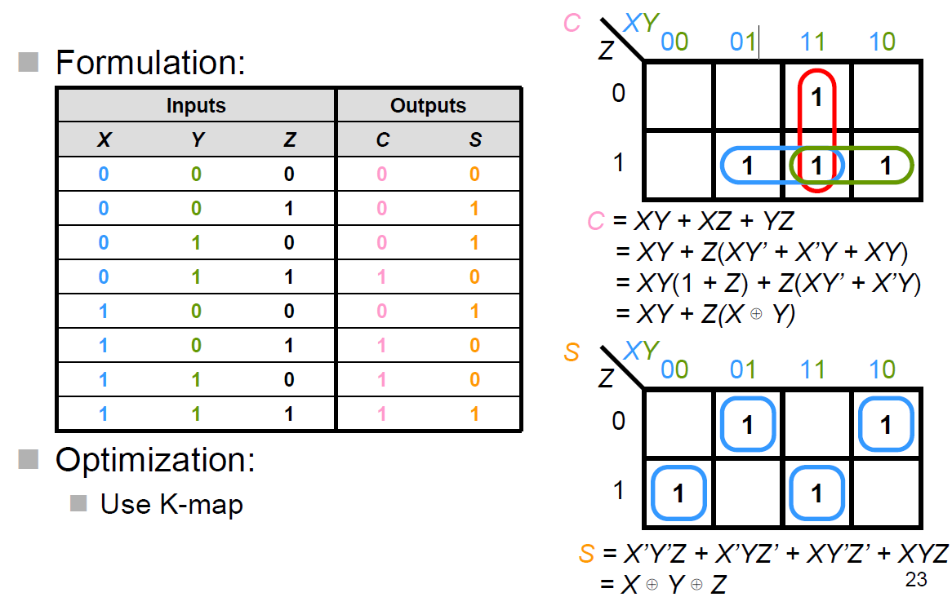
1-bit Full Adder

Slide 14
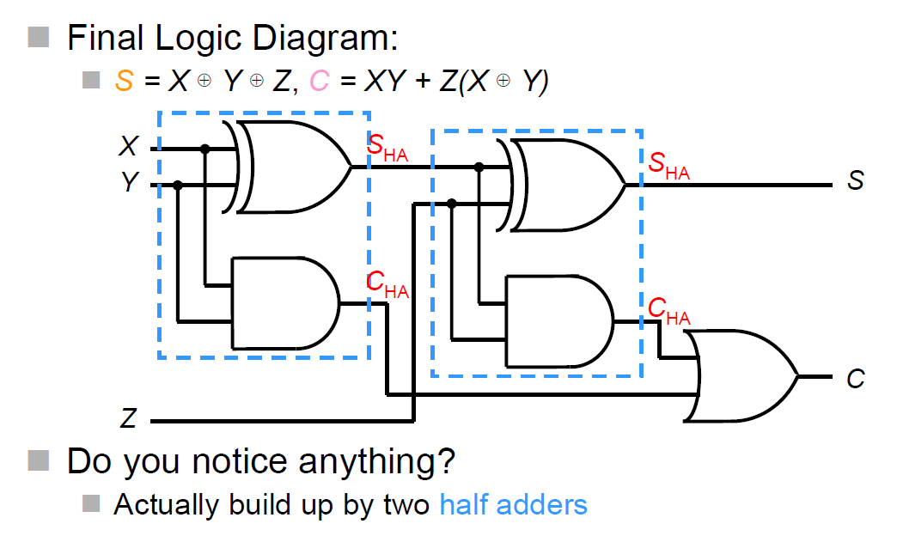
Full Adder

Slide 15
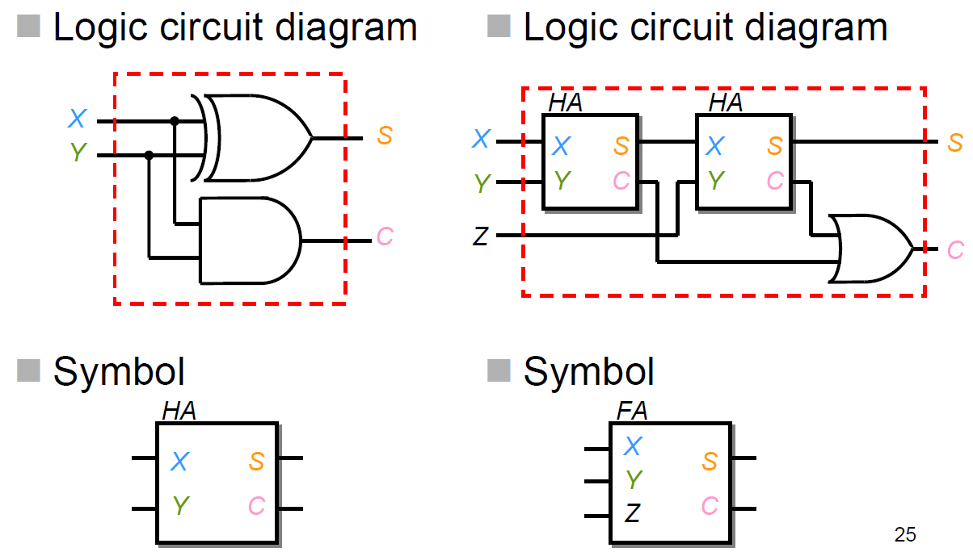
Half Adder and Full Adder

Slide 16
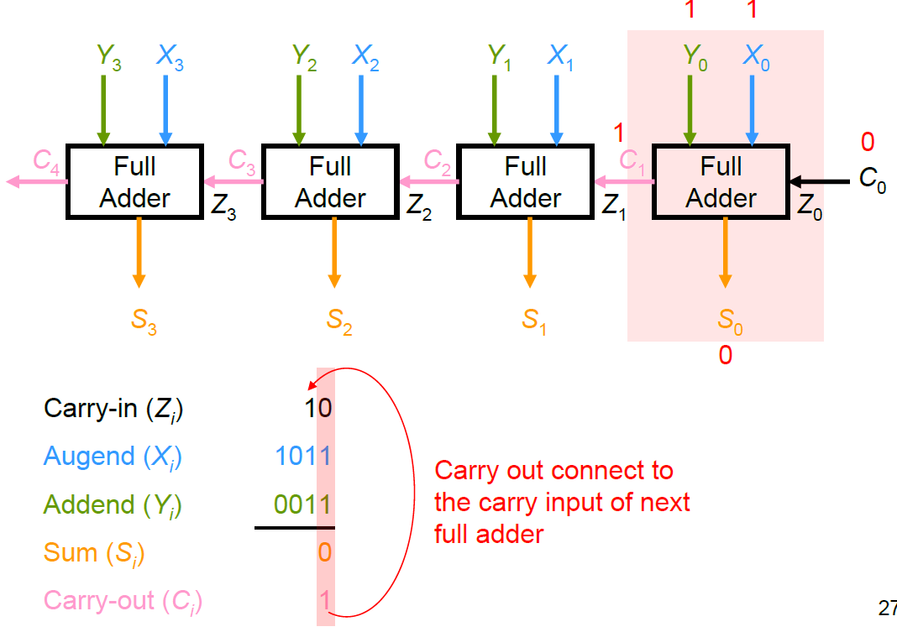
Ripple Carry Adder

Slide 17
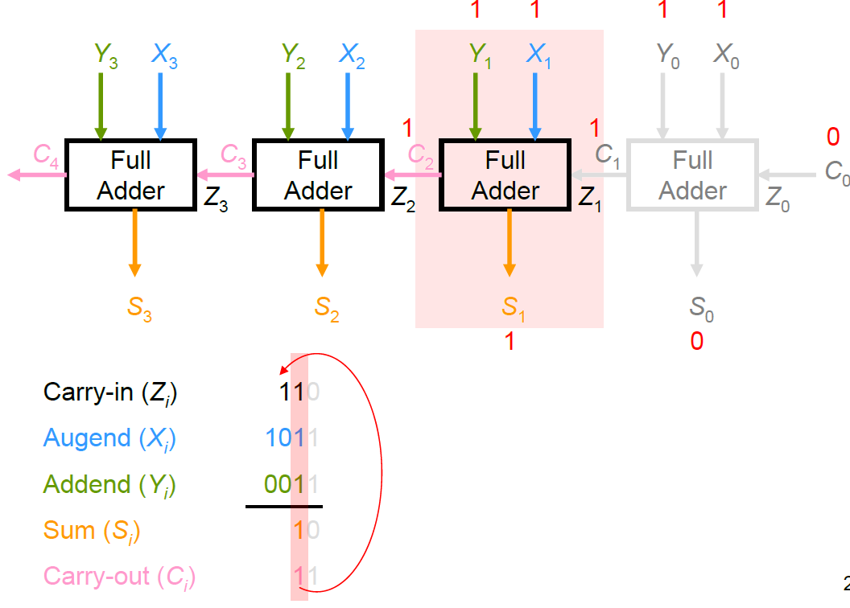
Ripple Carry Adder

Slide 18
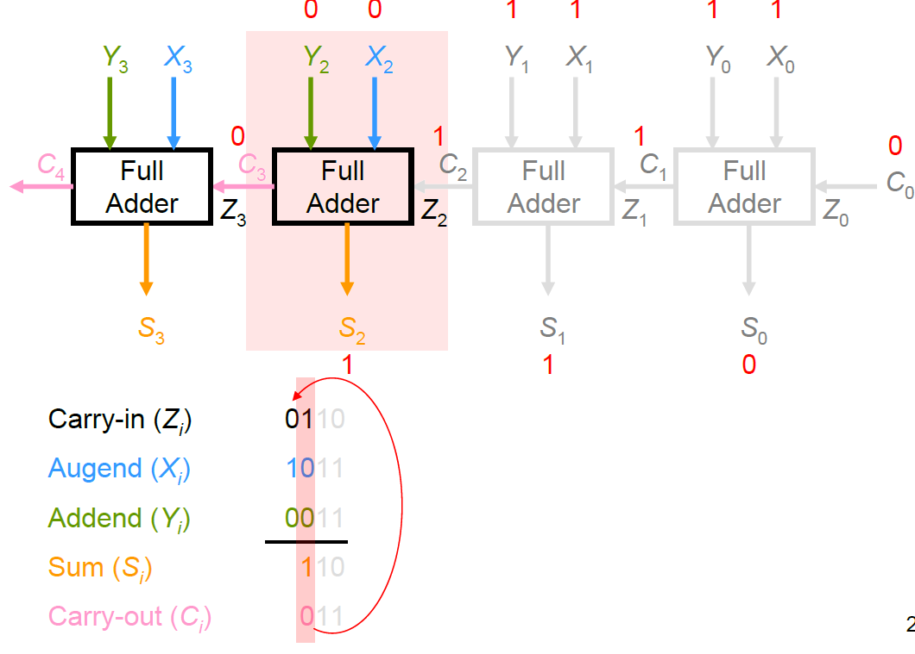
Ripple Carry Adder

Slide 19
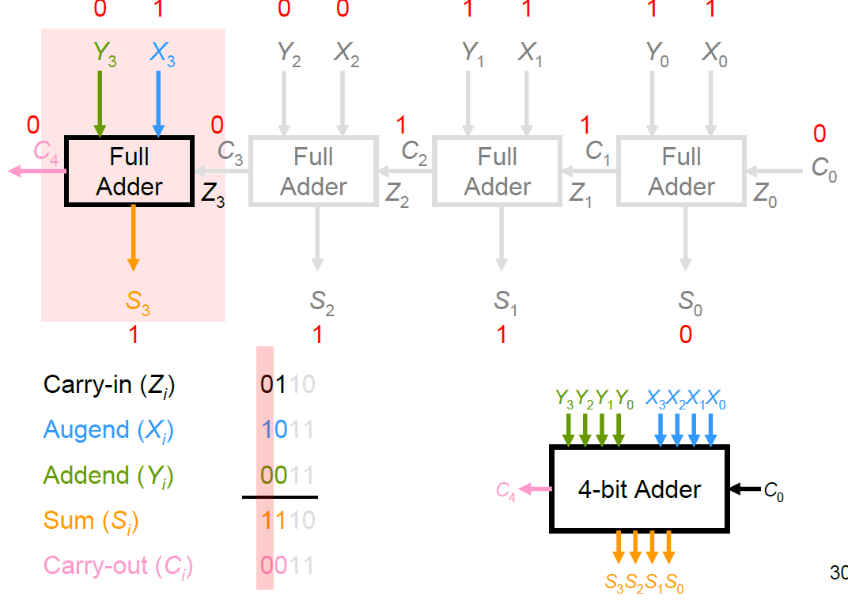
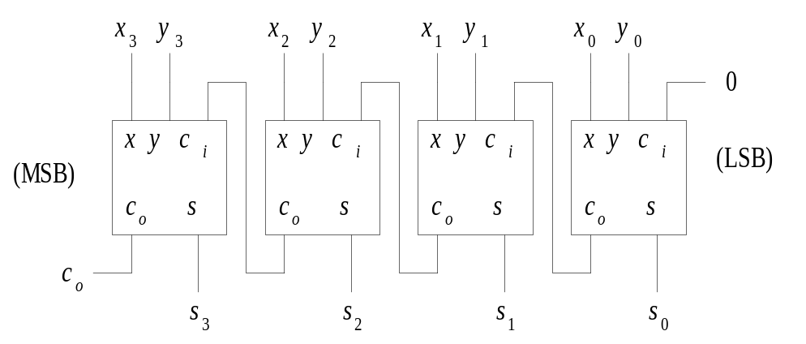
Ripple Carry Adder

Slide 20
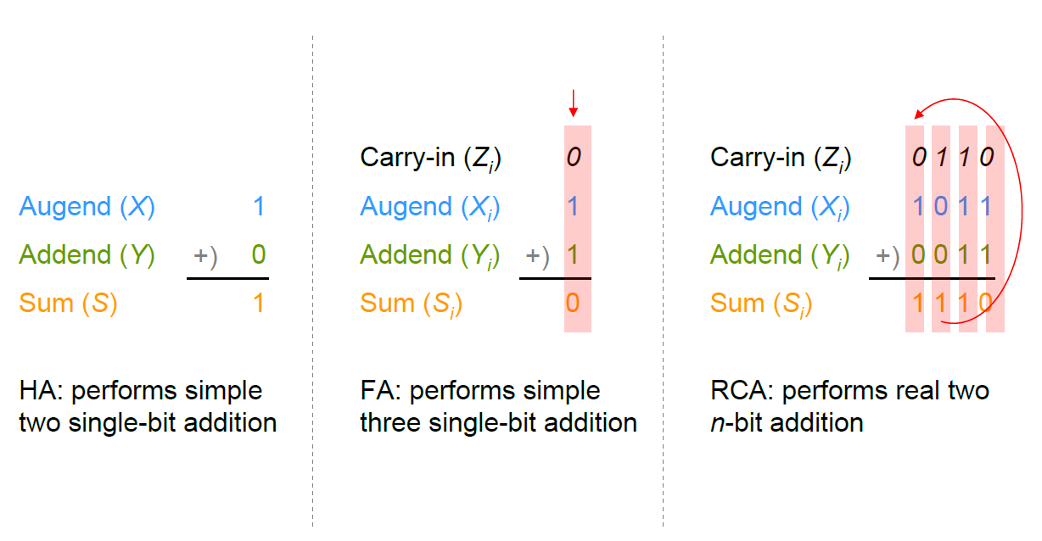
HA vs. FA vs. RCA

Slide 21
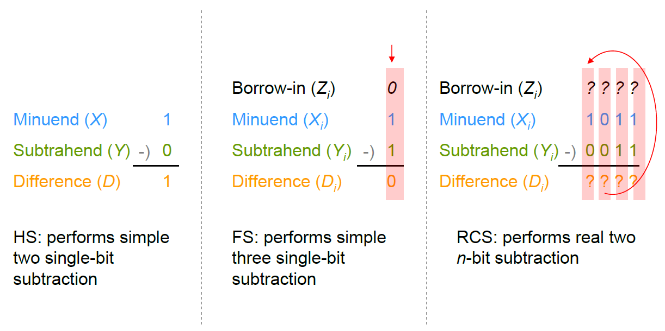
Subtractors

Slide 22
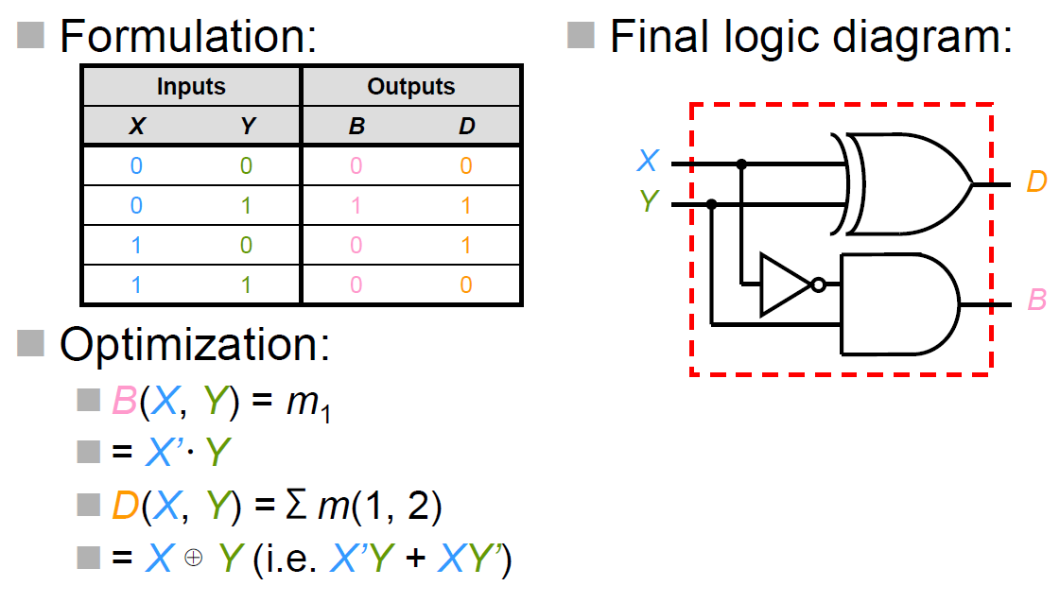
Half Subtractor
The outputs are
D (difference bit) and B (borrow out bit)

Slide 23
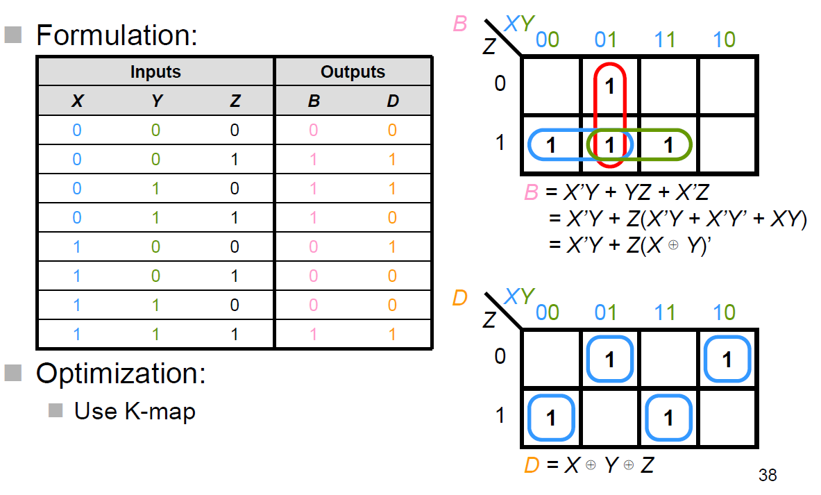
Full Subtractor

Slide 24
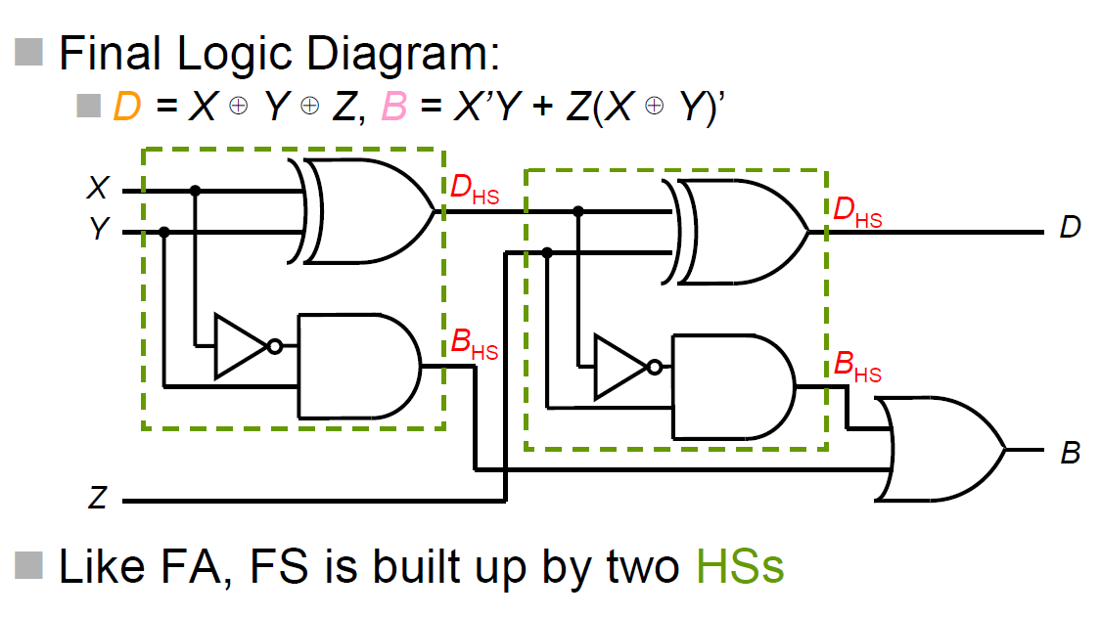
Full Subtractor

Slide 25
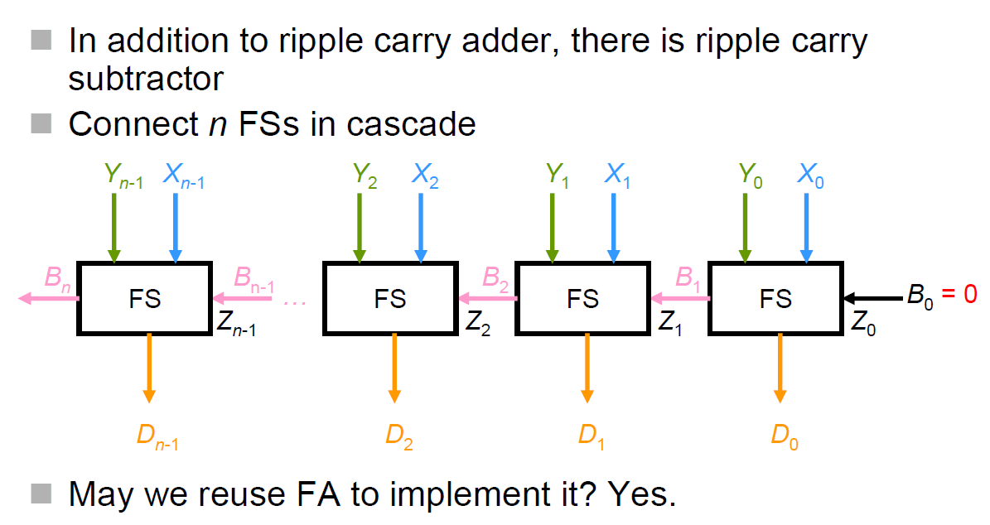
Ripple Carry Subtractor

Slide 26
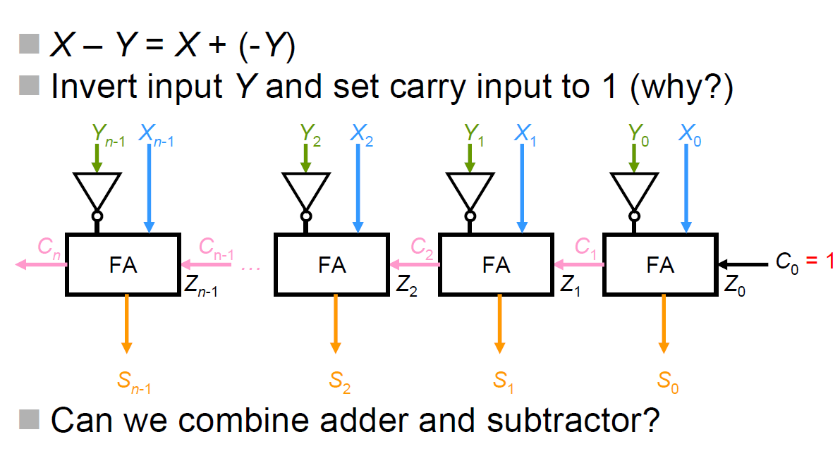
Ripple Carry Subtractor
(Another version)

Slide 27
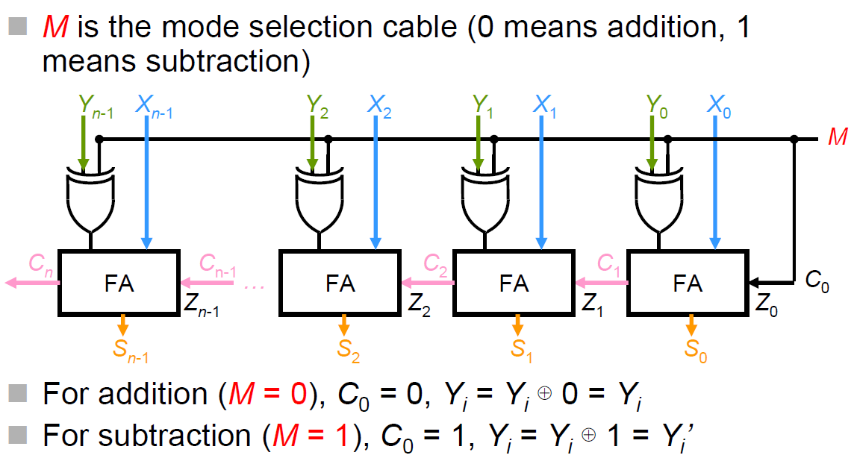
n-bit RC Adder/Subtractor

Slide 28
Delay Problem of RCA
The carry output of each full-adder stage is connected to the carry input of the next higher stage
A time delay thus occurs because the sum and the carry output of each stage cannot be produced until the input carry appears
Assuming that the delay for generating the carry output is m nsec
For a N-bit adder, the total delay will be up to Nm nsec
Serious delay problem if N is a large number
Solution: Calculate the carry bits beforehand, then construct carry-look-ahead adder

Slide 29
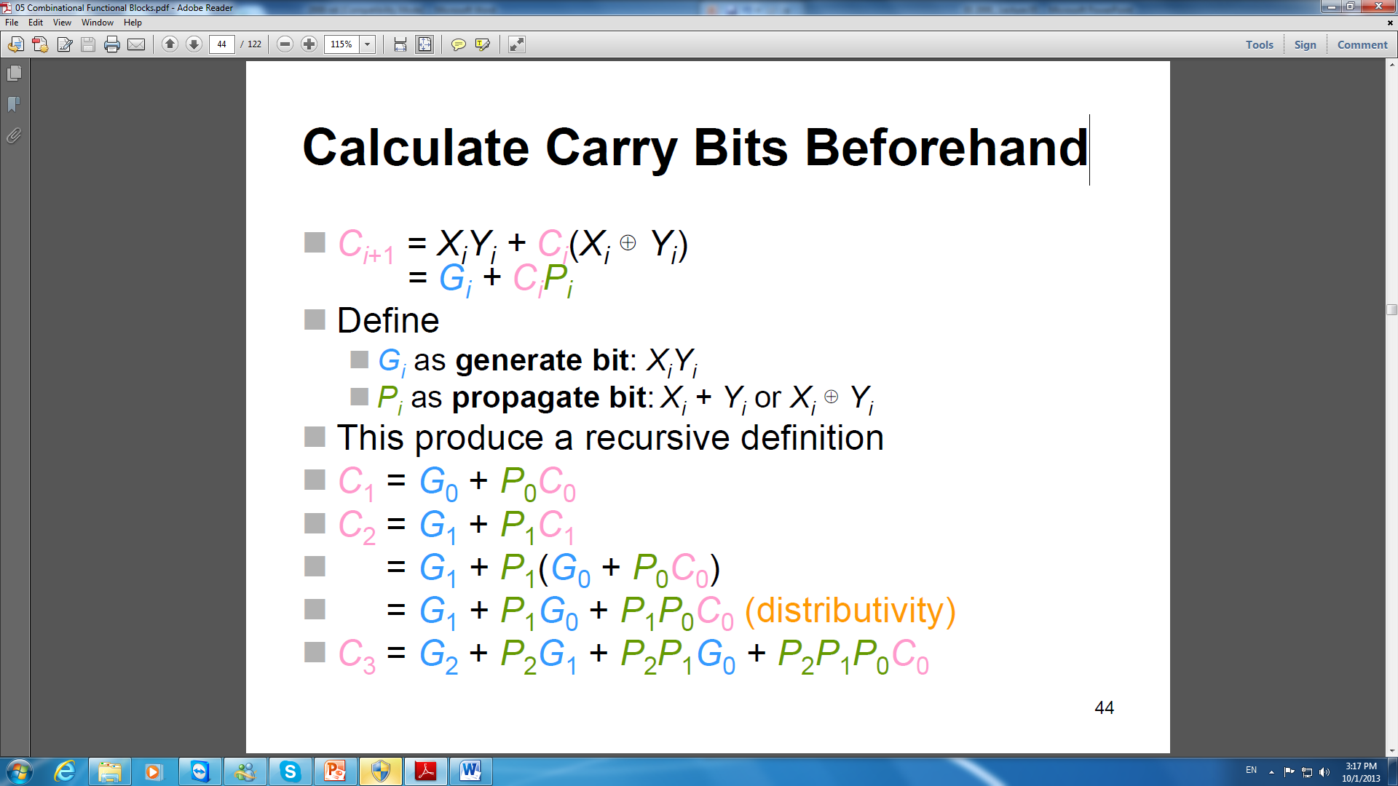
Full Adder

Slide 30
Calculate Carry Bits Beforehand

Slide 31
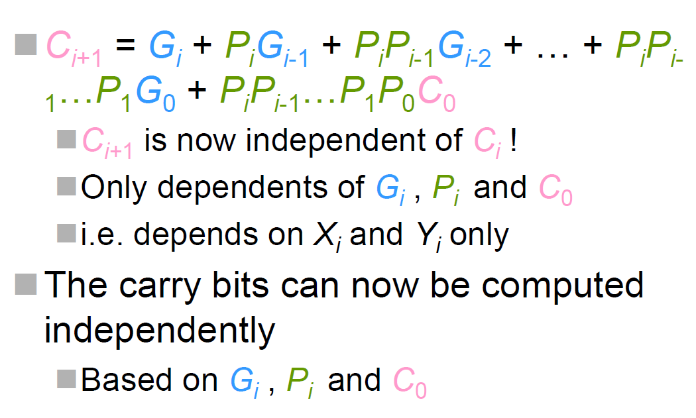
General Form of the Carry Bits

Slide 32
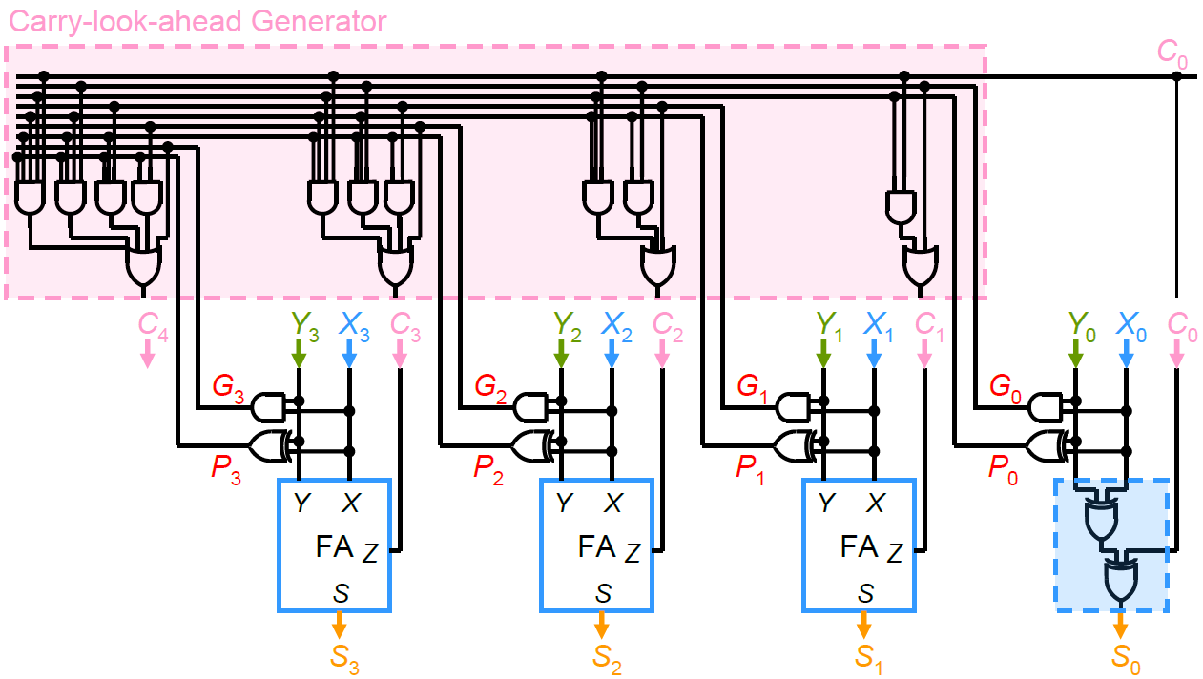
4-bit Carry-look-ahead Adder

Slide 33
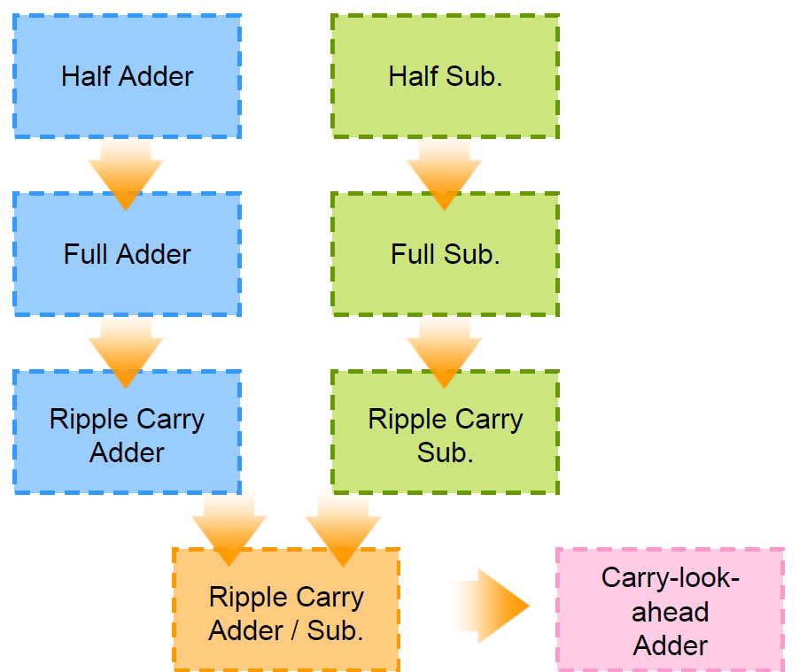
Summary of 4.2

Slide 34
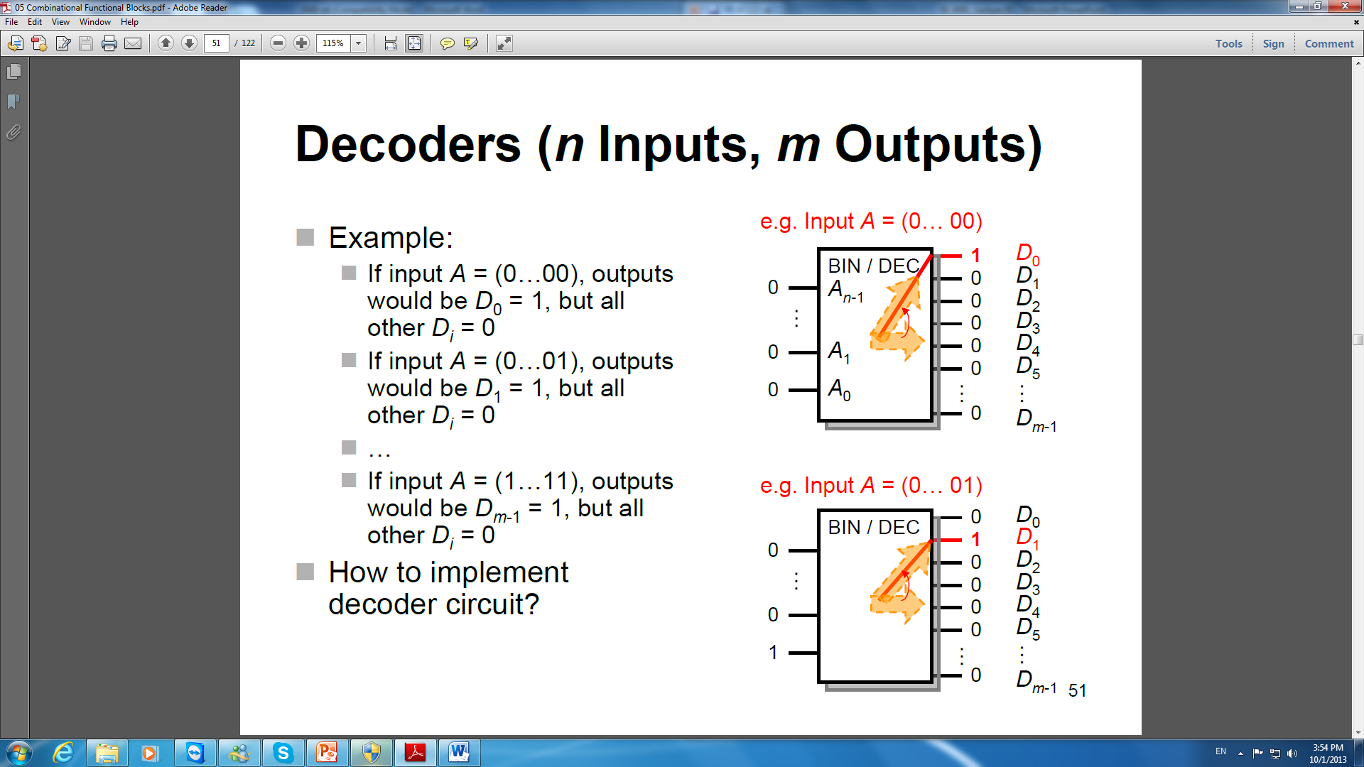
4.3 Logical functional blocks (Decoder)
Decoder
A decoder is a combinational circuit with n- input and m-output (0 < n ≤m ≤ 2n, but usually m = 2^{n})
A very important functional blocks as it can be incorporated into many of the other functions

Slide 35
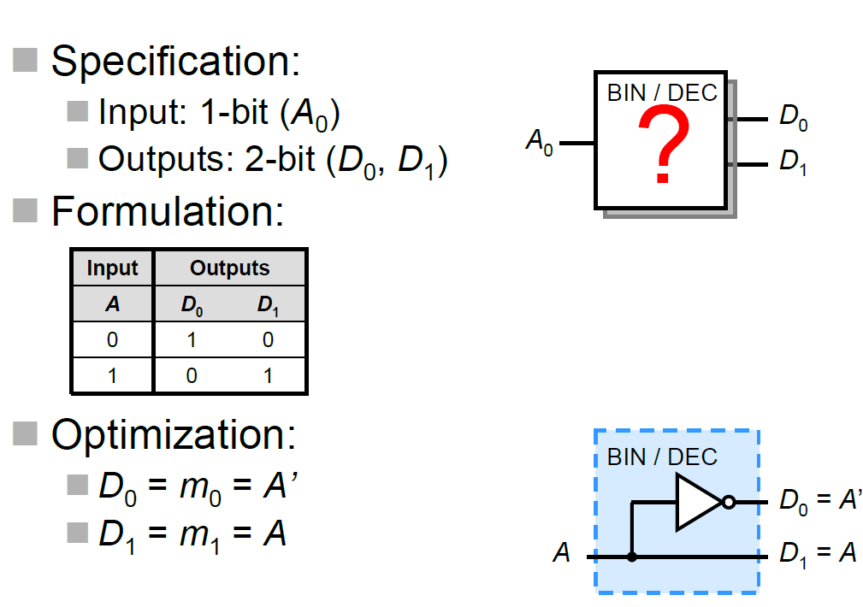
1-to-2-Line decoder

Slide 36
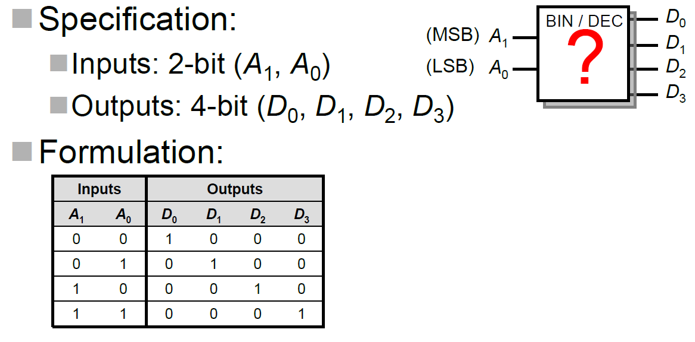
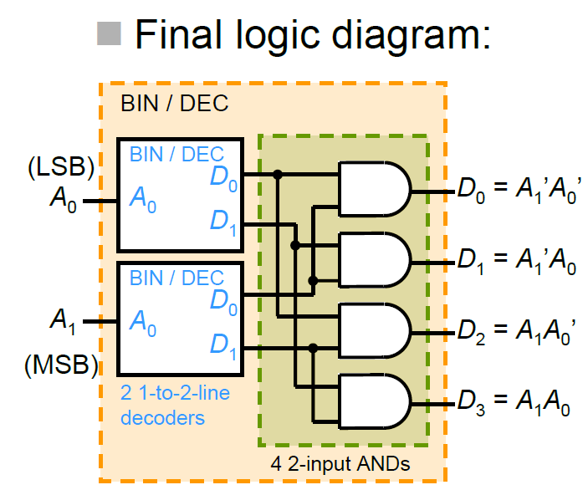
2-to-4-Line Decoder

Slide 37
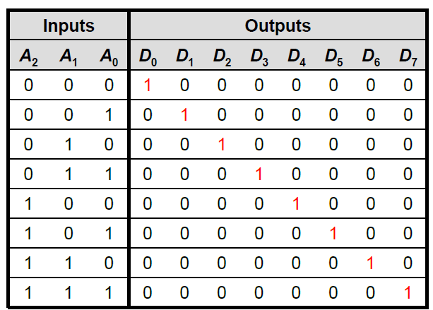
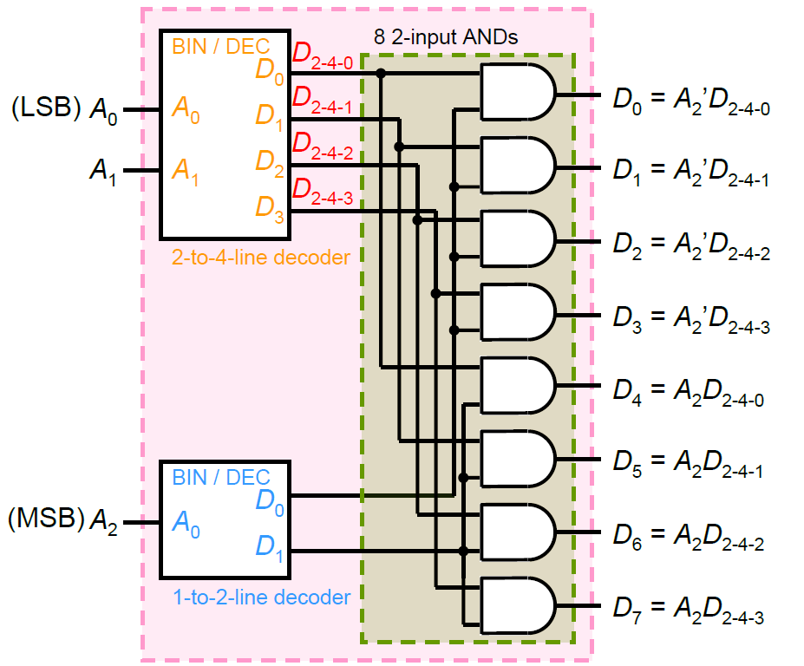
3-to-8-Line Decoder
Build the simplest block:
(i) 1-to-2-line decoder
(ii) 2-to-4-line decoder
(iii) 3-to-8-line decoder (iv) n-to-2^{n}-line decoder

Slide 38
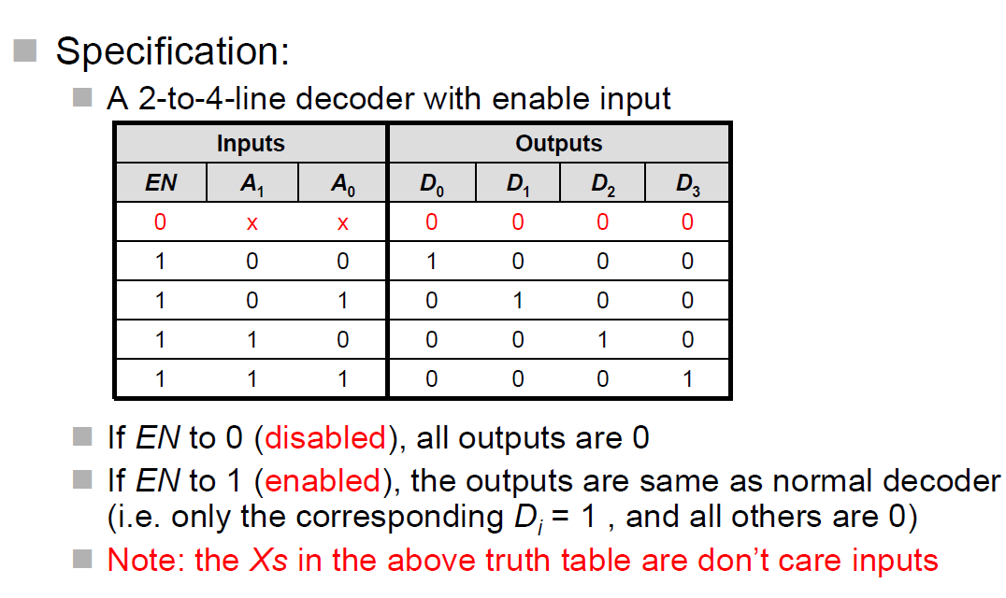
Decoder with Enabling

Slide 39
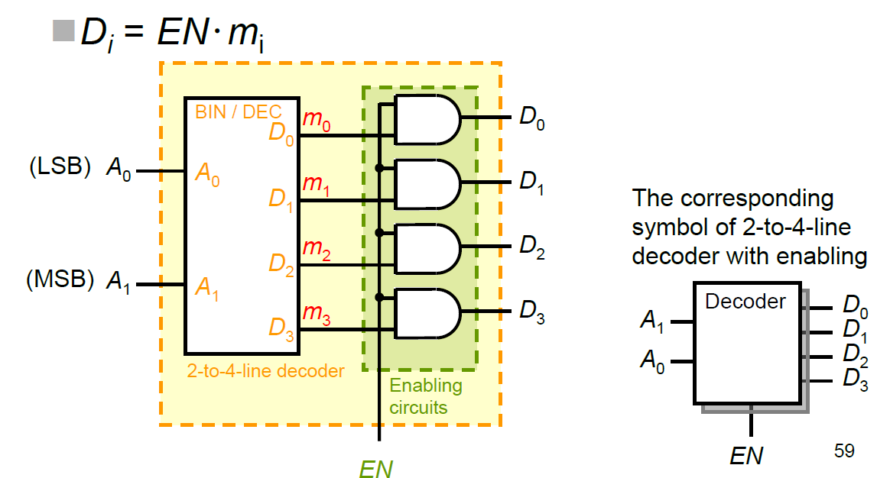
Decoder with Enabling

Slide 40
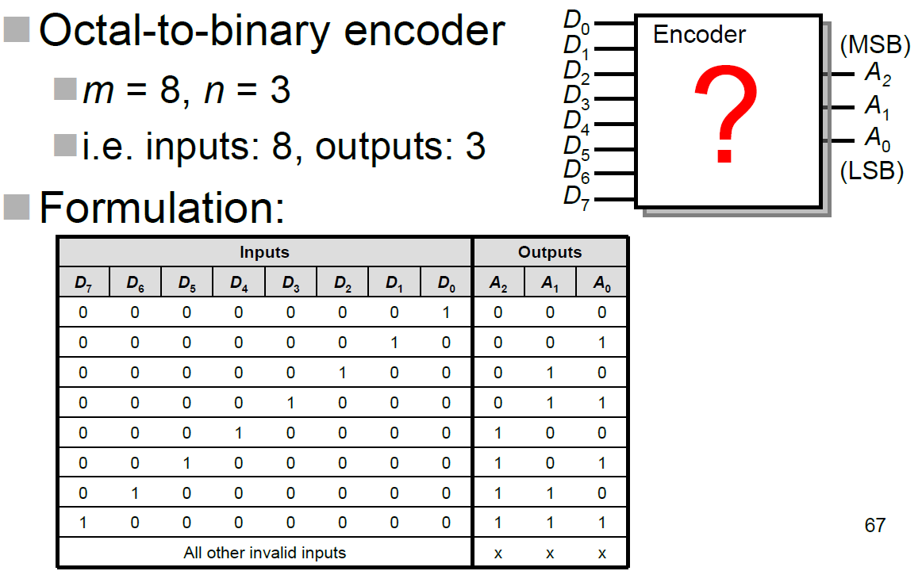
4.3 Logical functional blocks (Encoder)
An encoder is a functional block that performs the inverse operation of a decoder
m inputs and n outputs
0 < n ≤ m ≤ 2n, but usually m = 2^{n}
Example of Octal-to-Binary Encoder

Slide 41
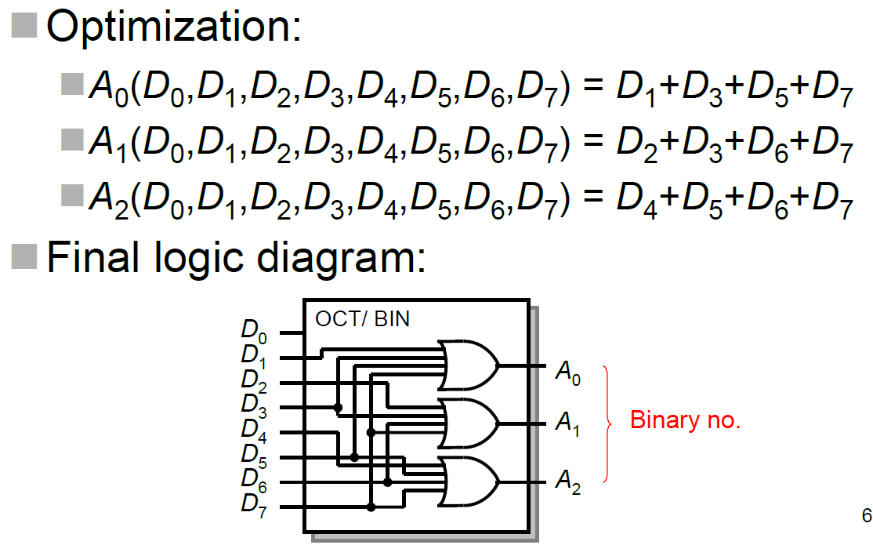
Octal-to-binary Encoder

Slide 42
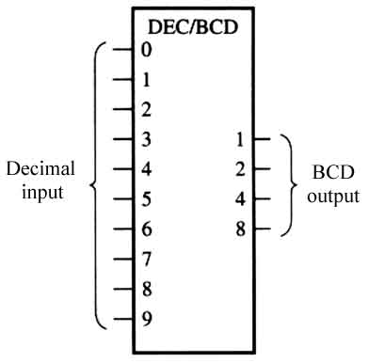
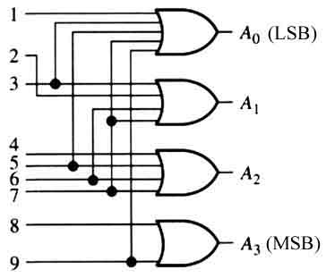
Decimal-to-BCD encoder
Inputs |  |  |  |  |  |  |  |  |  | Outputs
0 | 1 | 2 | 3 | 4 | 5 | 6 | 7 | 8 | 9 | A₃ | A₂ | A₁ | A₀
1 | 0 | 0 | 0 | 0 | 0 | 0 | 0 | 0 | 0 | 0 | 0 | 0 | 0
0 | 1 | 0 | 0 | 0 | 0 | 0 | 0 | 0 | 0 | 0 | 0 | 0 | 1
0 | 0 | 1 | 0 | 0 | 0 | 0 | 0 | 0 | 0 | 0 | 0 | 1 | 0
0 | 0 | 0 | 1 | 0 | 0 | 0 | 0 | 0 | 0 | 0 | 0 | 1 | 1
0 | 0 | 0 | 0 | 1 | 0 | 0 | 0 | 0 | 0 | 0 | 1 | 0 | 0
0 | 0 | 0 | 0 | 0 | 1 | 0 | 0 | 0 | 0 | 0 | 1 | 0 | 1
0 | 0 | 0 | 0 | 0 | 0 | 1 | 0 | 0 | 0 | 0 | 1 | 1 | 0
0 | 0 | 0 | 0 | 0 | 0 | 0 | 1 | 0 | 0 | 0 | 1 | 1 | 1
0 | 0 | 0 | 0 | 0 | 0 | 0 | 0 | 1 | 0 | 1 | 0 | 0 | 0
0 | 0 | 0 | 0 | 0 | 0 | 0 | 0 | 0 | 1 | 1 | 0 | 0 | 1

Slide 43
Limitation of Encoders
Only one input can be active (i.e. 1)
If two or more inputs active simultaneously, the output produces an incorrect combination
Solution:
- To resolve this ambiguity, introduce an input priority
- Each input pin has different priority
- If two or more inputs are 1 at the same time, only consider input that has higher priority
- This kind of encoder is called priority encoder

Slide 44
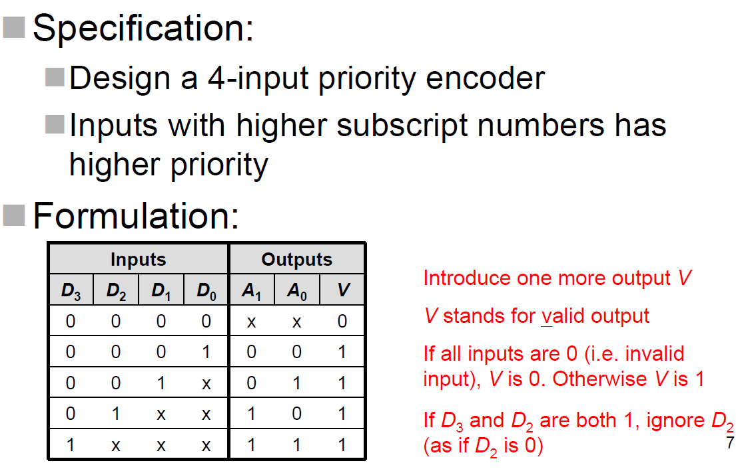
Priority Encoders

Slide 45
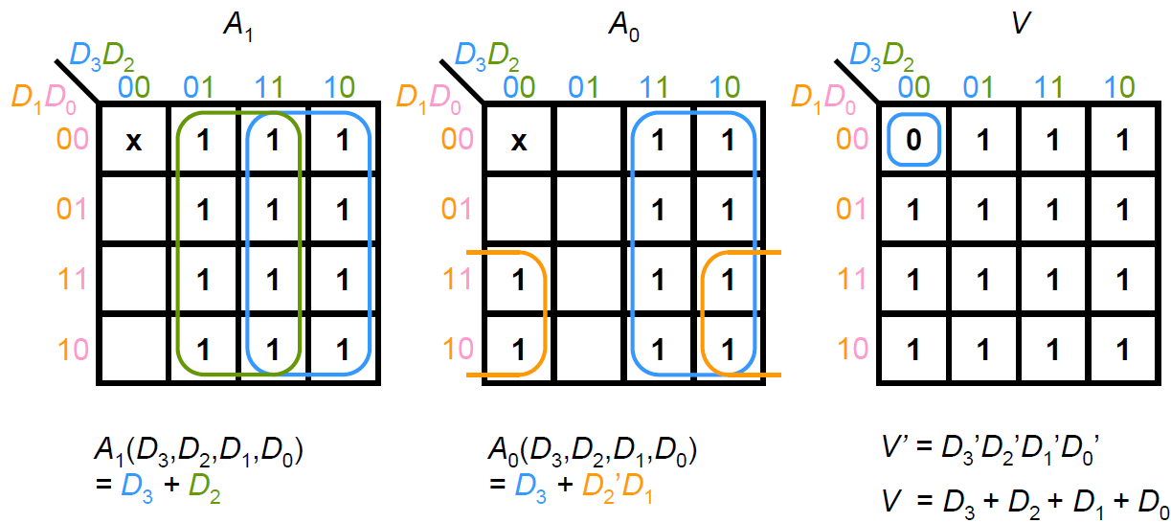
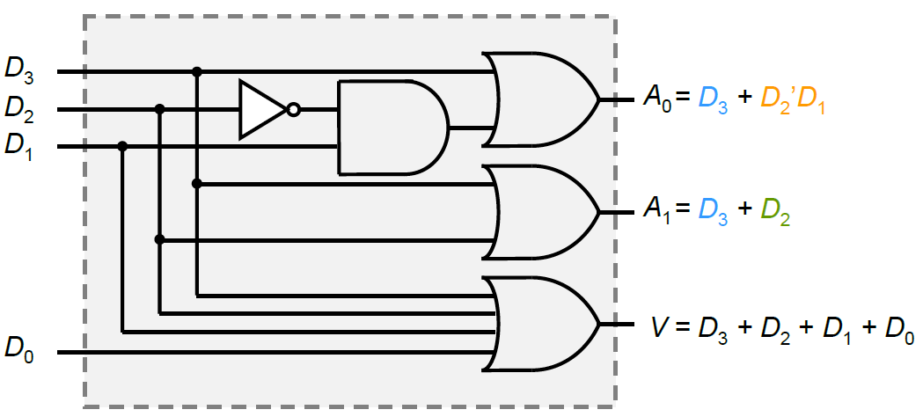
4-Input Priority Encoder

Slide 46
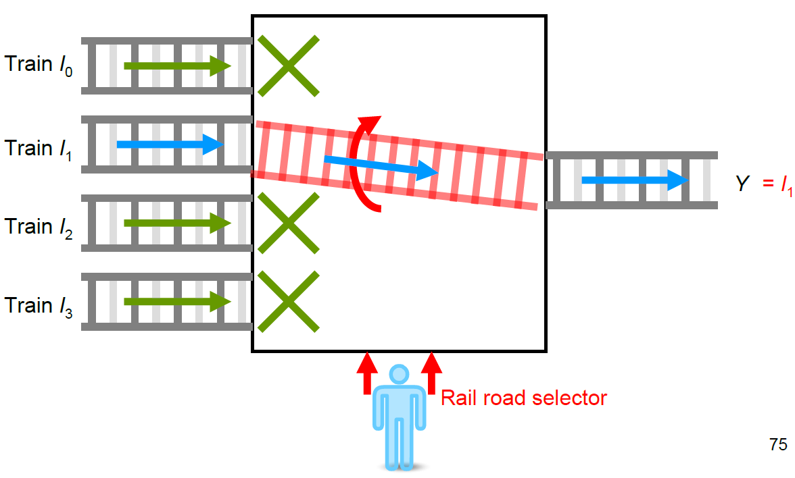
5.3 Logical functional blocks (Multiplexer -- MUX)
Combinational circuit performs selection
To appear I_{S} on a single output (Y) from many inputs (I_{i} )
A set of selection input variables (S)₁₀ = (S_{n-1}…S₁S0)₂

Slide 47
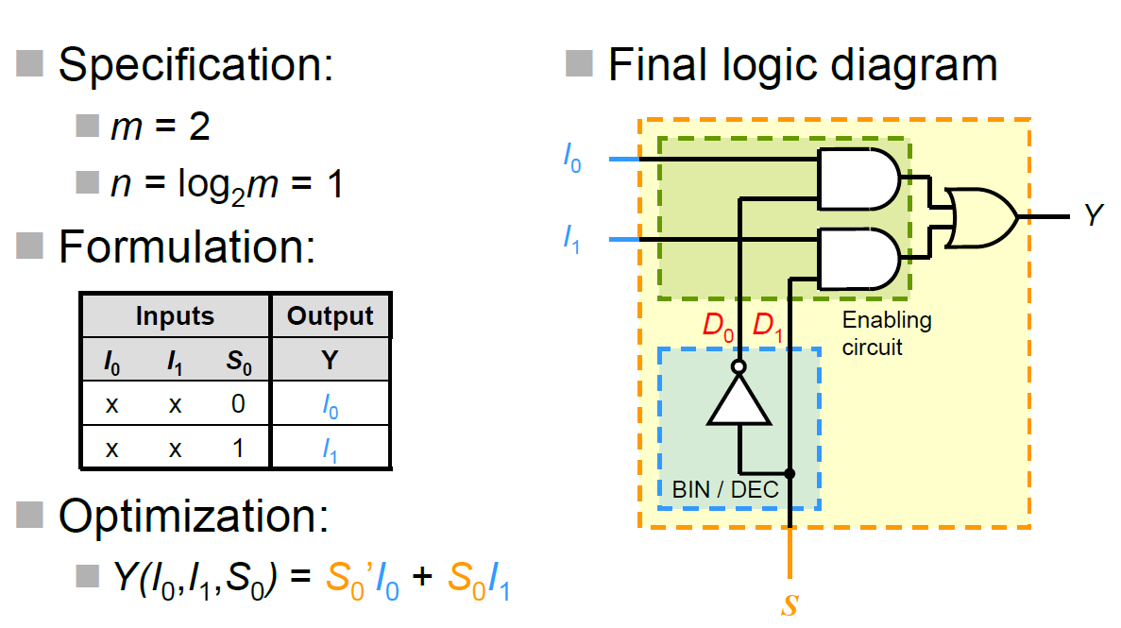
2-to-1-line MUX

Slide 48
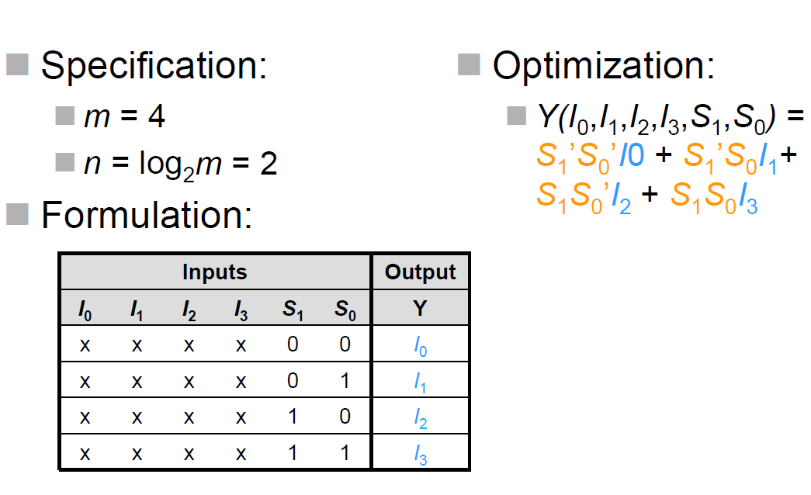
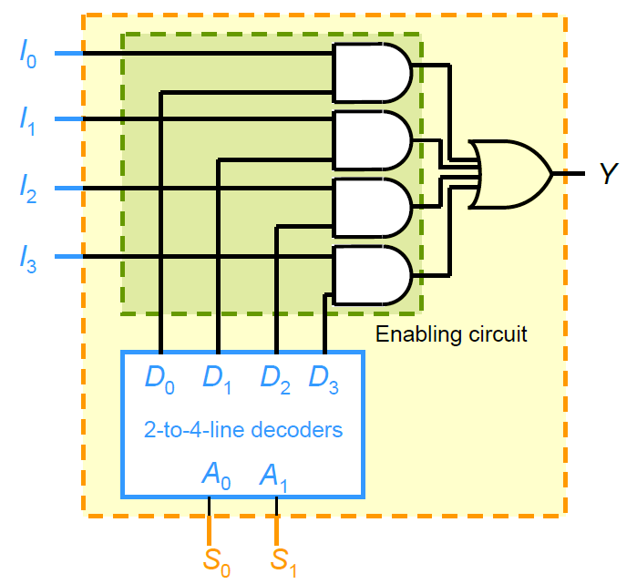
4-to-1-line MUX

Slide 49
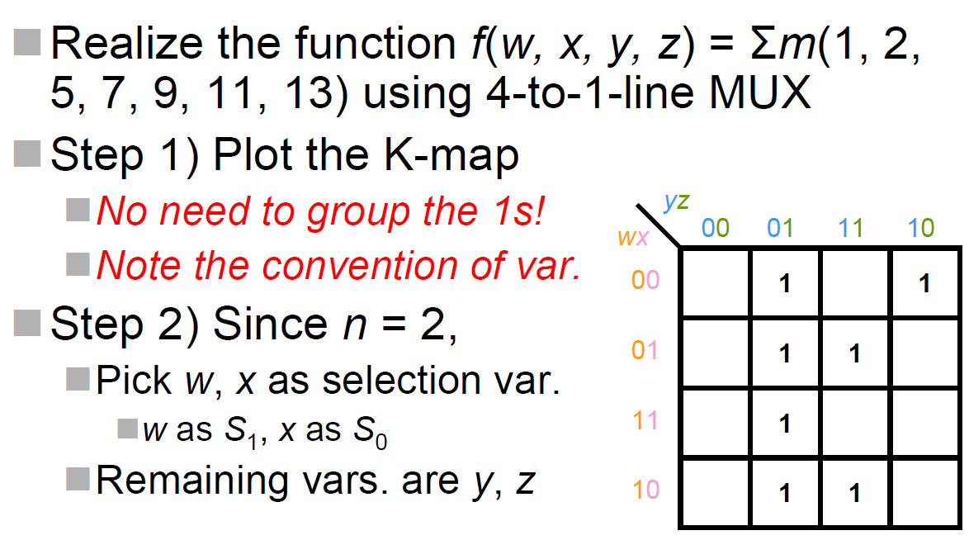
4-to-1-line MUX
(Example)

Slide 50
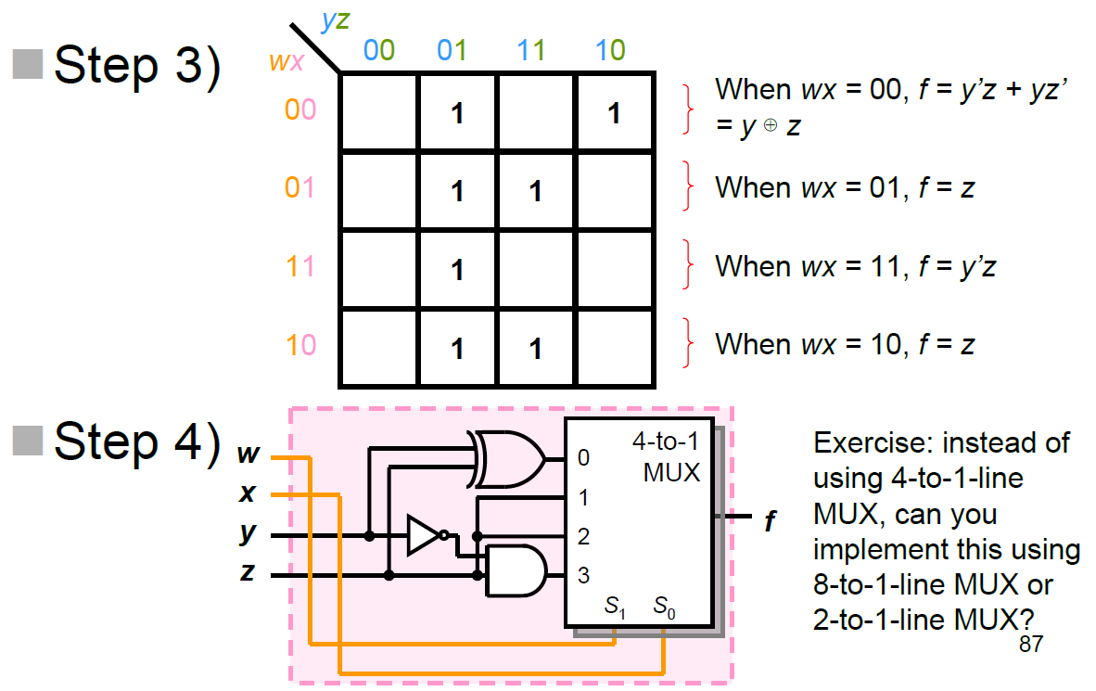
4-to-1-line MUX
(Example)

Slide 51
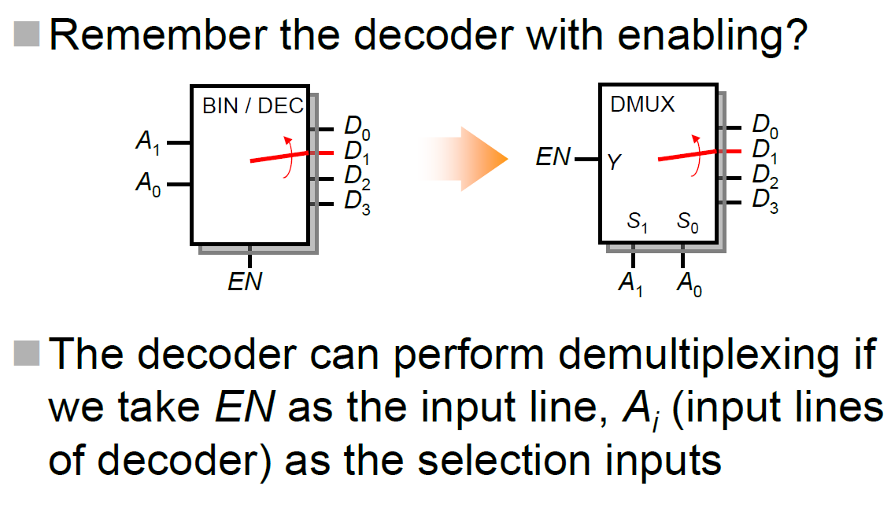
Demultiplexer (DMUX)

Slide 52
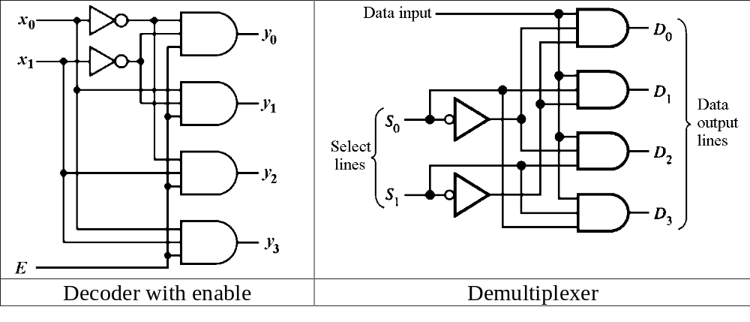
Demultiplexer (DMUX)
A demultiplexer (DMUX) basically reverses the multiplexing function. A DMUX is a circuit that receives information on a single line and transmits this information on one of 2^{n} possible output lines. The selection of a specific output line is controlled by the bit pattern of n select lines. For this reason, the demultiplexer is also known as a data distributor.
Decoder can function as demultiplexer if the E line is taken as a data input line and input lines taken as the selection lines.

