Slide 1
EE2203 Modelling Techniques
Week 12
Interaction

Slide 2
Interactions
Percent positive residuals: No interaction
 | X_{j} (%)
X_{i} | Low | Medium | High
Low | 50 | 52 | 48
Medium | 52 | 48 | 50
High | 49 | 50 | 51
Percent positive residuals: Interactions present
 | X_{j} (%)
X_{i} | Low | Medium | High
Low | 20 | 40 | 45
Medium | 40 | 50 | 60
High | 50 | 60 | 80

Slide 3
Same Example:
Regression of FEV1 on height and gender
Y=FEV₁
X = Height = ht in inches
Gender : D=1 if M, =0 if F
Question: do we need interaction?

Slide 4
Stratified Analysis
Regress FEV1 on height for females and males separately
If interaction exists, then the two coefficients of height (F vs. M) would be unequal

Slide 5
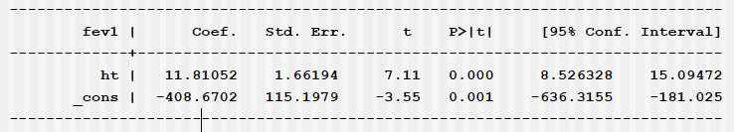
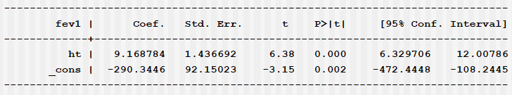
Results:
Stratified analysis
Males:
Females:

Slide 6
Comparison of slopes of Height
Males: B = 11.8, CI = (8.5, 15.1)
Females: B = 9.2, CI = (6.3, 12.0)
If CIs do not overlap then slopes are significantly different from each other
  Under some mild assumptions
Since CIs do overlap, then two slopes may or may not be significantly different from each other

Slide 7
Approximate analysis
What if we only had B estimates and their SEs?
Get approximate CIs:
  M: 11.8 ± 2*1.7 = (8.4, 15.2)
  F: 9.2 ± 2*1.4 = (6.4, 12.0)
Same conclusion

Slide 8
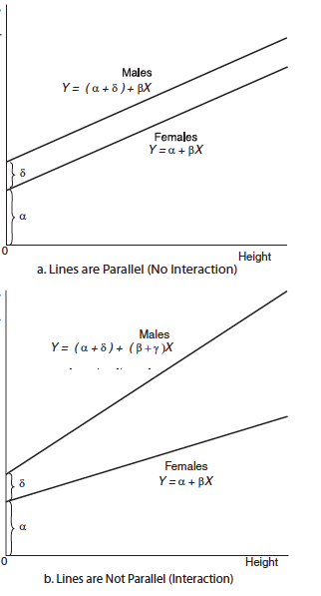
FEV1 vs. Height for Males and Females
FEV1
FEV1

Slide 9
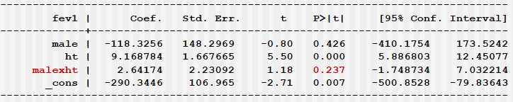
Example:
Model with interaction
Conclude that the two slopes for height are not statistically significantly different from each other (no interaction)

Slide 10
Another example
Random sample of N = 200 (100 F, 100 M)
Y = Systolic BP
X1 = BMI, standardized
X2 = Age, standardized
X3 = Male = 1 if M, =0 if F
X4 = Age_Male = Age*Male
X5 = BMI_Male = BMI*Male

Slide 11
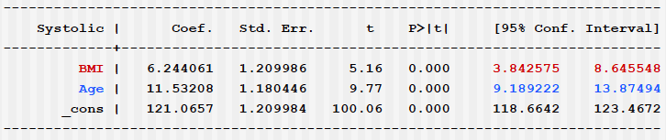
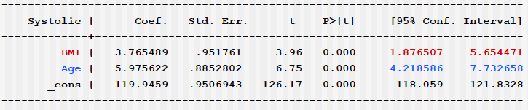
Results:
Stratified Analysis
Males:
Females:

Slide 12
Comparison of slopes
CIs for BMI overlap
  No interaction with gender?
CIs for Age do not overlap
  There is interaction with gender

Slide 13
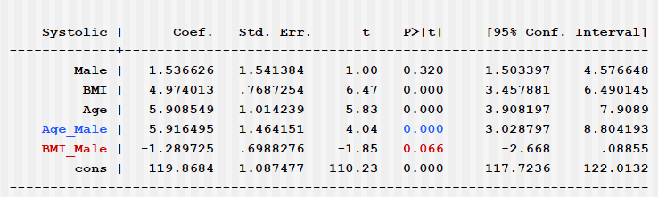
Example:
Model with two interactions
Drop BMI_Male

Slide 14
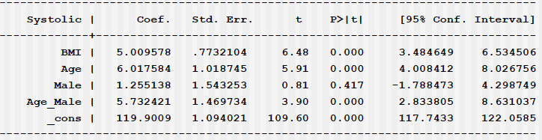
Example:
Model with one interaction

Slide 15
Slopes for Age
Interaction equation
  F: 6.0
  M: 6.0 + 5.7 = 11.7
Stratified analysis:
  F: 6.0
  M: 11.5

Slide 16
Acknowledgement
Textbook: Chapter 7, 9, 12. Abdelmonem Afifi, Susanne May, Virginia A. Clark. Practical Multivariate Analysis. Fifth Edition. CRC Press Taylor & Francis Group
Thanks Professor Afifi for his courtesy to share the materials
Thanks our teaching assistance team for preparing the tutorial materials

