Slide 1
CS2311 Computer Programming
Dr. Henry Xu
Lecture 10: Pointer Part I

Slide 2
Outline
Memory and variables
Pointers and pointer operations
Call by reference

Slide 3
Memory and variables
A variable is used to store data that will be accessed by a program on execution.
Normally, a variable is stored in the main memory
A variable has four attributes:
  Value - the content of the variable
  Identifier - the name of the variable
  Address - the memory location of the variable
  Scope - the accessibility of the variable

Slide 4
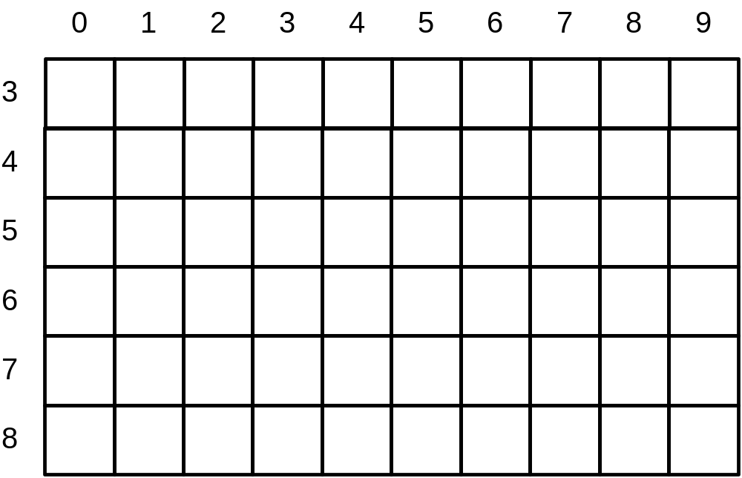
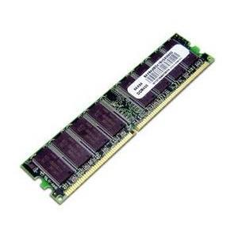
Main Memory

Slide 5
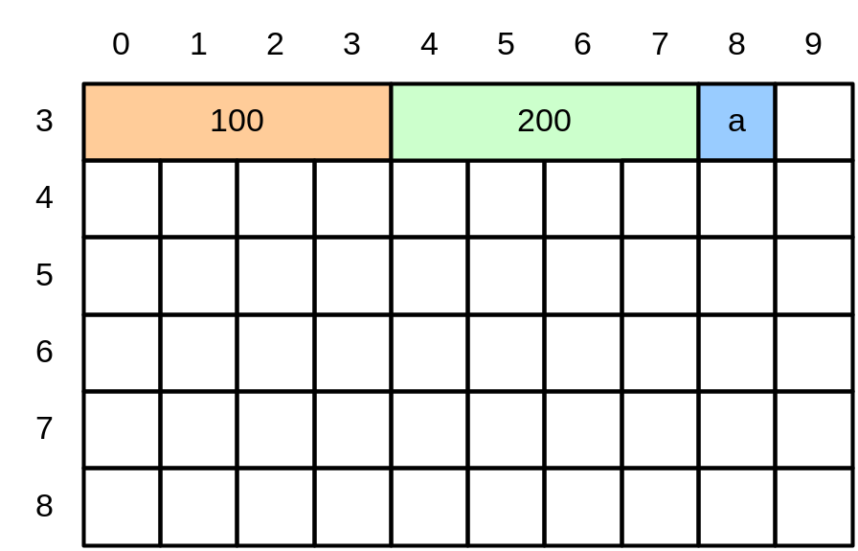
Variable and Memory
void main(){
int x;
int y;
char c;
x=100;
y=200;
c=`a`;
}
Identifier | Value | Address
x | 100 | 30
y | 200 | 34
c | ‘a’ | 38

Slide 6
Variable and Memory
Most of the time, the computer allocates adjacent memory locations for variables declared one after the other.
A variable’s address is the first byte occupied by the variable.
Address of a variable depends on the computer, and is usually in hexadecimal (base 16 with values 0-9 and A-F).
  e.g. 0x00023AF0, 00023AF0

Slide 7
Pointers
A pointer is a variable which stores the address of another variable, i.e. it points to the variable.
A pointer, like a regular variable, has a type. Its type is determined by the type of the variable it points to.
Variable type | int | float | double | char
Pointer type | int* | float* | double* | char*

Slide 8
* and & operator
To declare a pointer, place a “*” sign before an identifier name:
  char *cPtr; //a character pointer
  int *nPtr; //an integer pointer
  float *fp; //a floating point pointer
To retrieve the address of a variable, use the “&” operator:
  int x;
  nPtr=&x; // &x will return the address of variable x;
To access the variable a pointer pointing to, use “*” operator (dereferencing)
  *nPtr=10;
  y=*nPtr;

Slide 9
Example
int x,y; //x and y are integer variables
void main(){
int *p1,*p2; /*p1 and p2 are pointers of integer typed */
x=10;
y=12;
p1=&x; /* p1 stores the address of variable x */
p2=&y; /* p2 stores the address of variable y */
*p1=5; /* p1 value unchanged but x is updated to 5 */
*p2=*p1+10; /*what are the values of p2 and y? */
}

Slide 10
Common operations
Set a pointer p1 point to a variable x
  p1=&x;
Set a pointer p1 point to the variable pointed by another pointer p2
  p1=p2
Update the value of variable pointed by a pointer
  *p=10;
Retrieve the value of variable pointed by a pointer
  int x=*p;

Slide 11
More examples
x=3;
y=5;
p1=&x;
p2=&y;
y=*p1-*p2;
p1=p2;
y=*p1+*p2;
x=p1+1;
p2=p1+2;
x=*p2**p1;
x=*p2/*p1;
y=x**p2;
y+=*p1
*p2+=3;
*p1*=*p2

Slide 12
Guideline
* operator will give the value of pointing variable
& operator will give the address of a variable

Slide 13
Applications of pointer
Call by Reference
Fast Array Access
  Will be covered in later class
Dynamic Memory Allocation
  Require additional memory space for storing value.
  Similar to variable declaration but the variable is stored outside the program.

Slide 14
Call by reference
Pass the address of a variable to a function
To update a variable provided by a caller as call by value cannot be used to update arguments to function
Consider the following function

Slide 15
Call by value
void f (char c1_in_f){
c1_in_f='B'; //c1_in_f=66
}
void main(){
char c1_in_main='A'; // c1_in_main =65
f(c1_in_main);
cout << c1_in_main; //print 'A'
}

Slide 16
Call by value
When calling f(), the value of c1 (65 or 'A') is assigned to c1_in_f
Inside f(), the value of c1_in_f is changed to 66 or 'B'.
c1_in_main remains unchanged (65 or 'A').
In call by value, there is no way to modify c1_in_main inside f(), unless we use the return statement.

Slide 17
Call by reference
void f (char *c1_ptr){
*c1_ptr='B';
}
void main(){
char c1_in_main='A'; // c1_in_main =65
f(&c1_in_main);
cout << c1_in_main; //print 'B'
}
When f() is called, the following operation is performed
c1_ptr = &c1_in_main;
First, the value &c1_in_main (which is 3A8E) is retrieved

Slide 18
Call by reference
void f (char *c1_ptr){
*c1_ptr='B';
}
void main(){
char c1_in_main='A'; // c1_in_main =65
f(&c1_in_main);
cout << c1_in_main; //print 'B'
}
points to
Variable | Variable type | Memory location | Content
c1_in_main | char | 3A8E | 65
c1_ptr | char pointer | 4000 | 3A8E
Assign location 3A8E to c1_ptr
Location of c1_in_main (location 3A8E) is assigned to c1_ptr1
c1_ptr = &c1_in_main;

Slide 19
Call by reference
void f (char *c1_ptr){
*c1_ptr='B';
}
void main(){
char c1_in_main='A'; // c1_in_main =65
f(&c1_in_main);
cout << c1_in_main; //print 'B'
}
c1_ptr points to location 3A8E (that is the variable c1_in_main).
*c1_ptr refers to the variable pointed by c1_ptr, i.e. the variable stored at 3A8E
update
Variable | Variable type | Memory location | Content
c1_in_main | char | 3A8E | 66
c1_ptr | char pointer | 4000 | 3A8E
c1_ptr='B'; //error
Reason: c1_ptr1 stores a location so it cannot store a char (or the ASCII code of a char)

Slide 20
Note the different meaning of *
The type of c1_ptr is char* (pointer to star)
dereference a pointer
void f (char *c1_ptr){
*c1_ptr='B';
}
void main(){
char c1_in_main='A'; // c1_in_main =65
f(&c1_in_main);
cout << c1_in_main; //print 'B'
}

Slide 21
Exercise: what are the errors?
int x=3;
char c='a';
char *ptr;
ptr=&x;
ptr=c;
ptr=&c;

Slide 22
Answer
int x=3;
char c='a';
char *ptr;
ptr=&x; //error: ptr can only points to a char, but not int
ptr=c; //error: cannot assign a char to a pointer. A pointer can only store a location
ptr=&c; //correct

Slide 23
Exercise: What is the output?
int num=100;
int *ptr1;
ptr1=&num;
*ptr1=40;
cout << num;

Slide 24
Answer
int num=100;
int *ptr1;
ptr1=&num;
*ptr1=40;
cout << num; //print 40

Slide 25
Call by value and call by reference
In call by value, only a single value can be returned using a return statement.
In call by reference, the argument(s) can be a pointer which may reference or points to the variable(s) in the caller function.
  More than one variables can be updated, achieving the effect of returning multiple values.

Slide 26
Call-by-Value
Call-by-Reference
int add(int m, int n)
{
int c;
c = m+n;
m = 10;
return c;
}
void main()
{
int a=3, b=5,c;
c=add(a,b);
cout << a<<“ “<< c << endl;
}
int add(int *m, int *n)
{
int c;
c = *m + *n;
*m = 10;
return c;
}
void main()
{
int a=3, b=5,c;
c=add(&a,&b);
cout << a<<“ “<< c << endl;
}
Pass value as parameter.
Pass address as parameter.

Slide 27
Call by Reference - Guideline
Add the ‘*’ sign to the function parameters that store the variable call by reference.
  E.g.
  void cal(int *x, int y){
    //x is call by reference
    //y is call by value
    ……
    …….*x;
  }
Add the ‘&’ sign to the variable when it needs to be call by reference.
  E.g.
  cal(&result, factor);

Slide 28
Example: swapping values
#include <iostream>
using namespace std;
void swap(int *p, int *q) {
int tmp;
tmp = *p; /* tmp = 3 */
*p = *q; /* *p = 7 */
*q = tmp; /* *q = 3 */
}
int main(void)
{
int a = 3, b = 7;
swap(&a, &b);
cout << a <<“ “<< b <<endl;
/* 7 3 is printed */
return 0;
}
3
p
a
7
q
b
tmp

Slide 29
Example: swapping values
#include <iostream>
using namespace std;
void swap(int *p, int *q) {
int tmp;
tmp = *p; /* tmp = 3 */
*p = *q; /* *p = 7 */
*q = tmp; /* *q = 3 */
}
int main(void)
{
int a = 3, b = 7;
swap(&a, &b);
cout << a <<“ “<< b <<endl;
/* 7 3 is printed */
return 0;
}
3
p
a
7
q
b
3
tmp

Slide 30
Example: swapping values
#include <iostream>
using namespace std;
void swap(int *p, int *q) {
int tmp;
tmp = *p; /* tmp = 3 */
*p = *q; /* *p = 7 */
*q = tmp; /* *q = 3 */
}
int main(void)
{
int a = 3, b = 7;
swap(&a, &b);
cout << a <<“ “<< b <<endl;
/* 7 3 is printed */
return 0;
}
7
p
a
7
q
b
3
tmp

Slide 31
Example: swapping values
#include <iostream>
using namespace std;
void swap(int *p, int *q) {
int tmp;
tmp = *p; /* tmp = 3 */
*p = *q; /* *p = 7 */
*q = tmp; /* *q = 3 */
}
int main(void)
{
int a = 3, b = 7;
swap(&a, &b);
cout << a <<“ “<< b <<endl;
/* 7 3 is printed */
return 0;
}
7
p
a
3
q
b
3
tmp

Slide 32
Summary
Pointer is a special variable used to store the memory address (location) of another variable.
Pointer is typed, and its type is determined by the variable it pointing to.
* operator has two meaning
  For declaration, e.g int *p1, char *pc;
  For dereference, e.g. x=*p1, *pc=‘b’;
& operator return the address of any variable

Slide 33
Summary
Call by reference: pass the address of a variable to a function such that its content can be updated within the function.
For a function returns one value only, we can use a return statement.
For a function returns more than one value, one must use call by reference.

