Slide 1
CS2311 Computer Programming
Henry Xu
Lecture 5: Loops

Slide 2

Outline
while and do while
for

Slide 3
Loops
Beside sequential execution and branch execution, looping is another common control flow in programming.
When the execution enters a loop, it will execute a block of code repeatedly until the exit condition is matched

Slide 4
Loops
In general , a program loop consists of:
  Initialization statements
  Body
  Exit condition
  Post loop statements (stepping forward to exit loop condition)

Slide 5
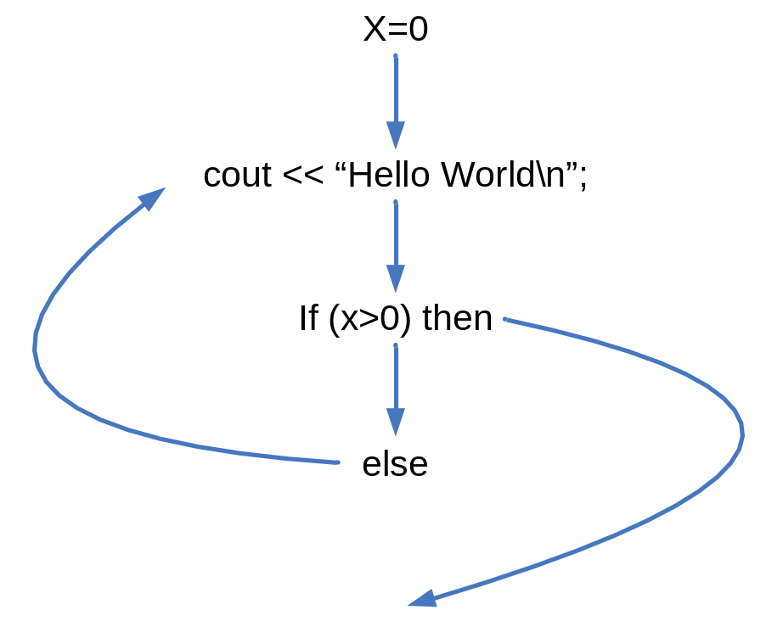
Loops
Set x=0;
cout << “Hello World\n”
If (x>10) then exit the loop
Add 1 to x
Loop back

Slide 6
while
#include <iostream>
using namespace std;
void main() {
int cnt = 0, n;
float max, x;
cout << "The maximum value will be computed.\n";
cout << "How many numbers do you wish to enter? ";
cin >> n;
while (n <= 0) /* ensure a positive number is entered */
{
cout << "\nERROR: Positive integer required.\n\n";
cout << "How many numbers do you wish to enter? ";
cin >> n;
}
/* To be continued in next page */

Slide 7
while
cout << "\nEnter “ << n << “ real numbers: ";
cin >> x; /* read 1st number */
max = x;
/* pick the largest number in while-loop */
while (++cnt < n) {
cin >> x; /* read another number */
if (max < x)
max = x;
}
cout << "\nMaximum value: " << max << endl;
}

Slide 8
do while statement
General form of do while
    do
    statement
    while (expression);
Semantics:
  statement is executed first; thus the loop body is run at least once
  If the value of expression is non-zero (true), the loop repeats; otherwise, the loop terminates

Slide 9
Example of do while
int error;
int n;
do {
cout << “Input a positive integer: “;
cin >> n;
if (error = (n <= 0))
cout << “\nError: negative input!\n”;
} while (error);
...

Slide 10
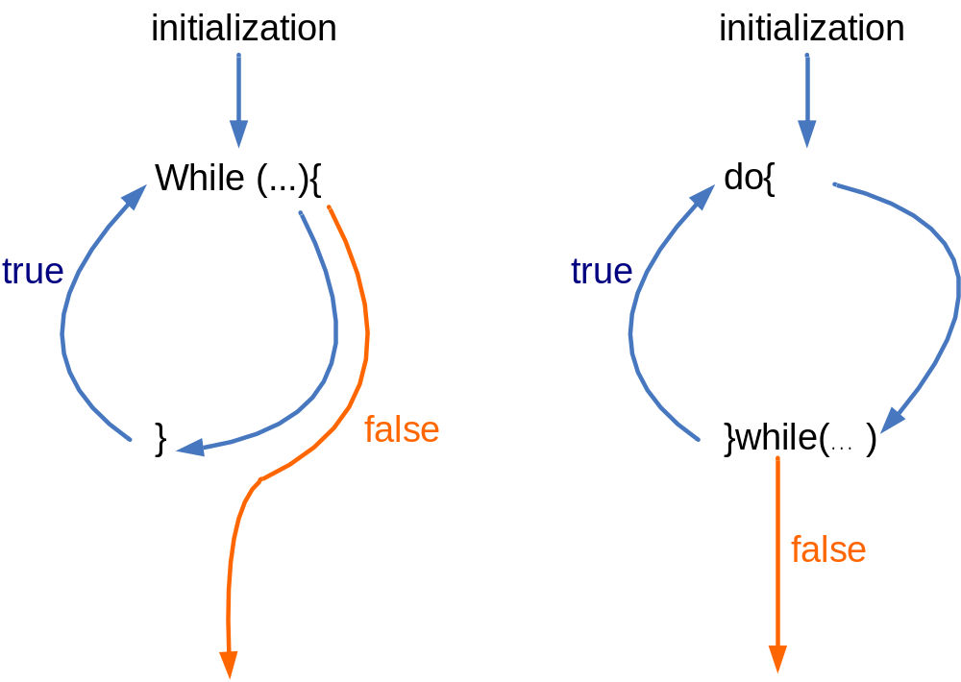
While vs Do while

Slide 11
For-loop statement
for (expr1 ; expr2; expr3){
loop statements;
}
The loop statements is executed as long as expr2 is true. When expr2 becomes false, the loop ends.
expr1: Executed before entering the loop. Often used for variable initialization.
expr3: For each iteration, expr3 is executed after executing the loop body. Often used to update the counter variables.

Slide 12
for loop
expr1 and expr3 can contain multiple statements. Each statement is separated by a comma ','
Example
for(i=0, j=0; i<10; i++, j++)
……
expr1: i=0, j=0
expr2: i<10
expr3: i++, j++

Slide 13
Examples of for
#include <iostream>
using namespace std;
void main() {
int i;
for (i=0; i<10; i++)
cout << i << endl;
}
#include <iostream>
using namespace std;
void main() {
int i;
for (i=0; i<10; i++){
if (i%2==0)
cout << i << endl;
}
}

Slide 14
Nested for loop
#include<iostream>
using namespace std;
void main(){
int i,j;
for (i=0;i<3; i++){
cout << "Outer for:\n";
for (j=0;j<2; j++){
cout << "Inner for:";
cout <<"i=“<<i<<", j=“<<j<< endl;
}
cout << endl;
}
}
Outer for:
Inner for:i=0, j=0
Inner for:i=0, j=1
Outer for:
Inner for:i=1, j=0
Inner for:i=1, j=1
Outer for:
Inner for:i=2, j=0
Inner for:i=2, j=1
The outer loop is executed 3 times.
For each iteration of the outer loop, the inner loop is executed 2 times

Slide 15
Exercise
Write a program to generate a multiplication of n rows and m column (where n and m is input by the user). Assume n>1 and m<=9.
E.g. when n=4, m=3, the following table is generated
  1 2 3
  2 4 6
  3 6 9
  4 8 12

Slide 16
Answer
void main(){
int m, n; // n is no. of rows, m no. of columns
int i, j; // i is row index, j is column index
for (i = 1;i <= n; i++){ // print each row
for (j = 1;j <= m; j++){ // print each column
cout << i*j << “\t”;
}
cout << endl; // each row ends with an endl
}
}

Slide 17
break statement
The break statement causes an exit from the innermost enclosing loop or switch statement (discussed already)
while (1) {
cin >> n;
if (n < 0)
break; /* exit loop if x is negative */
cout << n << endl;
}
/* If break is run, jumps to here */

Slide 18
continue statement
continue statement causes the current iteration of a loop to stop and the next iteration to begin immediately
It can be applied in a while, do-while or for statement

Slide 19
Example of continue
/* read in and sum 10 not-too-small numbers. */
cnt = 0;
while (cnt < 10) {
cin >> x;
if (x > -0.01 && x < 0.01)
continue; /* discard small values */
++cnt;
sum += x;
/* continue transfers control here */
}

Slide 20
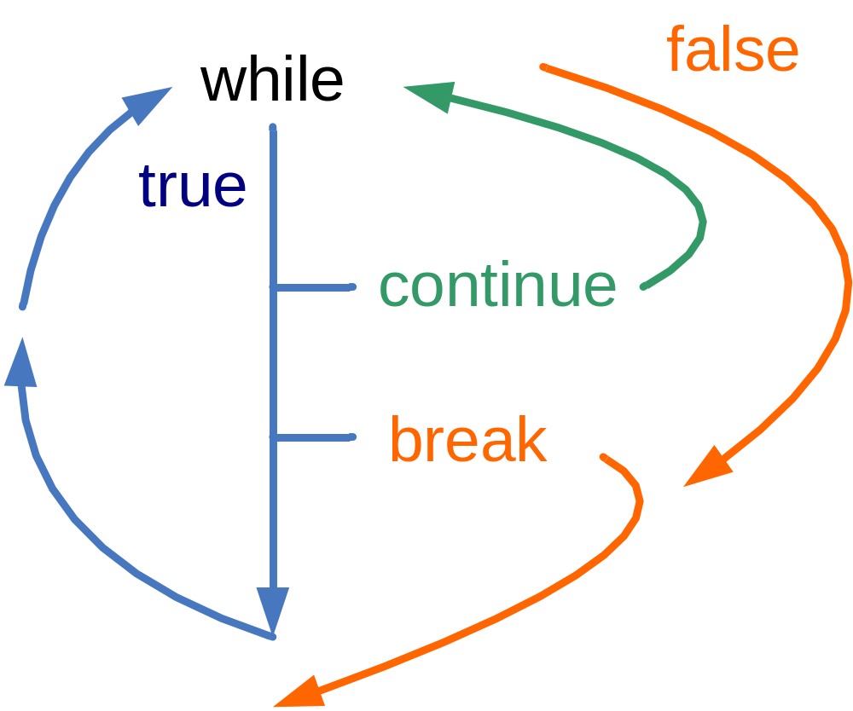
Continue, break

Slide 21
Example: prime numbers
Given a positive integer, we want to know if it’s a prime or composite number (lab 5 optional Q2)
A number is prime if and only if it has only two factors, 1 and itself
  5 is prime, 6 is composite
  1 is not prime nor composite by definition

Slide 22
Version 1.0
int n, m, i;
cout << “Enter a positive number:”;
cin >> n;
m = 0; // m is an indicator variable
for (i=2; i<n; i++)
{
if (n%i == 0)
m = 1;
}
if (m == 0)
cout << n << “is prime.\n”;
else
cout << n << “is composite.\n”;

Slide 23
Version 1.1
int n, m, i;
cout << “Enter a positive number:”;
cin >> n;
m = 0; // m is an indicator variable
for (i=2; i<n; i++)
{
if (n%i == 0) {
m = 1;
break;
}
}
if (m == 0)
cout << n << “is prime.\n”;
else
cout << n << “is composite.\n”;

Slide 24
Comma operator (,)
It has the lowest precedence of all operators in C++ and is evaluated from left to right
General form is
expr1, expr2
The comma expression as a whole has the value and type of its right operand
Sometimes used in for statements to allow multiple initializations and multiple processing of indices
The comma operator is rarely used
Not all commas in a C++ program are comma operators

Slide 25
Examples of comma operator
  sum=0;
  for (j=1; j<=10; j++)
  sum += j;
  and
  for (sum=0,j=1; j<=10; j++)
  sum += j;
  and
  for (sum=0,j=1; j<=10; sum += j, j++)
  ;
  are equivalent

Slide 26
Common errors
Mix up assignment = with equality operator ==
Mix up the comma operator with the semi-colon
Unaware of extra semi-colons, e.g.,
    sum=0;
    for (j=1; j<=10; j++)
    sum += j;
  is not the same as
    sum=0;
    for (j=1; j<=10; j++);
    sum += j;

Slide 27
Common errors (cont’d)
Fail to ensure that the termination condition of a loop is reachable → infinite loop
Misuse of relational operators
int k=8;
  if (2 < k < 7)
  cout >> “true”; /* print true */
  else
  cout >> “false”;
Use (2 < k && k < 7) for the correct answer

Slide 28
Further remarks
Use a relational expression, if possible, rather than an equality expression to control a loop or a selection statement, e.g.,
Don’t use while (j!=4) {
...
}
Use while (j<4) {
...
}

Slide 29
Further remarks
Don’t use a variable of any floating point data type to control a loop because real numbers are represented in their approximate values internally
Infinite loop can be made

Slide 30
Programming style
Follow the normal rules of English (e.g. putting a space after a comma)
Put one space on each side of a binary operator (e.g. = > <) for readability
Indent code in a consistent fashion to indicate the flow of control (use the tab key)
  Note the multiple levels of indentation

Slide 31
Indentation
void main(){
int i;
  for (i = 0; i < 100; i++) {
      if(i>3)
      cout << i;
  }
}
1st level (1 tab)
2nd level (2 tabs)
3rd level (3 tabs)

Slide 32
Formatting programs
Indent the code properly as you write the program to reflect the structure of the program.
  Improve readability and increase the ease for debugging the program
  In assignment, marks will be allocated for indentation.
To indent in visual studio, you may press the tab button
You may select multiple lines of statements and press tab to indent all of them
To move back one level to the left, press shift+tab

Slide 33
Summary
In C++, repeating tasks could be expressed with
  while(…){…}
  do {…}while(…);
  for (…;…;…){…}
A complete looping structure may consist of
  Loop initialization statements
  Loop Body
  Exit condition
  Post Loop statements

