Slide 1
EE3114 Systems and Control
Tutorial - 4
Semester A, 2018-19
2018-9-26

Slide 2
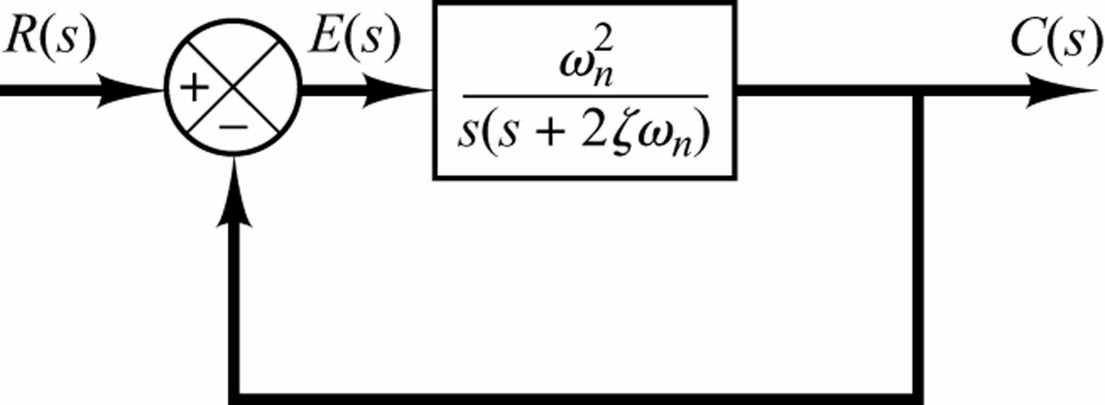
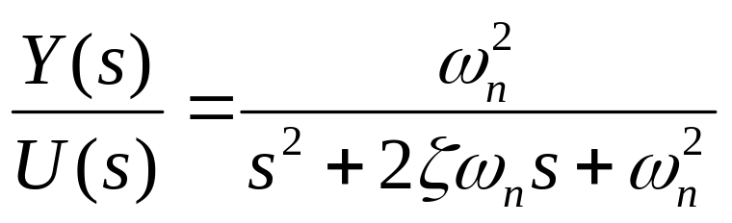
Recall: Standard Second-Order System
U(s)
Y(s)
Damping Ratio
Un-Damped Natural Frequency

Slide 3
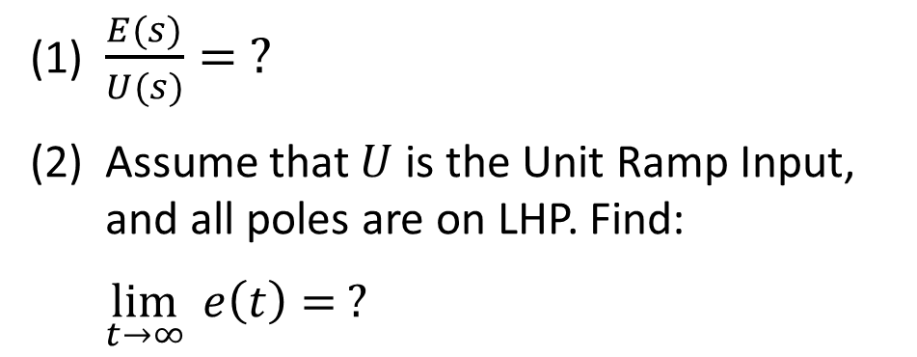
Exercise: (5 minutes)
U(s)
Y(s)
K
(1) $\frac{E(s)}{U(s)}= ?$
(2) Assume that $U$ is the Unit Ramp Input,
and all poles are on LHP. Find:
$\lim_{t→∞}{e\left(t\right)= ?}$

Slide 4
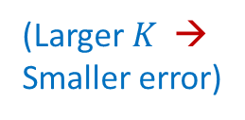
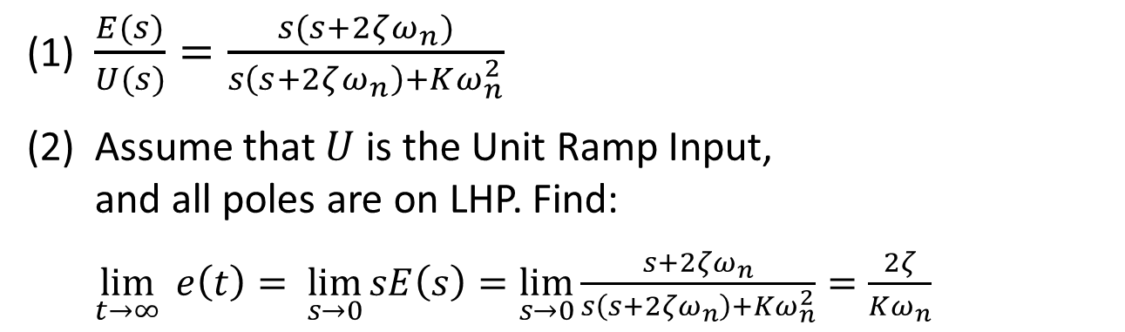
Answer:
U(s)
Y(s)
K
(1) $\frac{E(s)}{U(s)}=\frac{s(s+2ζω_{n})}{s\left(s+2ζω_{n}\right)+Kω_{n}^{2}}$
(2) Assume that $U$ is the Unit Ramp Input,
and all poles are on LHP. Find:
$\lim_{t→∞}{e\left(t\right)= \lim_{s→0}{sE\left(s\right)=\lim_{s→0}{\frac{s+2ζω_{n}}{s\left(s+2ζω_{n}\right)+Kω_{n}^{2}}=\frac{2ζ}{Kω_{n}}}}}$
(Larger $K$ →
Smaller error)

Slide 5


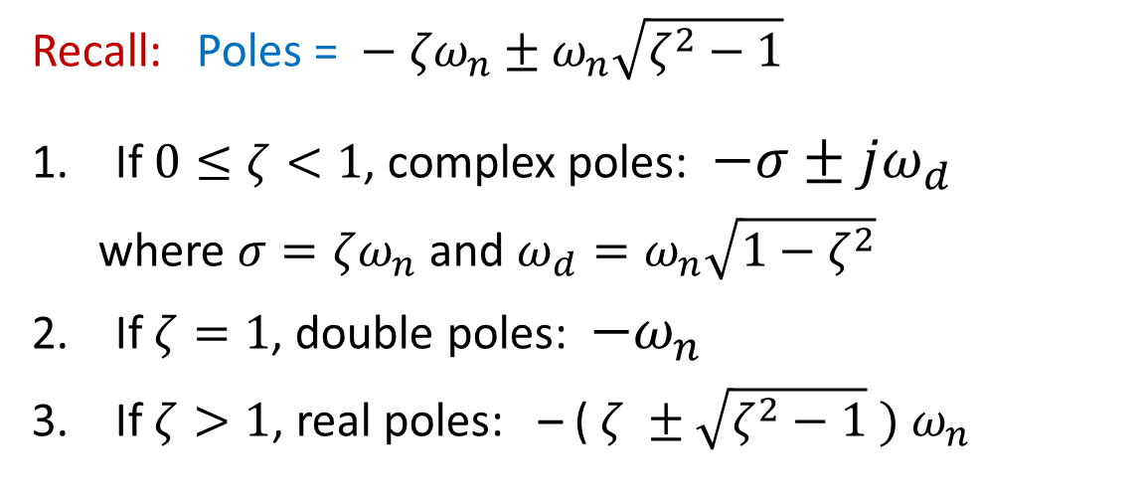
Return to:
U(s)
Y(s)
Recall: Poles = $− {ζω}_{n}±ω_{n}\sqrt{ζ^{2}−1}$
If $0≤ζ<1$, complex poles: $−σ±jω_{d}$
where $σ=ζω_{n}$ and ${ω_{d}=ω}_{n}\sqrt{{1−ζ}^{2}}$
If $ζ=1$, double poles: ${−ω}_{n}$
If $ζ>1$, real poles: – ( $ζ ±\sqrt{ζ^{2}−1} {) ω}_{n}$

Slide 6
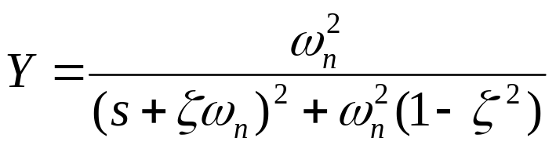
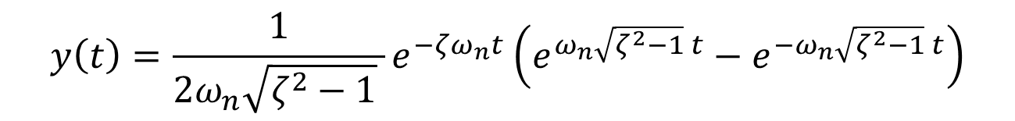
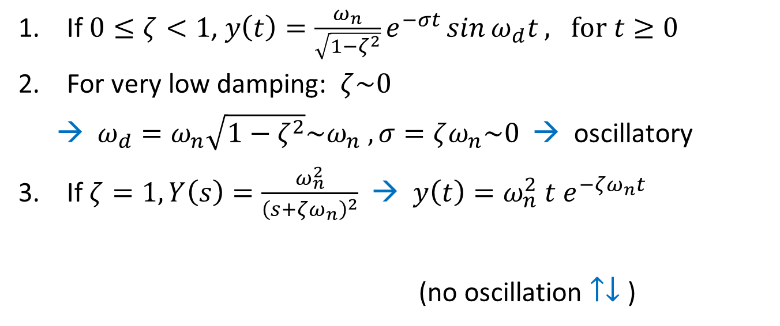
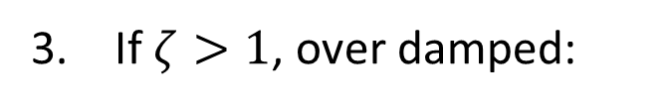

Impulse Response
U(s) = 1
If $0≤ζ<1$, $y\left(t\right)=\frac{ω_{n}}{\sqrt{1−ζ^{2}}}e^{−σt}\sin{ω_{d}t}, for t≥0$
For very low damping: $ζ\sim 0$
  →$ω_{d}=ω_{n}\sqrt{1−ζ^{2}}\sim ω_{n} , σ=ζω_{n}\sim 0$ → oscillatory
If $ζ=1, Y\left(s\right)=\frac{ω_{n}^{2}}{{\left(s+ζω_{n}\right)}^{2}}$ → $y\left(t\right)={ω_{n}^{2} t e}^{−ζω_{n}t}$
(no oscillation $↑↓$ )
${{ ω}_{d }=ω}_{n}\sqrt{{1−ζ}^{2}}=0$
If $ζ>1$, over damped:
$$y\left(t\right)=\frac{1}{2ω_{n}\sqrt{ζ^{2}−1} }e^{−ζω_{n}t}\left(e^{ω_{n}\sqrt{ζ^{2}−1} t}−e^{−ω_{n}\sqrt{ζ^{2}−1} t}\right)$$

Slide 7
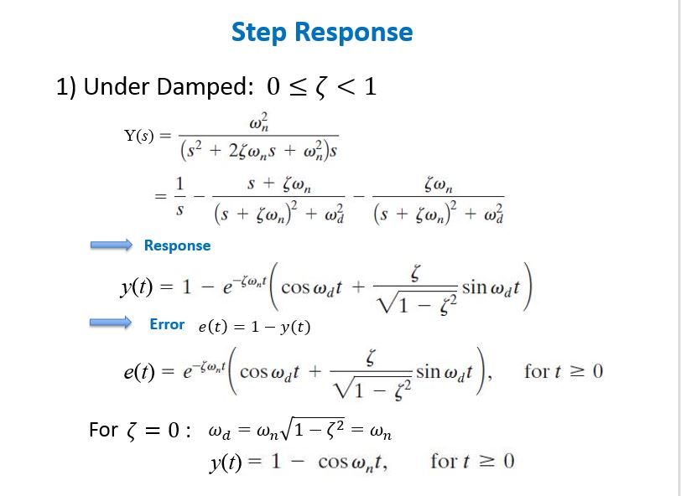





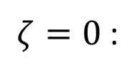
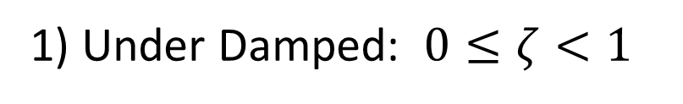


1) Under Damped: $0≤ζ<1$
Step Response
Y(s)
Response
y(t)
Error
$$e\left(t\right)=1−y(t)$$
e(t)
For
$ζ=0$ :
$$ω_{d}=ω_{n}\sqrt{1−ζ^{2}}=ω_{n}$$
y(t)

Slide 8
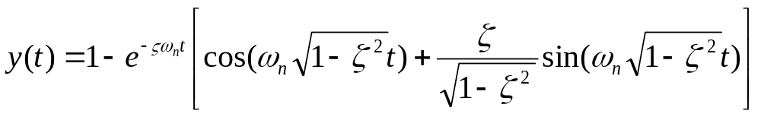
In Lecture-4, we will further analyze the Unite Step Response
Next, consider a related topic:

Slide 9
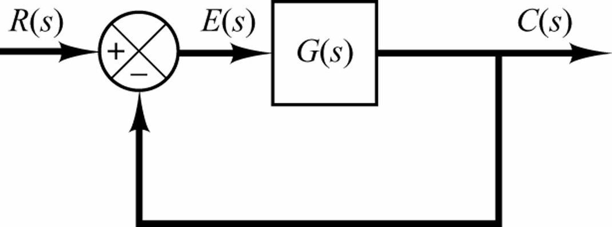
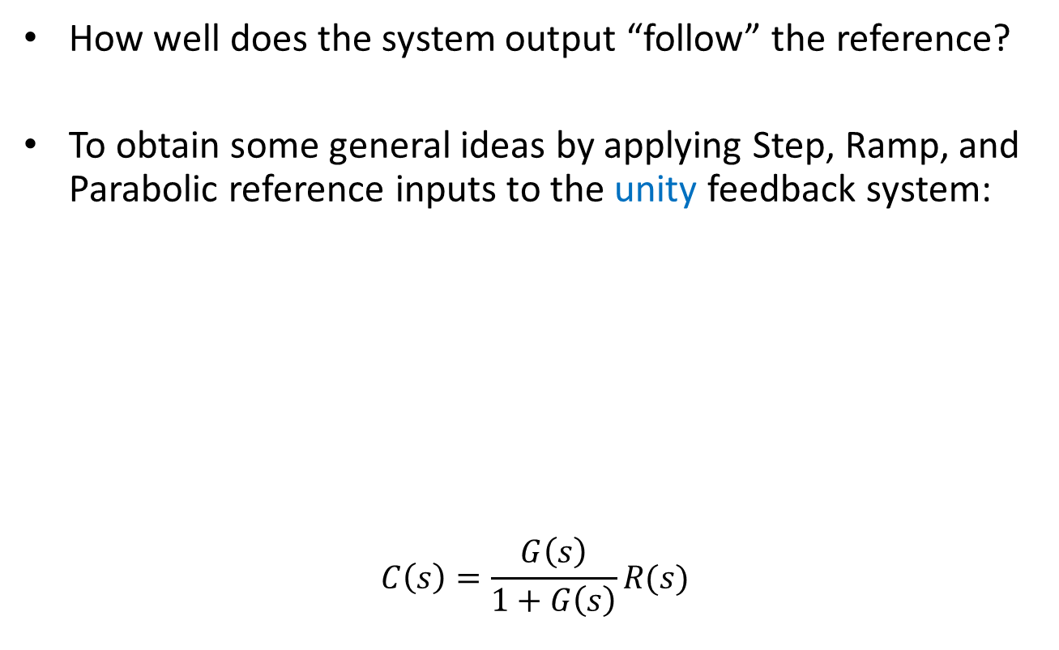
General Unity-Feedback Control Systems
How well does the system output “follow” the reference?
To obtain some general ideas by applying Step, Ramp, and Parabolic reference inputs to the unity feedback system:
$$C\left(s\right)=\frac{G\left(s\right)}{1+G\left(s\right)}R(s)$$

Slide 10
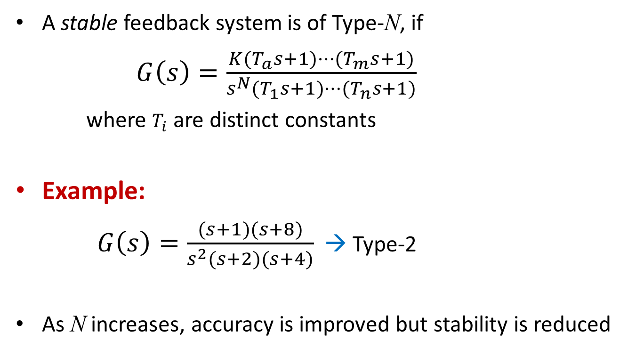
First, classify systems into different types
A stable feedback system is of Type-N, if
$G\left(s\right)=\frac{K(T_{a}s+1)⋯(T_{m}s+1)}{s^{N}(T_{1}s+1)⋯(T_{n}s+1)}$
where $T_{i}$ are distinct constants
Example:
$G\left(s\right)=\frac{(s+1)(s+8)}{s^{2}(s+2)(s+4)}$ → Type-2
As N increases, accuracy is improved but stability is reduced
Stability – To be discussed later

Slide 11

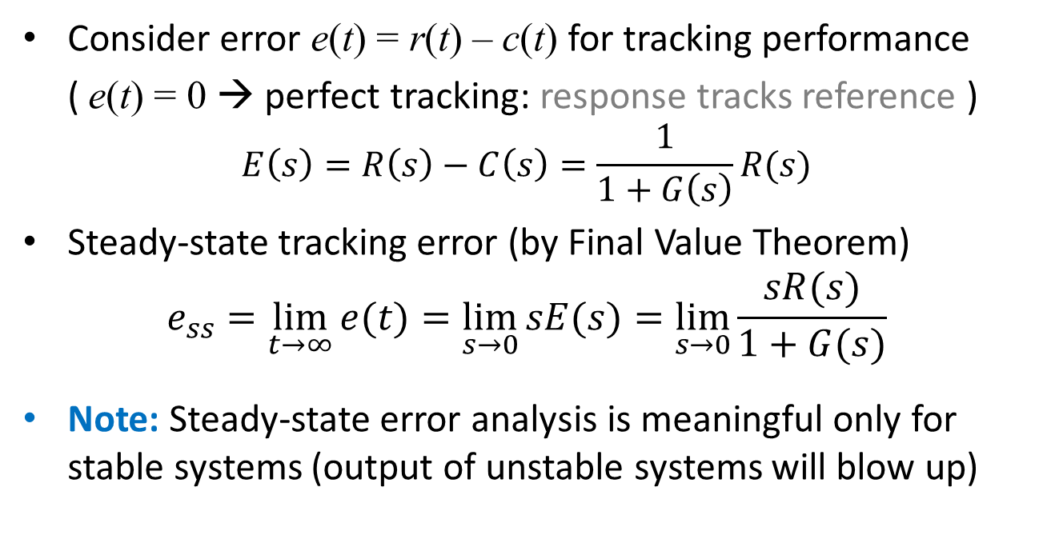
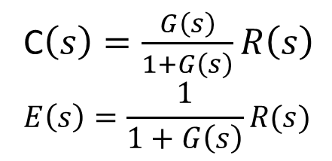
Steady-State Errors
C$\left(s\right)=\frac{G\left(s\right)}{1+G\left(s\right)}R\left(s\right)$
$$E\left(s\right)=\frac{1}{1+G\left(s\right)}R(s)$$
Consider error e(t) = r(t) – c(t) for tracking performance
( e(t) = 0 → perfect tracking: response tracks reference )
$$E\left(s\right)=R\left(s\right)−C\left(s\right)=\frac{1}{1+G\left(s\right)}R(s)$$
Steady-state tracking error (by Final Value Theorem)
$$e_{ss}=\lim_{t→∞}{e(t)}=\lim_{s→0}{sE(s)}=\lim_{s→0}{\frac{sR(s)}{1+G(s)}}$$
Note: Steady-state error analysis is meaningful only for stable systems (output of unstable systems will blow up)

Slide 12
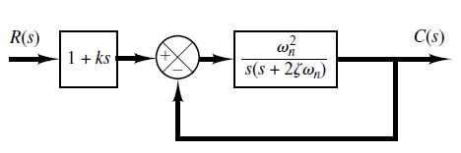
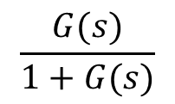
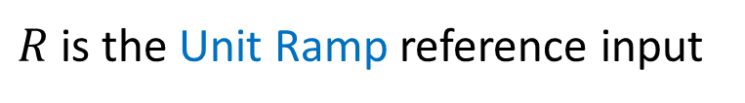
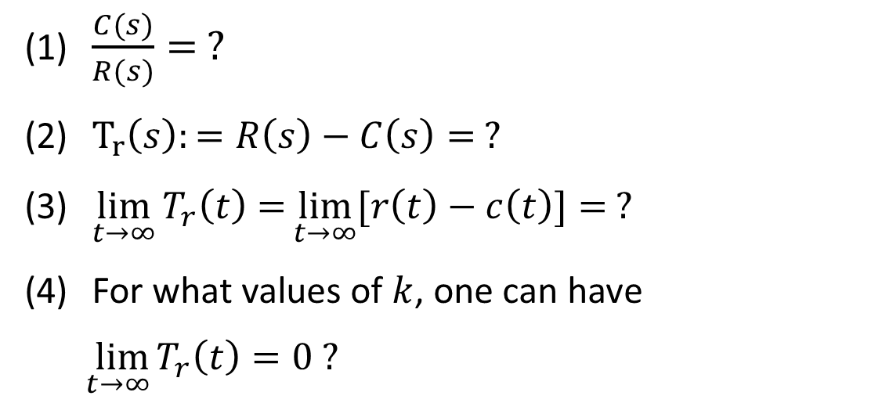
Exercise:
(10 minutes)
$$\frac{G(s)}{1+G(s)}$$
$R$is the Unit Ramp reference input
$\frac{C(s)}{R(s)}= ?$
$T_{r}\left(s\right):=R\left(s\right)−C\left(s\right)= ?$
$\lim_{t→∞}{T_{r}\left(t\right)=}\lim_{t→∞}{[r\left(t\right)−c\left(t\right)]= ?}$
For what values of $k$, one can have
$\lim_{t→∞}{T_{r}\left(t\right)=0 ?}$

Slide 13
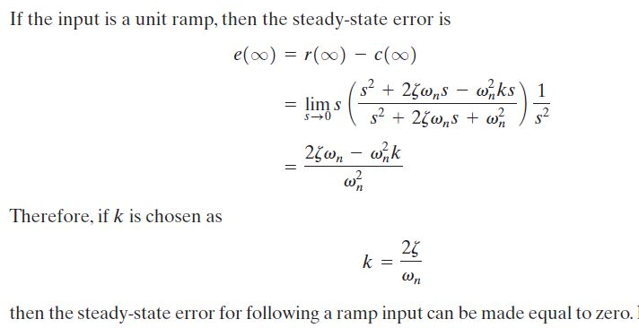

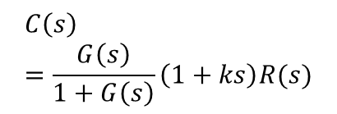

Answer:
$$C\left(s\right)=\frac{G\left(s\right)}{1+G\left(s\right)}\left(1+ks\right)R(s)$$
$$\frac{G(s)}{1+G(s)}$$
$$T_{r}$$

Slide 14
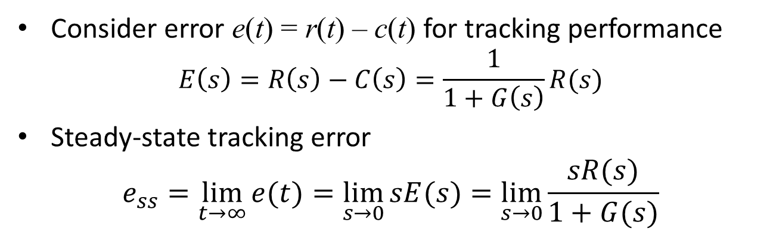
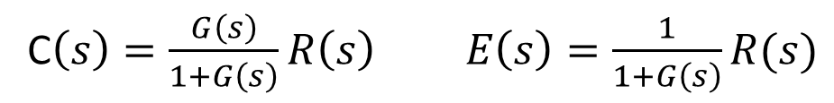
Return to: Steady-State Errors
C$\left(s\right)=\frac{G\left(s\right)}{1+G\left(s\right)}R\left(s\right) E\left(s\right)=\frac{1}{1+G\left(s\right)}R(s)$
Consider error e(t) = r(t) – c(t) for tracking performance
$$E\left(s\right)=R\left(s\right)−C\left(s\right)=\frac{1}{1+G\left(s\right)}R(s)$$
Steady-state tracking error
$$e_{ss}=\lim_{t→∞}{e(t)}=\lim_{s→0}{sE(s)}=\lim_{s→0}{\frac{sR(s)}{1+G(s)}}$$

Slide 15
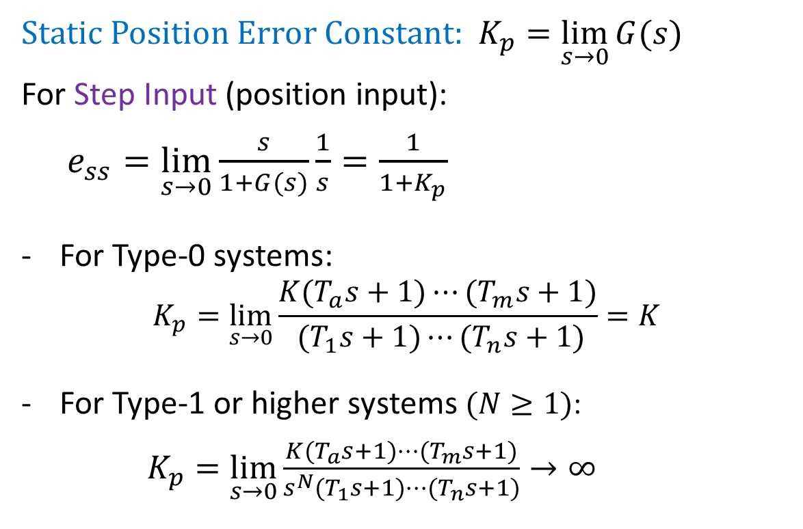
1. Static Position Error Constant Kp
Static Position Error Constant: $K_{p}=\lim_{s→0}{G(s)}$
For Step Input (position input):
$e_{ss}=\lim_{s→0}{\frac{s}{1+G(s)}\frac{1}{s}}=\frac{1}{1+K_{p}}$
For Type-0 systems:
$$K_{p}=\lim_{s→0}{\frac{K(T_{a}s+1)⋯(T_{m}s+1)}{ (T_{1}s+1)⋯(T_{n}s+1)}}=K$$
For Type-1 or higher systems $(N≥1)$:
$K_{p}=\lim_{s→0}{\frac{K(T_{a}s+1)⋯(T_{m}s+1)}{s^{N}(T_{1}s+1)⋯(T_{n}s+1)}}→∞$

Slide 16
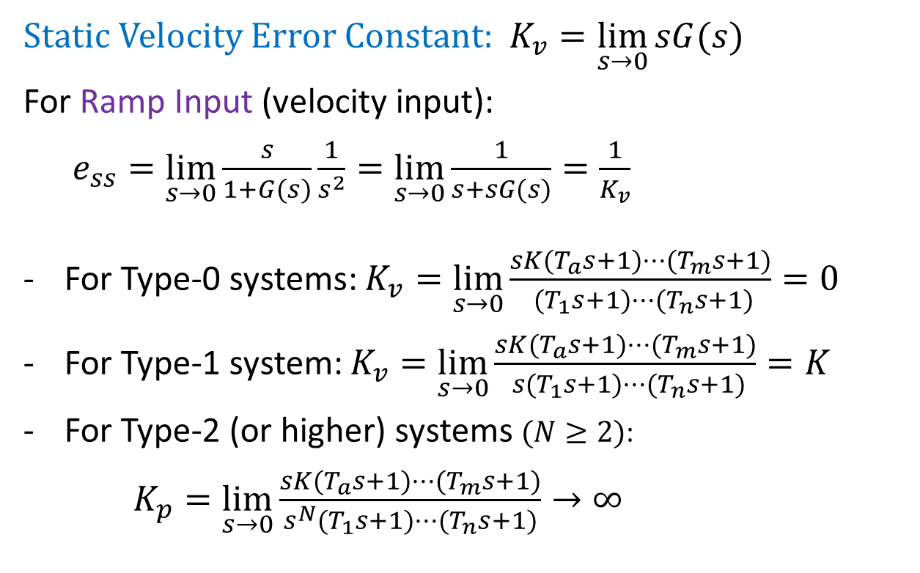
2. Static Velocity Error Constant Kv
Static Velocity Error Constant: $K_{v}=\lim_{s→0}{sG(s)}$
For Ramp Input (velocity input):
$e_{ss}=\lim_{s→0}{\frac{s}{1+G(s)}\frac{1}{s^{2}}}=\lim_{s→0}{\frac{1}{s+sG(s)}}=\frac{1}{K_{v}}$
For Type-0 systems: $K_{v}=\lim_{s→0}{\frac{sK(T_{a}s+1)⋯(T_{m}s+1)}{ (T_{1}s+1)⋯(T_{n}s+1)}}=0$
For Type-1 system: $K_{v}=\lim_{s→0}{\frac{sK(T_{a}s+1)⋯(T_{m}s+1)}{ s(T_{1}s+1)⋯(T_{n}s+1)}}=K$
For Type-2 (or higher) systems $(N≥2)$:
$K_{p}=\lim_{s→0}{\frac{sK(T_{a}s+1)⋯(T_{m}s+1)}{s^{N}(T_{1}s+1)⋯(T_{n}s+1)}}→∞$

Slide 17
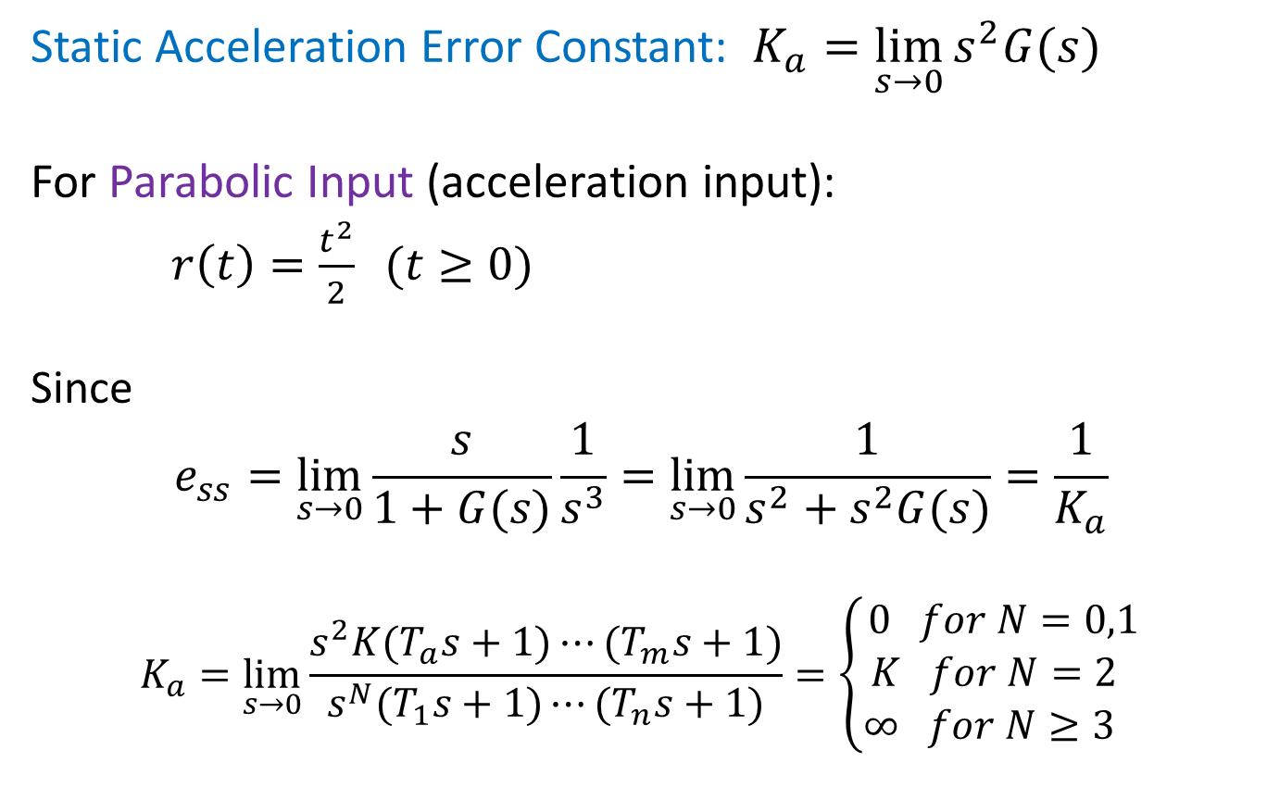
3. Static Acceleration Error Constant Ka
Static Acceleration Error Constant: $K_{a}=\lim_{s→0}{s^{2}G(s)}$
For Parabolic Input (acceleration input):
$r\left(t\right)=\frac{t^{2}}{2} (t≥0)$
Since
$$e_{ss}=\lim_{s→0}{\frac{s}{1+G(s)}\frac{1}{s^{3}}}=\lim_{s→0}{\frac{1}{s^{2}+s^{2}G(s)}}=\frac{1}{K_{a}}$$
$$K_{a}=\lim_{s→0}{\frac{s^{2}K(T_{a}s+1)⋯(T_{m}s+1)}{s^{N}(T_{1}s+1)⋯(T_{n}s+1)}=\left\{\begin{matrix}0 for N=0,1 \\ K for N=2 \\ ∞ for N≥3 \end{matrix}\right.}$$

Slide 18
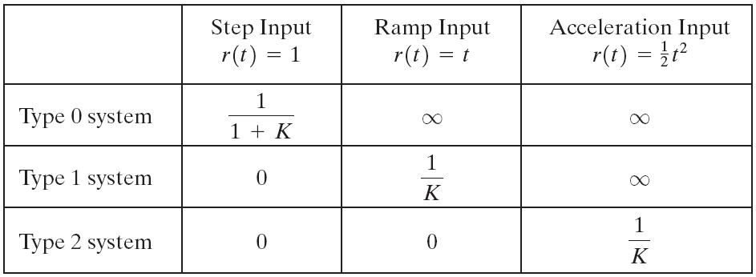


Summary
Steady-State Errors for Unity Feedback Systems
Type 3 system | 0 | 0 | 0
Higher N All 0

Slide 19

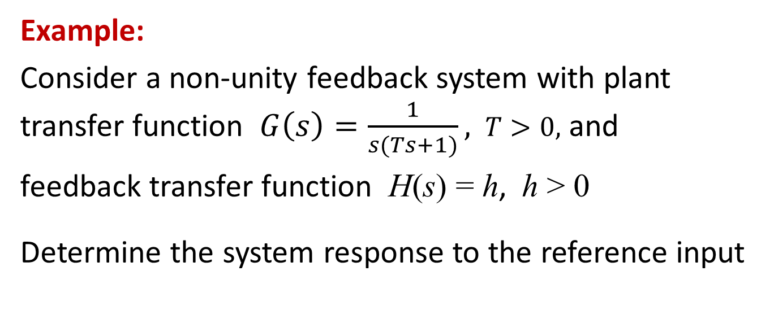
Unity versus Non-Unity Feedback Systems
Y(s)
H(s)
Example:
Consider a non-unity feedback system with plant transfer function $G\left(s\right)=\frac{1}{s(Ts+1)},$ $T>0,$ and
feedback transfer function H(s) = h, h > 0
Determine the system response to the reference input

Slide 20
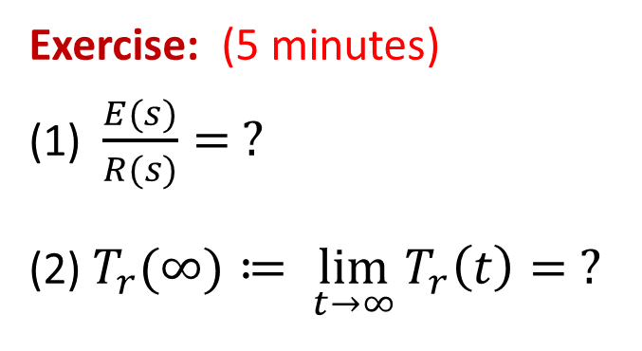

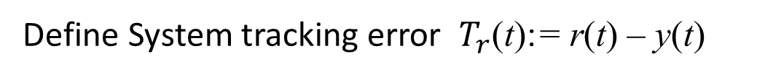
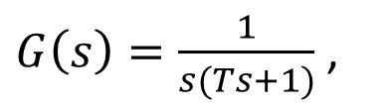
Unity versus Non-Unity Feedback Systems
Y(s)
H(s)
$G\left(s\right)=\frac{1}{s(Ts+1)}$ ,
T > 0 , H(s) = h, h > 0, $R(s)$ is Unit Step input
Define System tracking error $T_{r}$(t):= r(t) – y(t)
Exercise: (5 minutes)
(1) $\frac{E(s)}{R(s)}= ?$
(2) $T_{r}(∞)≔ \lim_{t→∞}{T_{r}\left(t\right)= ?}$

Slide 21
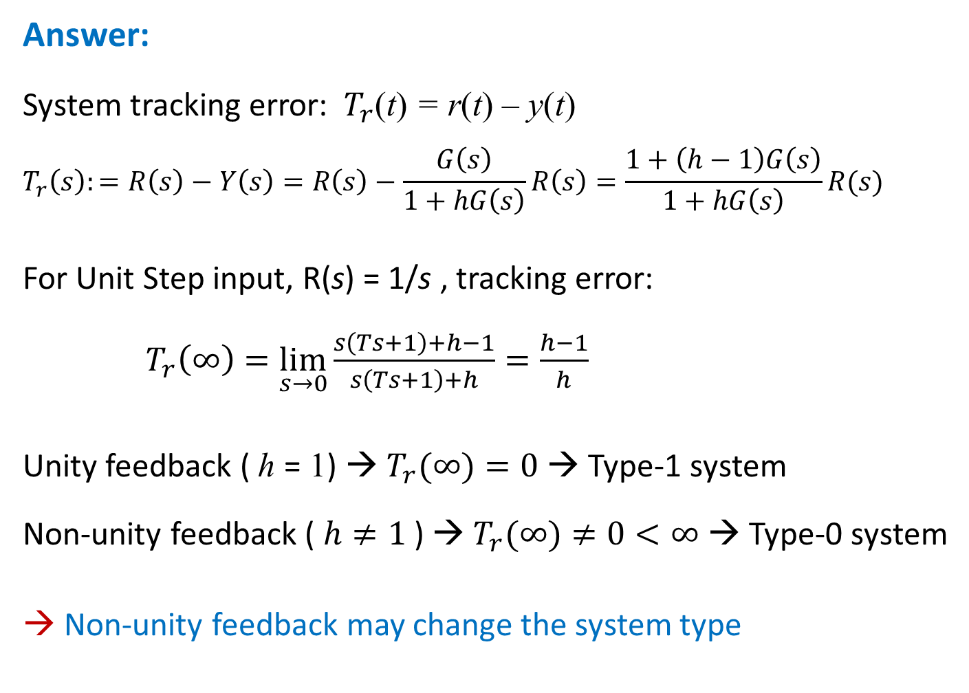
Answer:
System tracking error: $T_{r}$(t) = r(t) – y(t)
$$T_{r}\left(s\right):=R\left(s\right)−Y\left(s\right)=R\left(s\right)−\frac{G\left(s\right)}{1+hG\left(s\right)}R\left(s\right)=\frac{1+\left(h−1\right)G\left(s\right)}{1+hG\left(s\right)}R(s)$$
For Unit Step input, R(s) = 1/s , tracking error:
$T_{r}\left(∞\right)=\lim_{s→0}{\frac{s\left(Ts+1\right)+h−1}{s\left(Ts+1\right)+h}=\frac{h−1}{h}}$
Unity feedback ( h = 1) → $T_{r}(∞)=0$ → Type-1 system
Non-unity feedback ( $h≠1$) → $T_{r}(∞)≠0<∞$→ Type-0 system
→ Non-unity feedback may change the system type

Slide 22
END

