Slide 1
Orthogonal Frequency Division Multiplexing (OFDM)

Slide 2
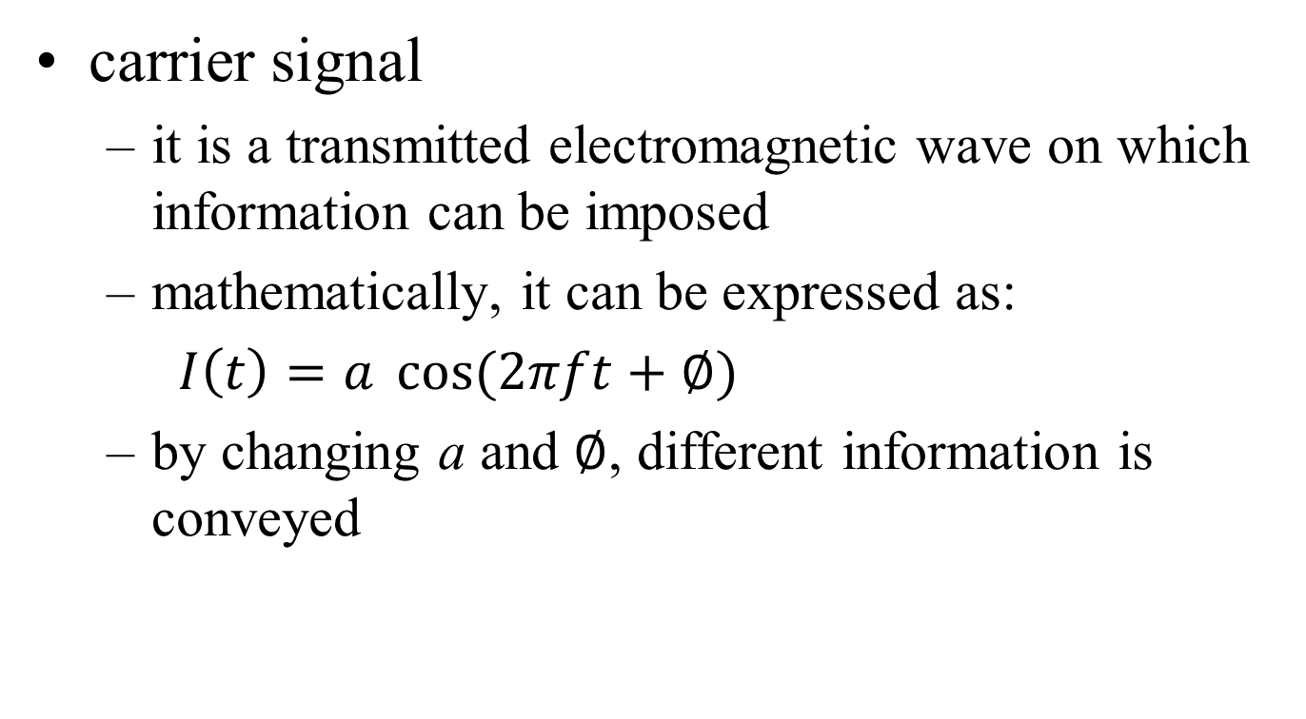
Quick revision on Radio Transmission (1/2)
carrier signal
  it is a transmitted electromagnetic wave on which information can be imposed
  mathematically, it can be expressed as:
  $I\left(t\right)=a \cos{(2πft+∅)}$
  by changing a and $∅$, different information is conveyed

Slide 3
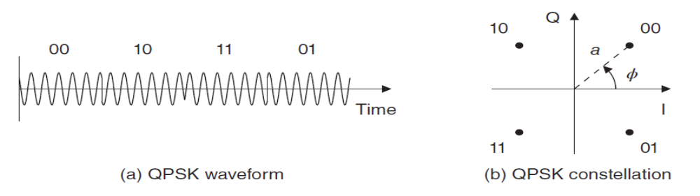
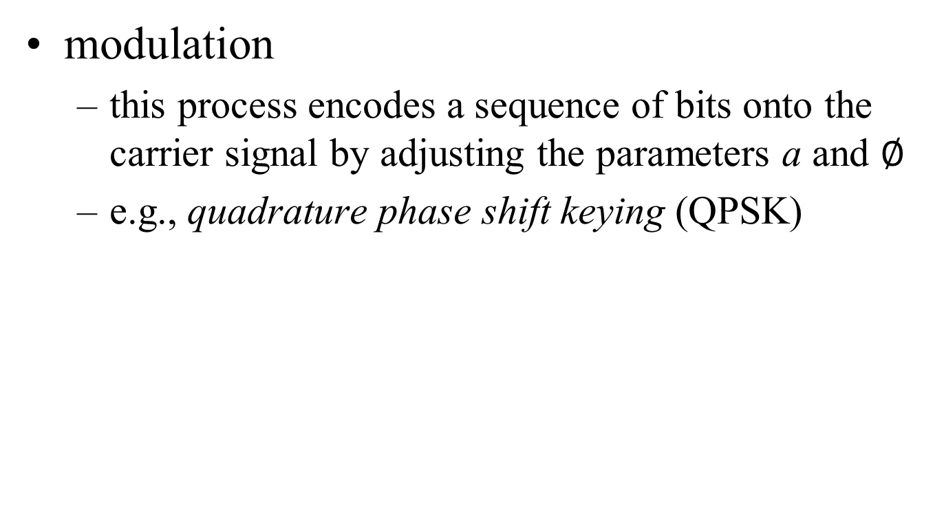
Quick revision on Radio Transmission (2/2)
modulation
  this process encodes a sequence of bits onto the carrier signal by adjusting the parameters a and $∅$
  e.g., quadrature phase shift keying (QPSK)

Slide 4
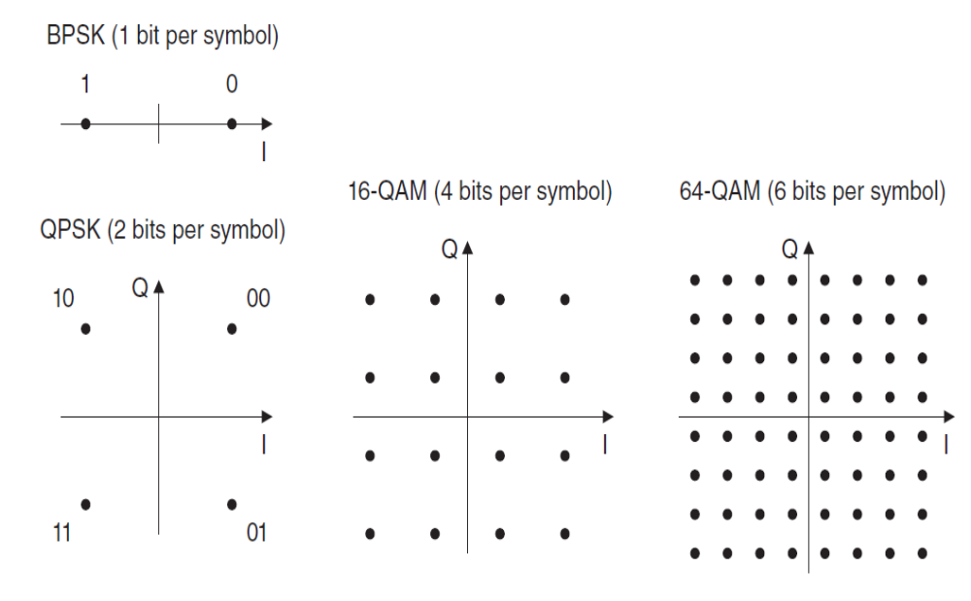
Modulation Schemes used by LTE

Slide 5
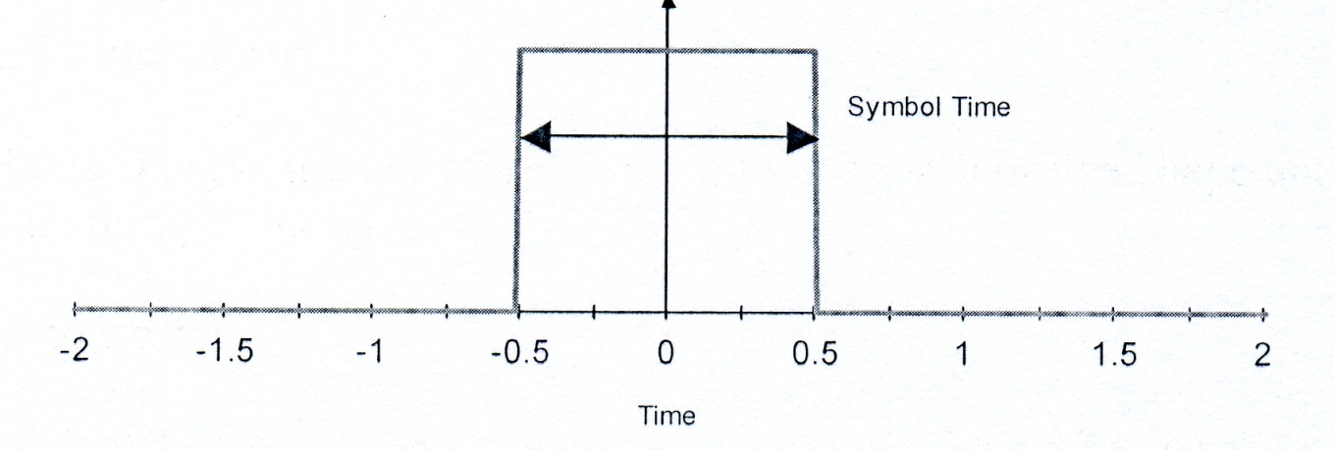
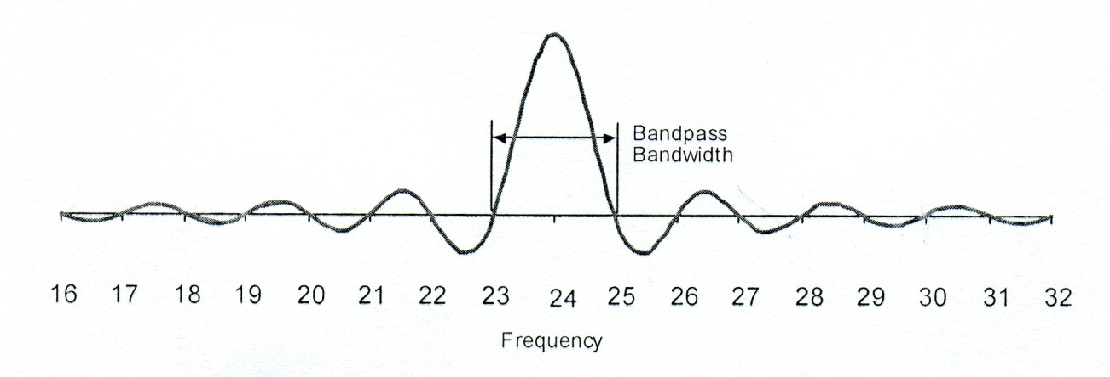
Time and Frequency Domain
Inverse Fourier Transform
Fourier Transform

Slide 6
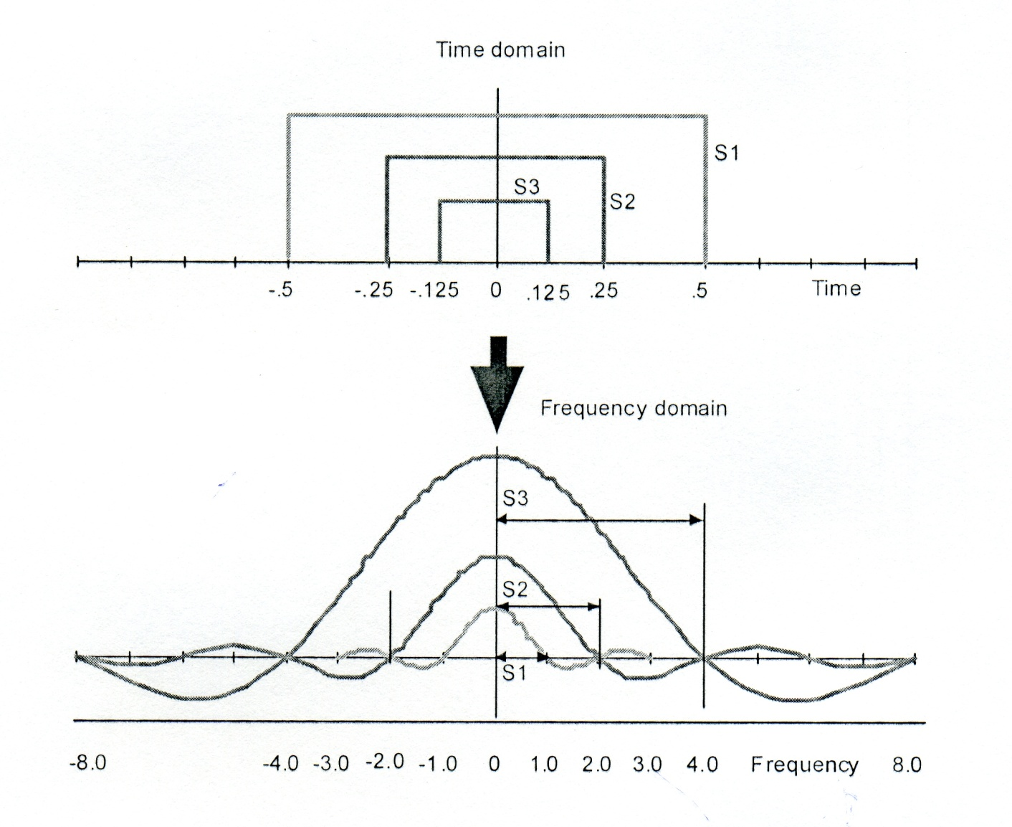
Effect of Symbol Duration

Slide 7


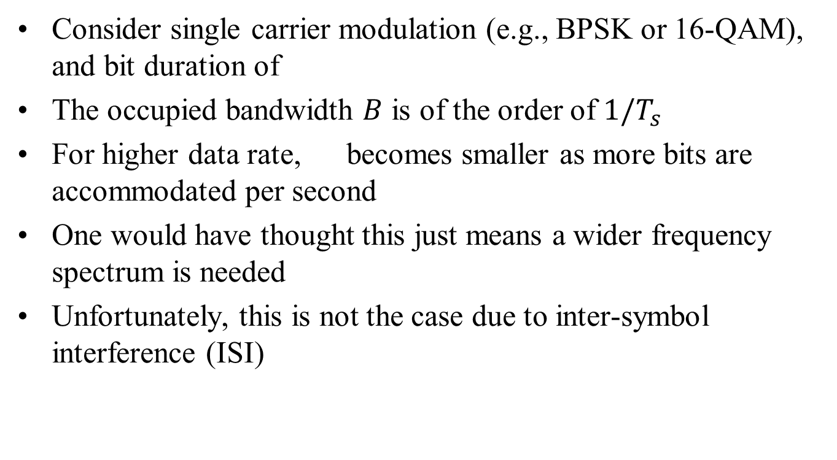
Single Carrier Modulation
Consider single carrier modulation (e.g., BPSK or 16-QAM), and bit duration of
The occupied bandwidth $B$ is of the order of $1/T_{s}$
For higher data rate, becomes smaller as more bits are accommodated per second
One would have thought this just means a wider frequency spectrum is needed
Unfortunately, this is not the case due to inter-symbol interference (ISI)

Slide 8
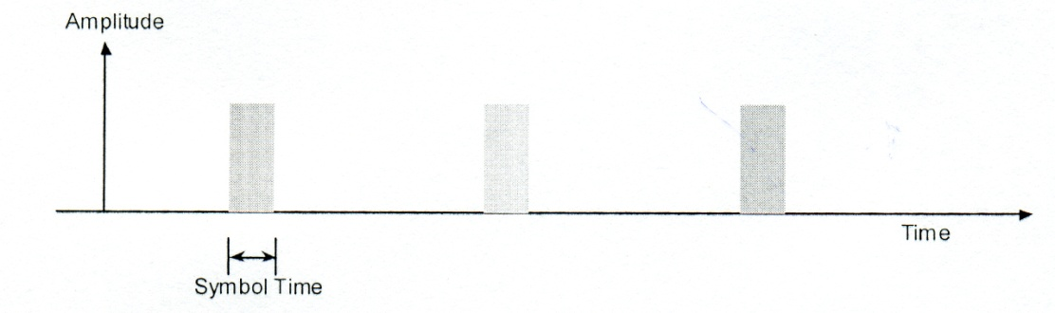
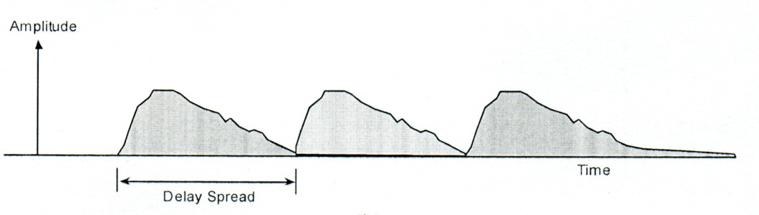
Inter-symbol Interference (1/3)
When a signal is transmitted through a channel, it is distorted
original bits sent
channel
received bits

Slide 9
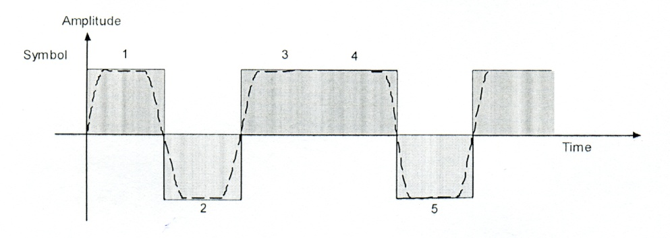
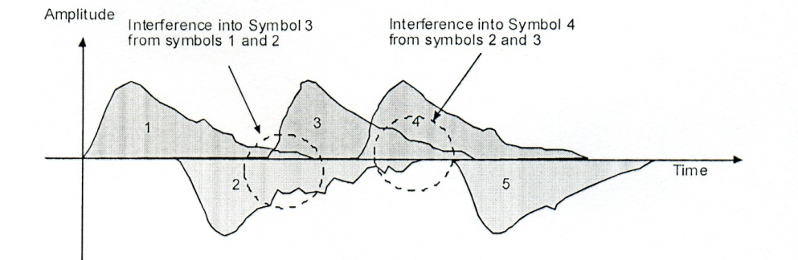
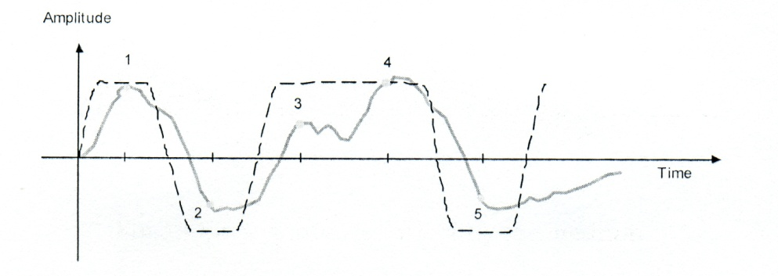
Inter-symbol Interference (2/3)
bit stream of 101101to be sent
each bit is spread by the medium
received signal vulnerable to noise

Slide 10



Inter-symbol Interference (3/3)
For a transmission channel with a delay spread , a reception free of ISI is only possible if
Unfortunately, we can only reduce to a certain extent, but cannot reduce it to any value we want
Therefore, ISI limits the achievable data rate even if there is a wide frequency spectrum
We need a smarter way to make use of the wide frequency spectrum - OFDM

Slide 11
Orthogonal Frequency Division Multiplexing (OFDM)
Based on multi-carrier transmission
Allows carriers to overlap (no guard band), resulting in lesser wasted bandwidth without any Inter Carrier Interference (ICI)
High data rate distributed over multiple carriers resulting in lower symbol rate (more immune to ISI)
Permits higher data rate as compared to FDM
More robust to multipath effects.

Slide 12





Orthogonality
the signals and are orthogonal to each other

Slide 13




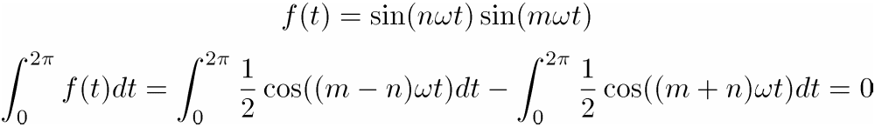
Orthogonality in OFDM
OFDM uses a set of carriers, which is referred to as sub-carriers
The sub-carrier are harmonic sine/cosine waves, ,
, , , where both n and k are integers
These carriers are orthogonal to each other:
The orthogonality allows simultaneous transmission on a lot of sub-carriers in a tight frequency space without interfering each other.

Slide 14
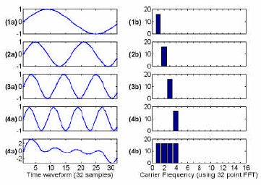
Orthogonality in Time Domain

Slide 15
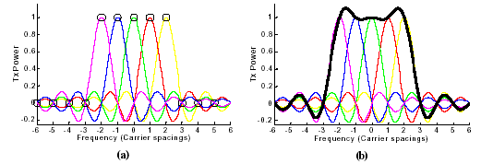
Orthogonality in Frequency Domain
Each carrier is modulated using BPSK / QPSK / M-ary QAM
Overlap of frequency response is possible as against FDM where inter-carrier spacing is a must
Frequency responses of the carriers overlap at zero crossings avoiding Inter Carrier Interference

Slide 16
Example: OFDM with 4 sub-carriers
Input bit stream: 1, 1, -1, -1, 1, 1, 1, -1, 1, -1, -1, -1, -1, 1, -1, ...
Serial to parallel conversion of data bits:
c1 c2 c3 c4
1 1 -1 -1
1 1 1 -1
1 -1 -1 -1
-1 1 -1 -1
-1 1 1 -1
-1 -1 1 1

Slide 17
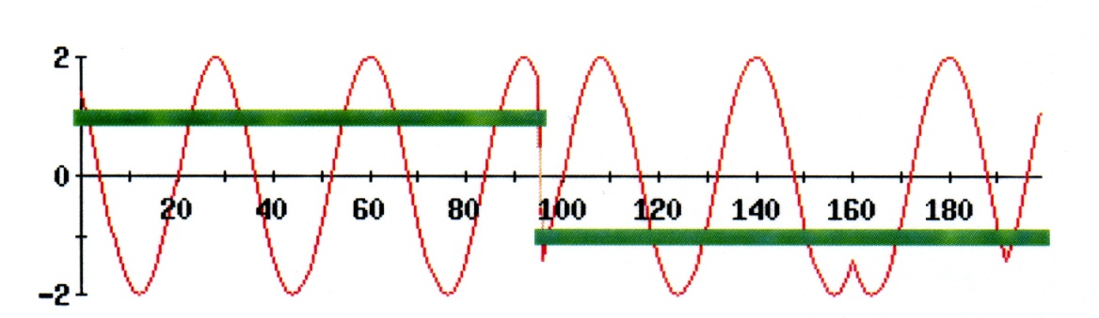
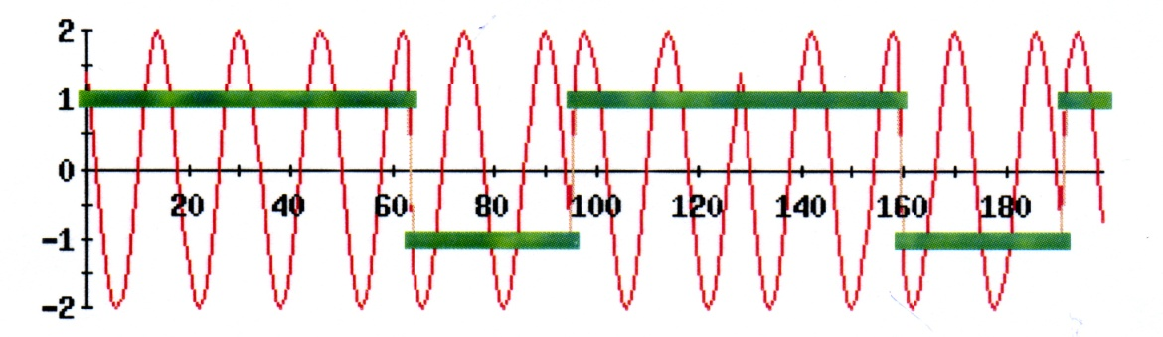
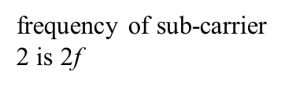
Modulation in Different Sub-carriers
Assuming BPSK is used
assuming frequency of sub-carrier 1 is f
sub-carrier 1 and the bits that it is modulating
sub-carrier 2 and the bits that it is modulating

Slide 18
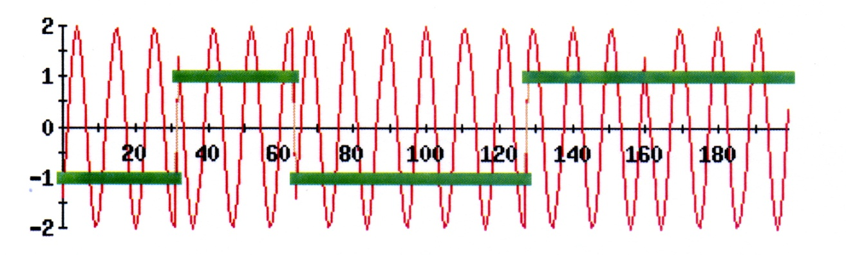
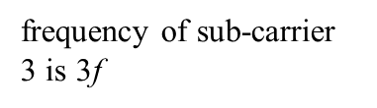
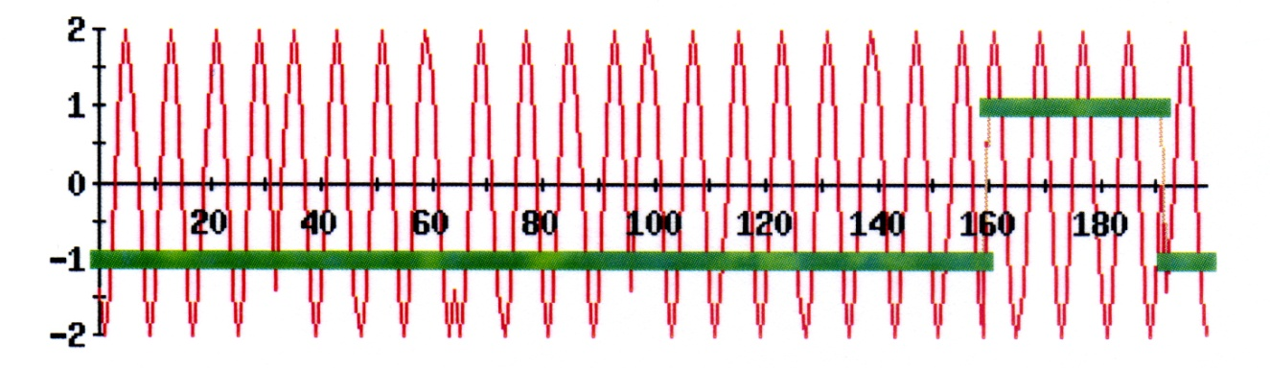
sub-carrier 3 and the bits that it is modulating
frequency of sub-carrier 4 is 4f
sub-carrier 4 and the bits that it is modulating

Slide 19
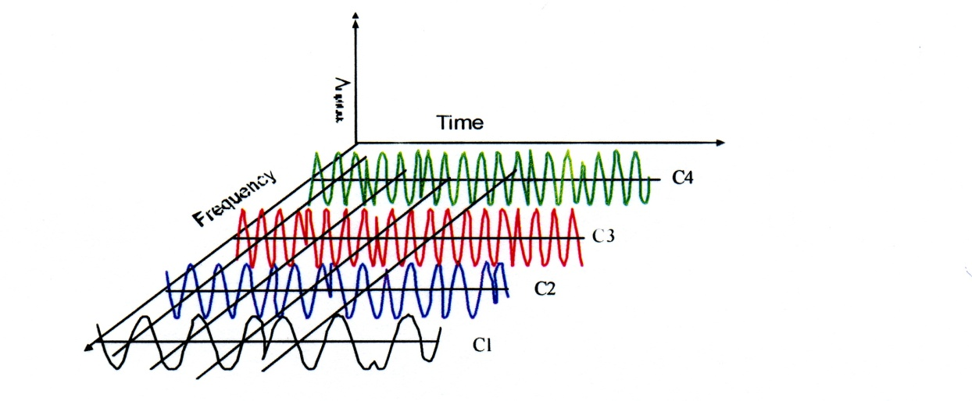
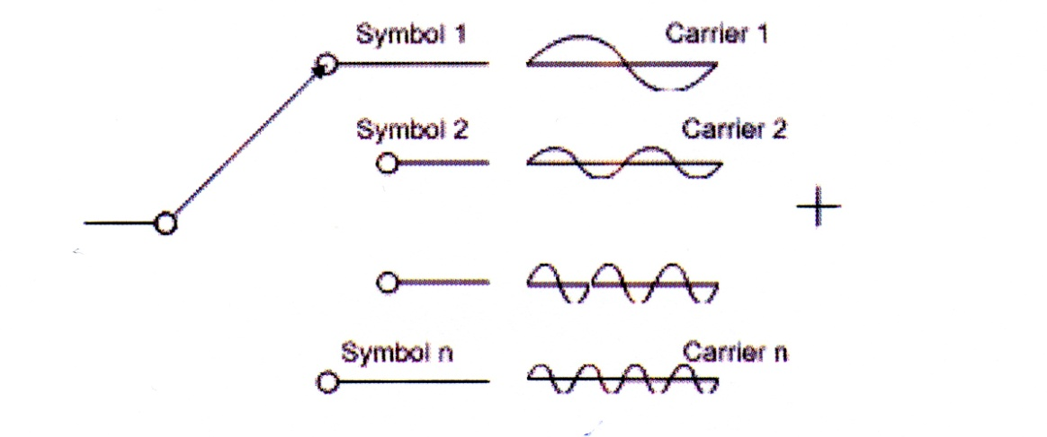
What Have We Got Now?
frequency and time domain of modulated sub-carriers
need a method to do this summation!

Slide 20
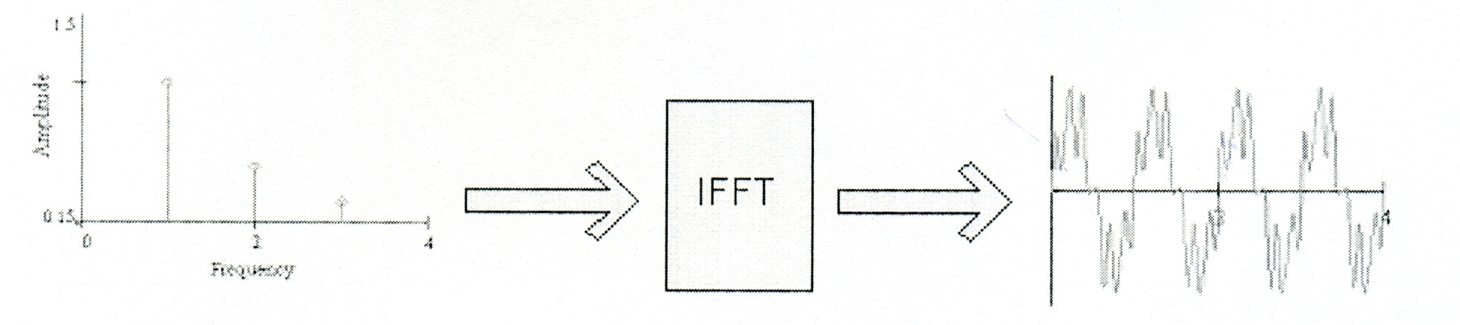
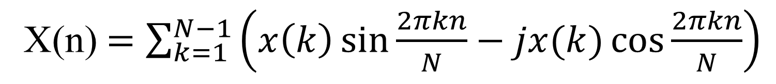
Fast Fourier Transform (FFT)
discrete Fourier transform (DFT) computes an approximation of the Fourier Transform on a discrete set of frequencies from a discrete set of time samples
FFT is an efficient algorithm to perform DFT
IFFT is the inverse of FFT
X(n)$=\sum_{k=1}^{N−1}{\left(x\left(k\right)\sin{\frac{2πkn}{N}}−jx(k)\cos{\frac{2πkn}{N}}\right)}$

Slide 21
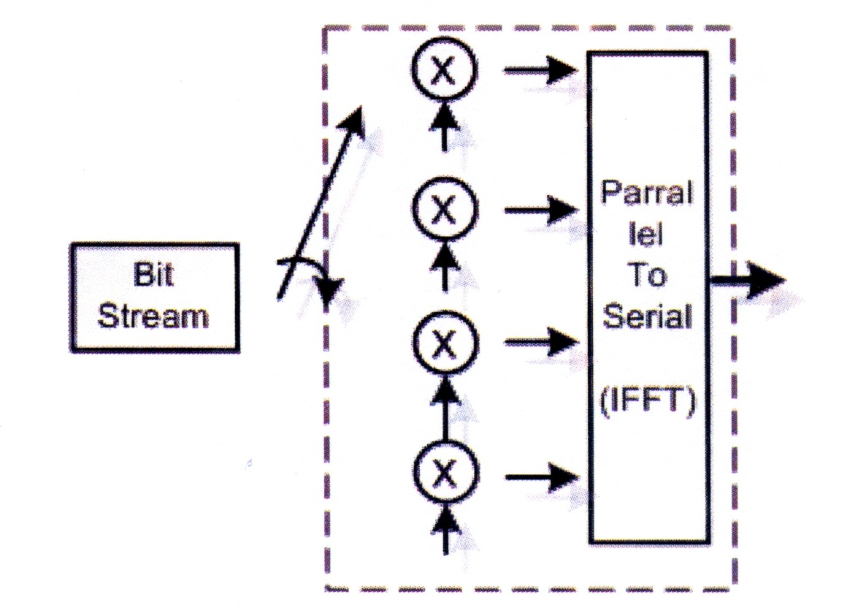
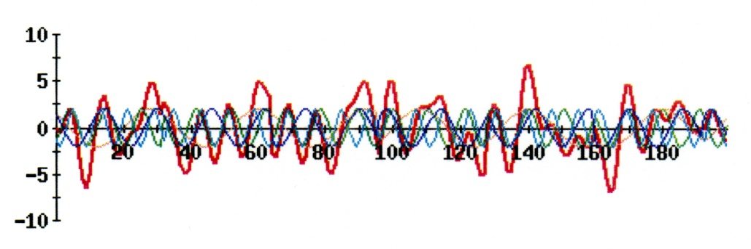
OFDM Transmission
generated OFDM signal
block diagram of an OFDM signal creation

Slide 22
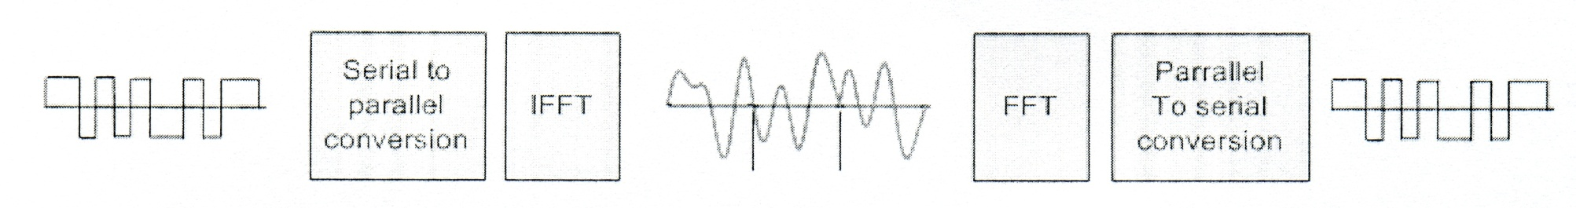
OFDM System

Slide 23
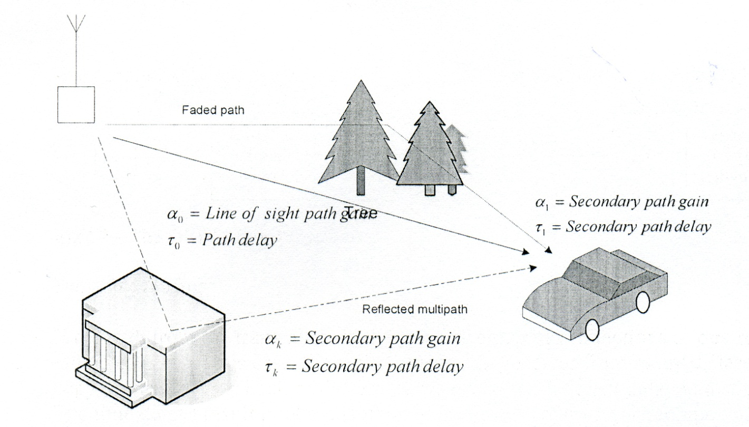
Multipath Fading
copies of the signal reaches the receiver from many different routes, with a slightly different delay and different signal gain
when delayed copies of signal is added to the main signal component, the main signal is degraded

Slide 24
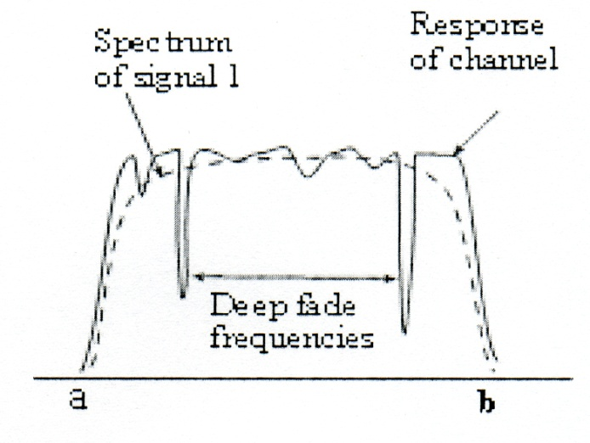
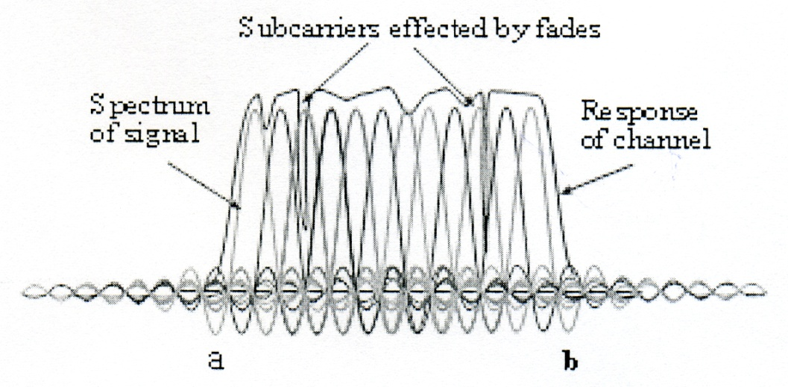
Effect of Fading on OFDM
deep fading channel
only a small subset of data is lost due to fading
OFDM spectrum in deep fading channel

Slide 25
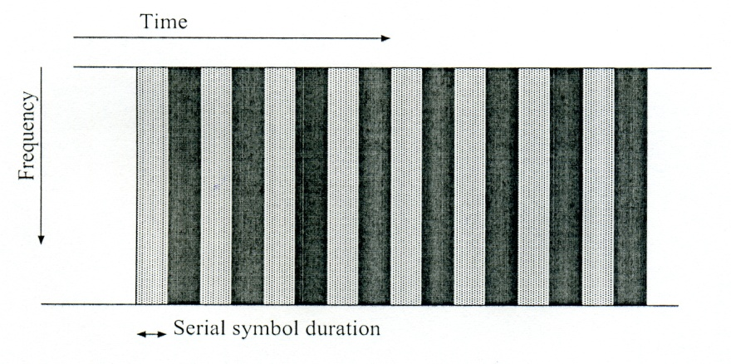

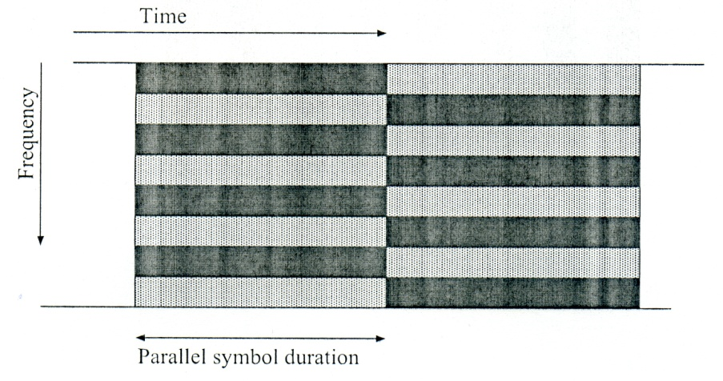

Limitation
In summary, OFDM splits a data stream into K substreams of lower data rate and to transmit data substreams on adjacent subcarriers. For example, K=8:
larger K, higher data rate
but K cannot be arbitrarily increased, it is constrained by another physical parameter, the maximum Doppler frequency
restriction on K:
K < 64

