Slide 1
EE3211
Modelling Techniques
Week 5 Tutorial
Hypothesis testing: Categorical data

Slide 2
Scenario: OC use and heart disease
A study looked at the effects of OC use on heart disease in women 40 to 44 years of age. The researchers found that among 5000 current OC users at baseline, 13 women developed a myocardial infarction (MI) over a 3-year period, whereas among 10,000 never-OC users, 7 developed an MI over a 3-year period.
Q1. Design the MI data in the form of a 2x2 contingency table.
Q2. Compute the expected table for the OC-MI data.
Q3. What do the observed and expected tables tell us?

Slide 3
Q1. Design the MI data in the form of a 2x2 contingency table.
Let the rows of the table represent the OC-use group, with the first row representing “current OC users” and the second row representing “never-OC users”.
Let the columns of the table represent MI, with the first column representing “Yes” and the second column representing “No”.
We studied 5000 current OC users, of whom 13 developed MI and 4987 did not.
We studied 10,000 never-OC users, of whom 7 developed MI and 9993 did not.
2x2 contingency table for the OC-MI data
OC-use group | Yes | No | Total
Current OC users | 13 | 4987 | 5000
Never-OC users | 7 | 9993 | 10000
Total | 20 | 14980 | 15000

Slide 4
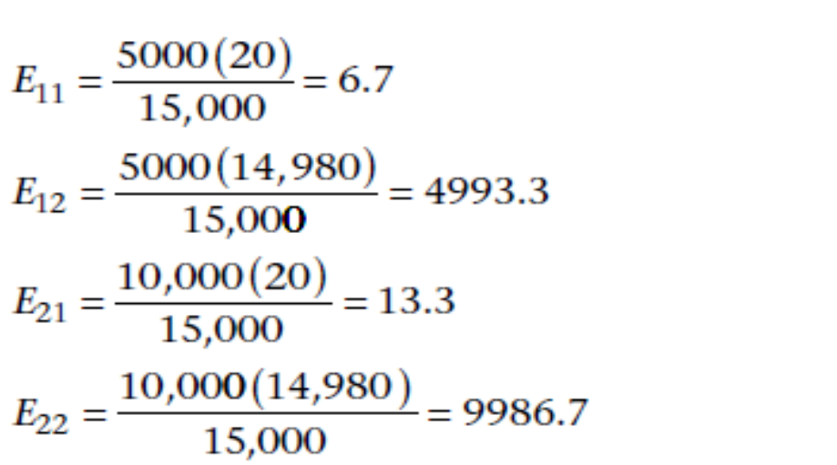
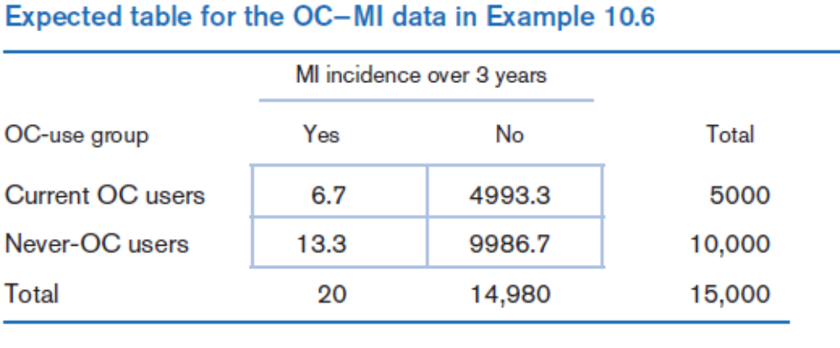
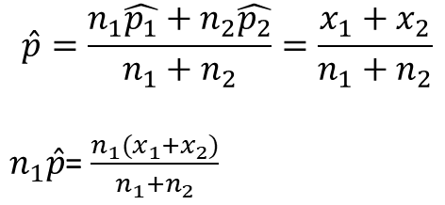
Q2. Compute the expected table for the OC-MI data.
$$\hat{p}=\frac{n_{1}\hat{p_{1}}+n_{2}\hat{p_{2}}}{n_{1}+n_{2}}=\frac{x_{1}+x_{2}}{n_{1}+n_{2}}$$
$n_{1}\hat{p}$= $\frac{{n_{1}(x}_{1}+x_{2})}{n_{1}+n_{2}}$

Slide 5
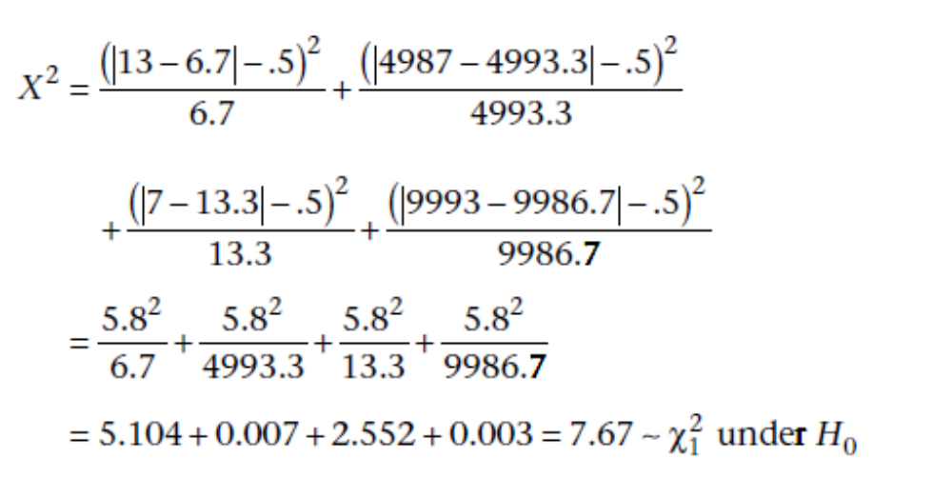
Q3. What do the observed and expected tables tell us?
Minimum expected value is 5.
The test procedure Yates-corrected chi-square test can be used:

Slide 6
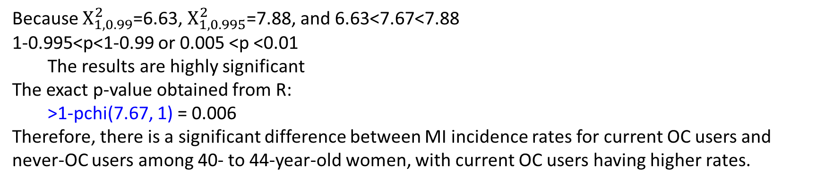
Q3. What do the observed and expected tables tell us?
Because $Χ_{1,0.99}^{2}$=6.63, $Χ_{1,0.995}^{2}$=7.88, and 6.63<7.67<7.88
1-0.995<p<1-0.99 or 0.005 <p <0.01
  The results are highly significant
The exact p-value obtained from R:
  >1-pchi(7.67, 1) = 0.006
Therefore, there is a significant difference between MI incidence rates for current OC users and never-OC users among 40- to 44-year-old women, with current OC users having higher rates.

Slide 7
Q3. What do the observed and expected tables tell us?
Use the matrix command of R to form the contingency table matrix
Assign it the name “table” as follows:
>table=matrix(c(a,b,c,d), nrow=2)
*Note: cell counts have to be entered column-wise (i.e. cell counts a and c are placed in the first column of the matrix, then the cell counts b and d are put in the second column of the matrix)
To obtain the Yates-corrected chi-square statistics:
>chisq.test(table)

Slide 8
Q3. What do the observed and expected tables tell us?
> table<-matrix(c(13,7,4993,9987),nrow=2)
> table
[,1] [,2]
[1,] 13 4993
[2,] 7 9987
> chisq.test(table)
Pearson's Chi-squared test with Yates' continuity correction
data: table
X-squared = 7.6409, df = 1, p-value = 0.005706

Slide 9
Scenario: OC use and Cancer
A 1980 study investigated the relationship between the use of OCs and the development of endometrial cancer. The researchers found that of 117 endometrial-cancer patients, 6 had used the OC Oracon at some time in their lives, whereas 8 of the 395 controls had used this agent.
Q1. Design the Observed Table.
Q2. Test for an association between the use of Oracon and the incidence of endometrial cancer, using a two-tailed test.

Slide 10
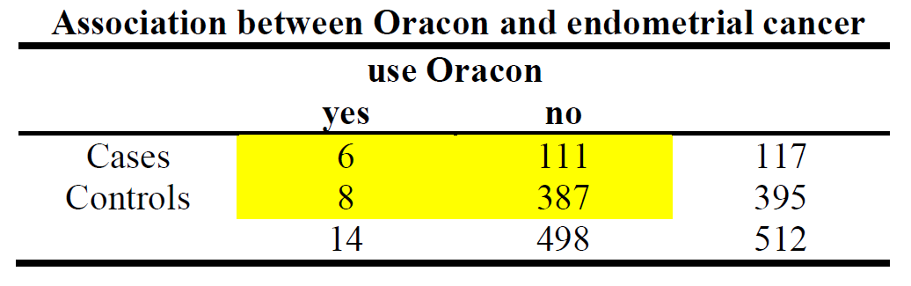
Q1. Design the Observed Table.
Smaller row total in first row
Smaller column total in first column

Slide 11
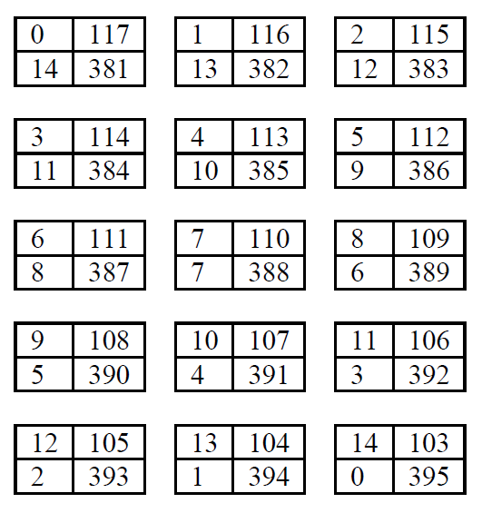
Q2. Test for an association between the use of Oracon and the incidence of endometrial cancer, using a two-tailed test.
Begin the table with 0 in the (1, 1) cell. Other cells determined from the row and column margins.
Increase the (1, 1) cell by 1 in the next table, decrease the (1, 2) and (2, 1) cells by 1, increase the (2, 2) cell by 1, until one of the cells is 0
The observed table is the “6” table.

Slide 12
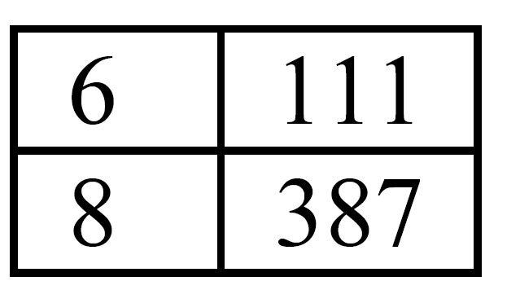
Q2. Test for an association between the use of Oracon and the incidence of endometrial cancer, using a two-tailed test.
Use R to perform the test
  Hypothesis H₀: p₁ = p₂ vs. H₁: p₁ ≠ p₂
  p-value = 2 × min[Pr(0)+Pr(1)+…+Pr(a),
  Pr(a)+Pr(a+1)+…+Pr(k),.5]
  Hypothesis H₀: p₁ = p₂ vs. H₁: p₁ < p₂
  p-value = Pr(0) +Pr(1)+…+Pr(a)
  Iii Hypothesis H₀: p₁ = p₂ vs. H₁: p₁ > p₂
  p-value = Pr(a) +Pr(a+1)+…+Pr(k)
>table=matrix(c(6,8,111,387), nrow=2)
>plower=fisher.test(table, alternative="l")
>pupper=fisher.test(table, alternative= "g")
> ptwosided=2*min(plower$p.value,pupper$p.value,0.5)
> ptwosided
[1] 0.1495903
Thus, there is no significant association between the use of Oracon and the development of endometrial cancer.

