Slide 1

Chapter 9
Uniprocessor Scheduling
Operating Systems:
Internals and Design Principles
William Stallings

Slide 2
Roadmap
Types of Processor Scheduling
Scheduling Algorithms
  FCFS (First-Come-First-Serve)
  RR (Round-Robin)
  SPN (Shortest-Process-Next)
  SRT (Shortest-Remaining-Time)
  HRRN (Highest-Response-Ratio-Next)
  FB (Feedback)
Fair-Share Scheduling

Slide 3
Scheduling
An OS must allocate resources amongst competing processes.
The resource provided by a processor is execution time.
Processor resource is allocated by means of scheduling - determines which processes will wait and which will progress.
The aim of processor scheduling is to assign processes to be executed by the processor in a way that meets system objectives, such as response time, turnaround time, throughput, and processor utilization.

Slide 4
Scheduling Objectives
The scheduling function should
  Share time fairly among processes
  Prevent starvation of a process
  Use the processor efficiently
  Have low overhead
  Prioritise processes when necessary (e.g. real time deadlines)

Slide 5
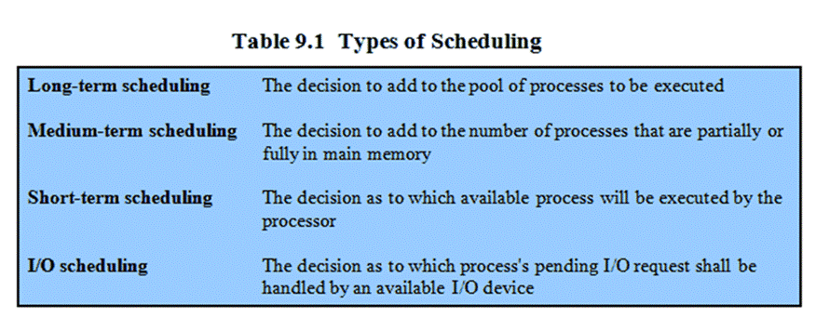
Types of Scheduling

Slide 6
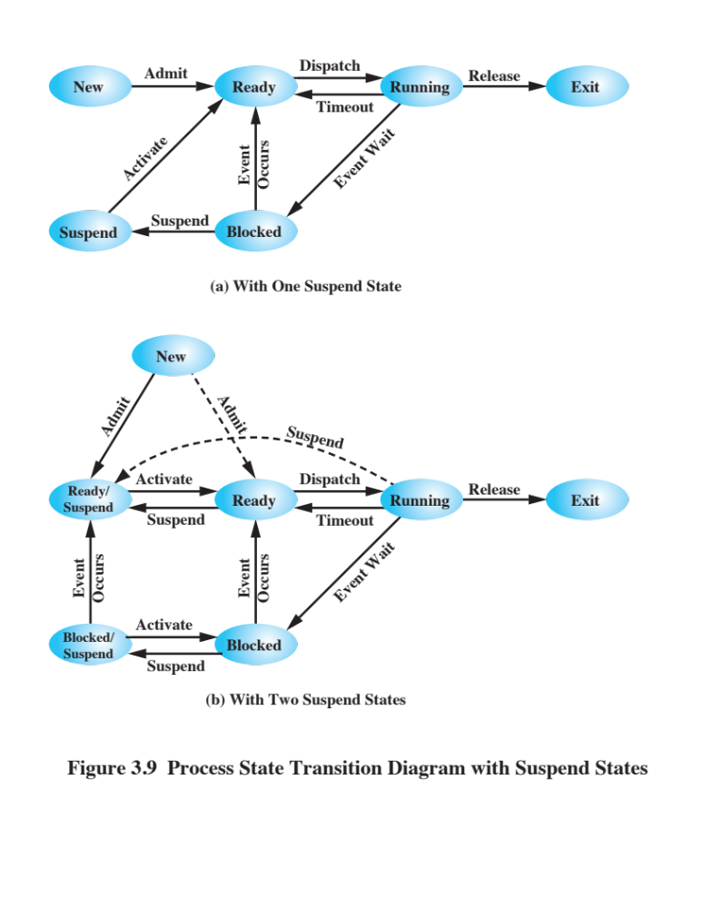
Two Suspend States
Remember this diagram from Chapter 3?

Slide 7
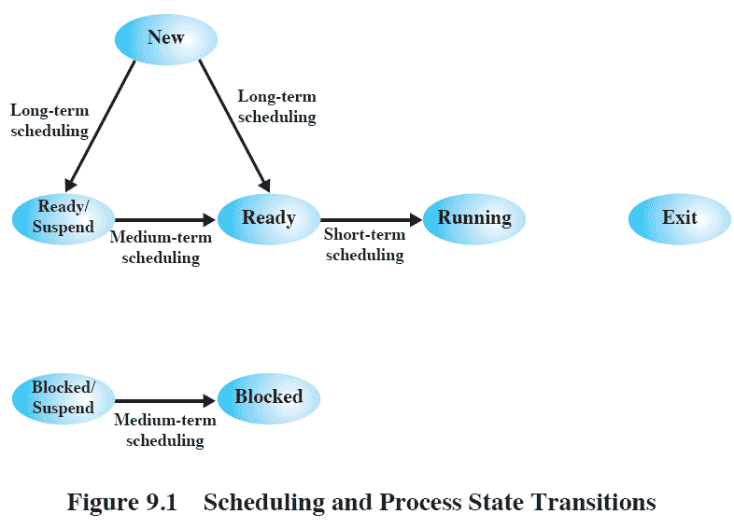
Scheduling and
Process State Transitions
Long-term scheduling: whether a new process is admitted.
Medium-term scheduling: whether a process is swapped in.
Short-term scheduling: which ready process to execute next.
Focus of this chapter

Slide 8
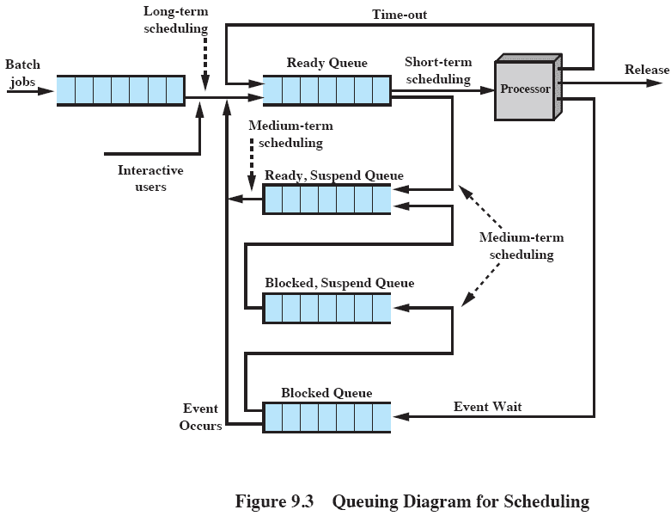
Queuing Diagram
Scheduling is a matter of managing queues to minimize queuing delay and to optimize performance.

Slide 9
Long-Term Scheduling
Determines which programs are admitted to the system for processing
  May be first-come-first-served
  Or, according to criteria such as priority, I/O requirements or expected execution time
Controls the degree of multiprogramming
  If more processes are admitted,
     less likely that all processes will be blocked → better processor utilization
     smaller percentage of time that each process can be executed → may limit to provide satisfactory service to the current set of processes

Slide 10
Medium-Term
Scheduling
Part of the swapping function
Swapping-in decisions are based on
  the need to manage the degree of multiprogramming
  the memory requirements of the swapped-out processes

Slide 11
Short-Term Scheduling
Short-term scheduler is also known as the dispatcher
Executes most frequently to decide which process to execute next
Invoked when an event occurs that may lead to the blocking of the current process or that may provide an opportunity to preempt a currently running process in favor of another
  Clock interrupts
  I/O interrupts
  OS calls
  Signals (e.g., semaphores)

Slide 12
Short-Term Scheduling
Criteria: User / System
Main objective is to allocate processor time to optimize certain aspects of system behaviour.
A set of criteria is needed to evaluate the scheduling policy
  User-oriented criteria
    Behavior of the system as perceived by individual user or process
    Example: response time in an interactive system
      Elapsed time between the submission of a request until there is output.
  System-oriented criteria
    Effective and efficient utilization of the processor
    Example: throughput
      Number of processes completed within a unit of time

Slide 13
Short-Term Scheduling
Criteria: Performance
Performance-related
  Quantitative
  Easily measured
  Example: response time and throughput
Non-performance related
  Qualitative
  Hard to measure
  Example: predictability (stable service provided to users over time)

Slide 14
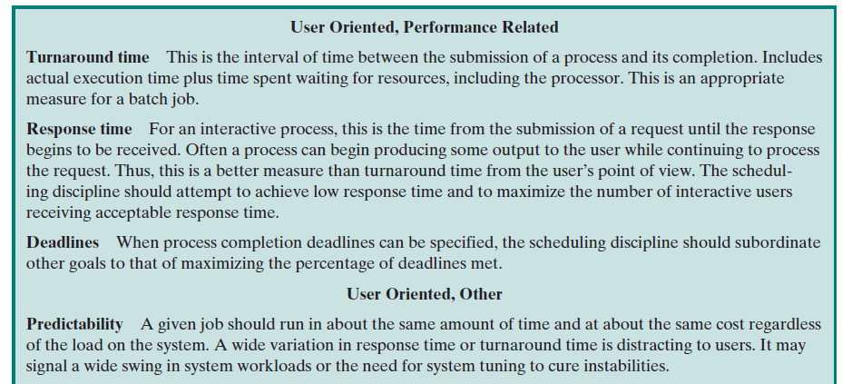
Scheduling Criteria

Slide 15
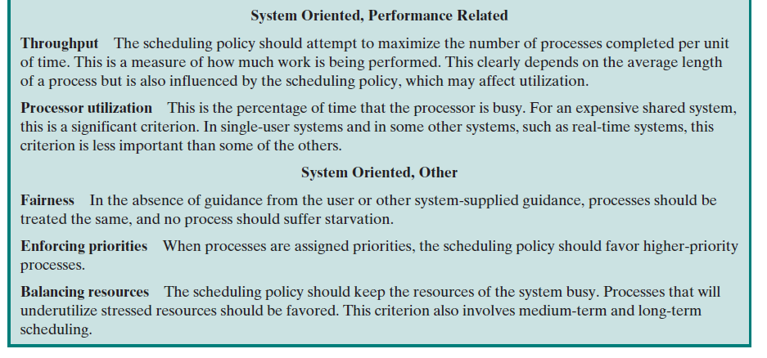
Scheduling Criteria (cont.)

Slide 16
Interdependent
Scheduling Criteria
Impossible to optimize all criteria simultaneously.
  Example: response time vs. throughput
    good response time requires frequent process switching which increases the system overhead, reducing throughput
Design of a scheduling policy involves compromising among competing requirements.

Slide 17
Priorities
In many systems, each process is assigned a priority.
Scheduler will always choose a process of higher priority over one of lower priority
  Problem: lower-priority may suffer starvation if there is a steady supply of high priority processes
  Solution: allow a process to change its priority based on its age or execution history

Slide 18
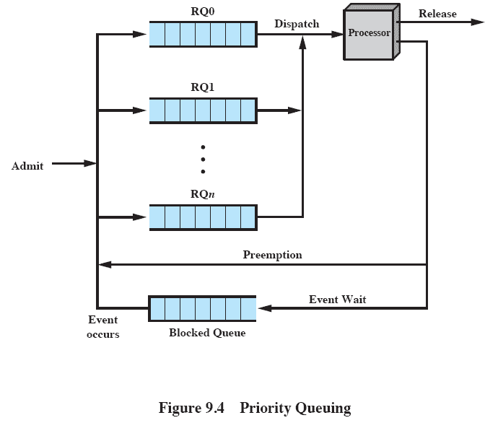
Priority Queuing
Have multiple ready queues, in descending order of priority: RQ0, RQ1, …, RQn.
The scheduler will start at the highest-priority ready queue (RQ0).
 Lower priority processes may suffer starvation.

Slide 19
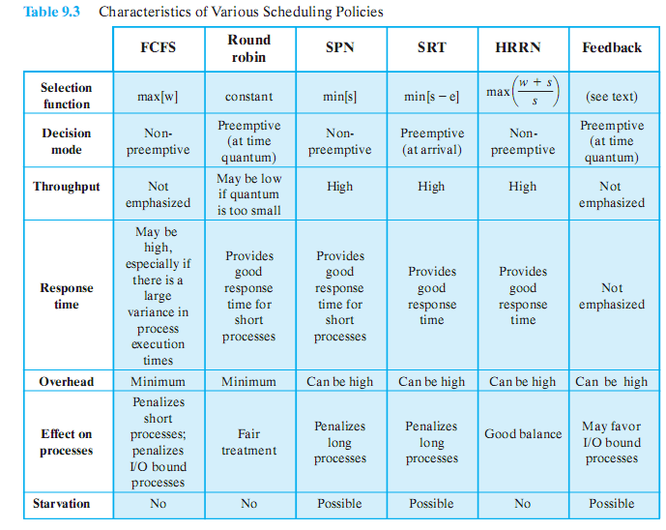
Alternative Scheduling
Policies

Slide 20
Roadmap
Types of Processor Scheduling
Scheduling Algorithms
  FCFS (First-Come-First-Serve)
  RR (Round-Robin)
  SPN (Shortest-Process-Next)
  SRT (Shortest-Remaining-Time)
  HRRN (Highest-Response-Ratio-Next)
  FB (Feedback)
Fair-Share Scheduling

Slide 21
Selection Function
Determines which process is selected next for execution
Important quantities based on execution characteristics:
  w = time spent waiting in system so far
  e = time spent in execution so far
  s = total service time required by the process, including e; generally, this quantity must be estimated or supplied by the user

Slide 22
Decision Mode:
Non-preemptive vs Preemptive
Specifies the instants in time at which the selection function is exercised.
Two categories of decision mode:
  Non-preemptive
    Once a process is in the running state, it will continue until it terminates or blocks itself for I/O or OS service
  Preemptive
    Currently running process may be interrupted and moved to ready state by the OS
    Preemption may occur
      when a new process arrives
      when an interrupt occurs that places a blocked process in the Ready state, or
      periodically, based on a clock interrupt

Slide 23
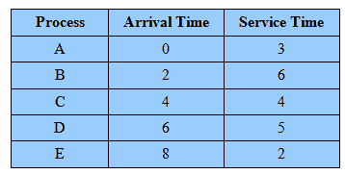
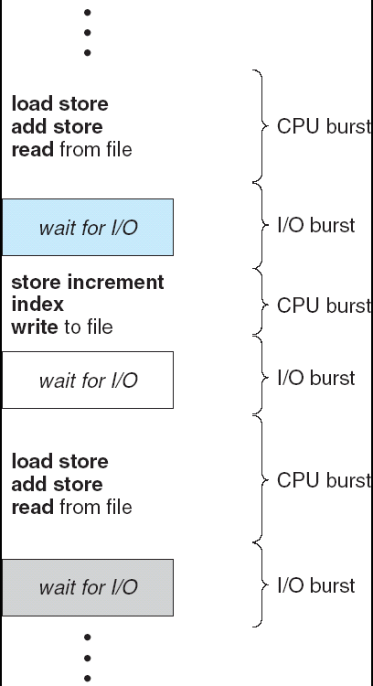
Process Scheduling
Example
Example set of processes
Process requires alternate use of the processor and I/O in a repetitive fashion.
The service times represent the processor time required in one cycle.

Slide 24
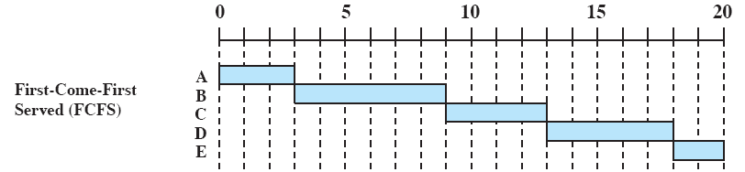
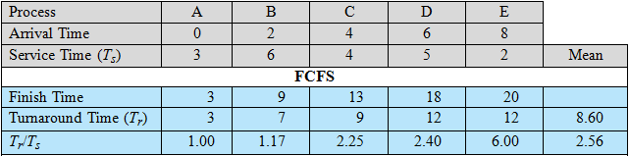
First-Come-First-Served
(FCFS)
Also known as first-in-first-out (FIFO) or strict queuing
When the current process ceases to execute, select the process that has been in the ready queue the longest

Slide 25
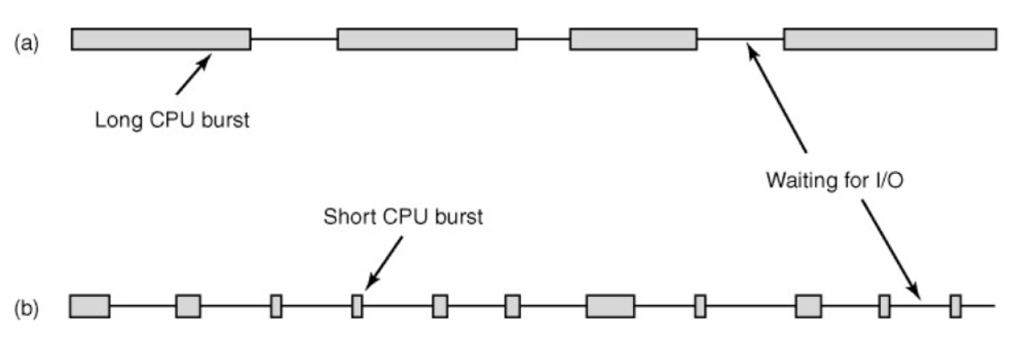
FCFS Performance
 Favors long processes over short ones
  A short process has to wait a long time when it arrives just after a long process
 Favors CPU-bound processes over I/O-bound ones
  May result in inefficient use of both the processor and the I/O devices
CPU-bound process
I/O-bound process

Slide 26
Round Robin (RR)
RR uses preemption based on a clock
  Clock interrupts are generated at periodic intervals
  When an interrupt occurs, the currently running process is placed in the ready queue, select next ready job on a FCFS basis
  also known as time slicing, because each process is given a slice of time (time quantum) before being preempted.
   Reduce the penalty that short jobs suffer with FCFS
   Particularly effective in a general-purpose time-sharing system

Slide 27
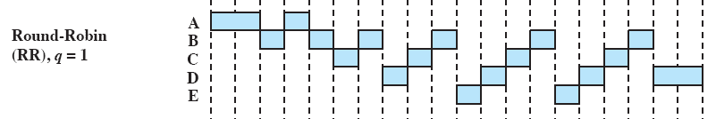
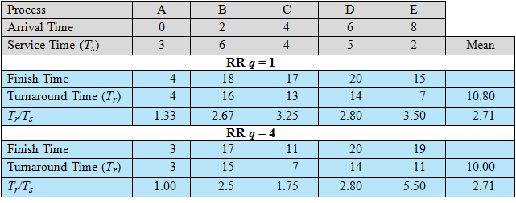
Round Robin

Slide 28
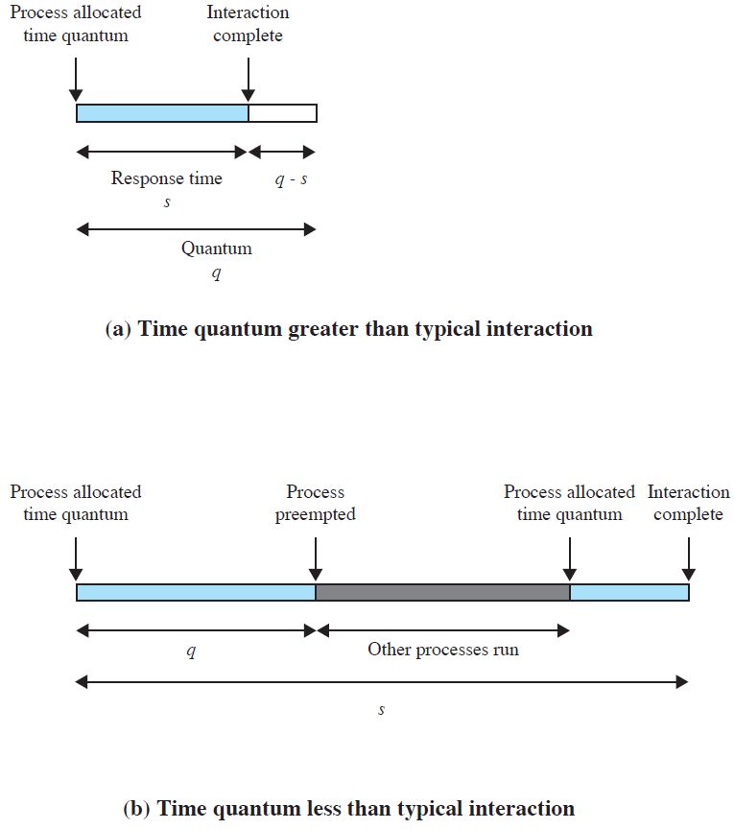
Effect of Size of
Preemption Time Quantum
Principal design issue: length of the time quantum
  Very short time quanta should be avoided because there is processing over-head in handling the clock interrupt and performing the scheduling and dispatching function.
  The time quantum should be slightly greater than the time required for a typical interaction.

Slide 29
RR Performance
 Favors CPU-bound processes over I/O-bound ones
  An I/O-bound process uses a processor for a short period and then is blocked before joining the ready queue again
  vs.
    A CPU-bound process uses a complete time quantum while executing and immediately returns to the ready queue.
  CPU-bound processes receive a greater portion of processor time →
    poor performance for I/O-bound processes
    inefficient use of I/O devices, and
    an increase in the variance of response time.

Slide 30
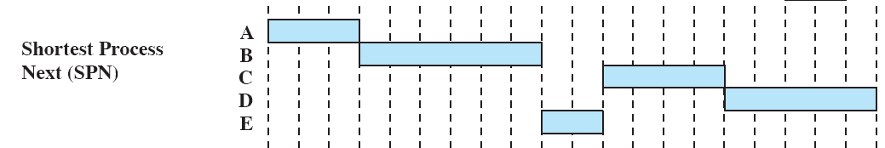

Shortest Process Next (SPN)
Nonpreemptive policy
Select process with shortest expected processing time
 Reduce the bias in favor of long processes in FCFS by allowing short processes jump ahead of longer processes.

Slide 31
SPN Performance
 Overall performance is significantly improved in terms of response time
 Need to know or estimate the required processing time of each process
  For batch jobs, programmers may be required to supply an estimate
  For repeating jobs, statistics may be gathered
 Variability of response times is increased, especially for longer processes
 Possibility of starvation for longer processes
 Because of the lack of preemption, late short processes may still be heavily penalized.

Slide 32
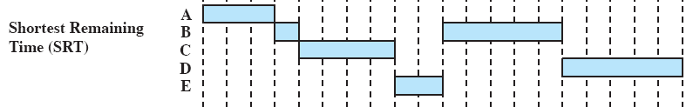
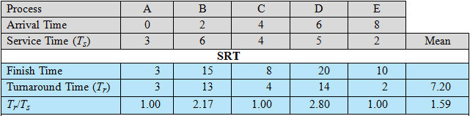
Shortest Remaining
Time (SRT)
Preemptive version of SPN
Select the process with the shortest expected remaining processing time

Slide 33
SRT Performance
 Does not have the bias in favor of long processes found in FCFS.
 Unlike RR, no additional interrupts are generated, reducing overhead.
  Preemption may occur when a new process becomes ready.
 Give superior turnaround time performance to SPN, because a short job is given immediate preference to a running longer job.
 Must estimate processing time and record elapsed service time.
 A risk of starvation of longer processes.

Slide 34

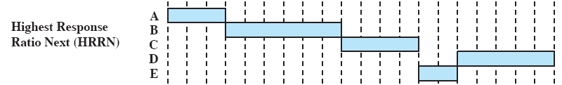
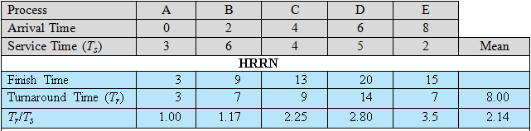
Highest Response
Ratio Next
Non-preemptive
Select next process with the greatest ratio, trying to minimize the normalized turnaround time
Response ratio (D) = (13-6+5)/5 = 2.4
Response ratio (E) = (13-8+2)/2= 3.5

Slide 35
HRRN Performance
 Shorter jobs are favored (a smaller denominator yields a larger ratio).
 Longer processes will eventually get past competing shorter jobs (aging without service also increases the ratio).
 As with SRT and SPN, the expected service time must be estimated.

Slide 36
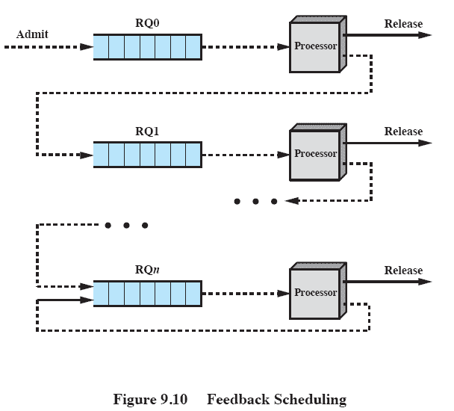
Feedback Scheduling (FB)
Service time may not be available or cannot be estimated.
Alternative solution: scheduling with preemptive and dynamic priority mechanism
  Penalize jobs that have been running longer by demoting to the next lower-priority queue
  Favors newer, shorter processes over older, longer ones.
When a process first enters the system, it is placed in the highest-priority queue
FCFS
FCFS
Each time it is preempted, it is demoted to the next lower-priority queue
RR

Slide 37
Feedback Performance
Variations:
  Pre-empts periodically, similar to round robin
    Longer processes may suffer starvation if new jobs are entering the system frequently
  A process scheduled from RQi is allowed to execute 2^{i} time units before preemption
    allow a greater time allocation at lower priority
  Promote a process to a higher-priority queue after it spends a certain amount of time waiting for service in its current queue

Slide 38
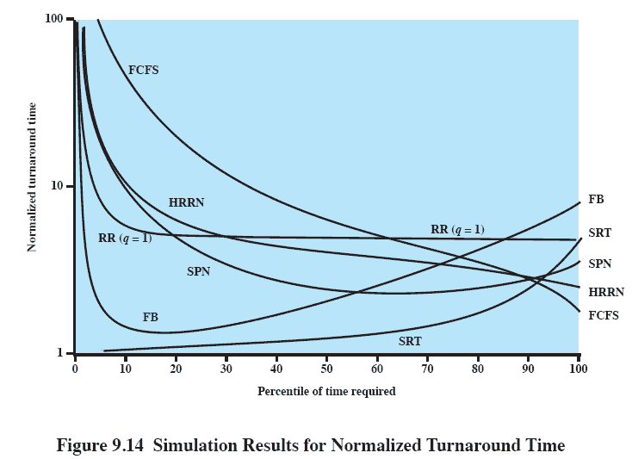
Performance Comparison
It is impossible to make definitive comparisons because relative performance will depend on a variety of factors.
short processes
long processes

Slide 39
Roadmap
Types of Processor Scheduling
Scheduling Algorithms
  FCFS (First-Come-First-Serve)
  RR (Round-Robin)
  SPN (Shortest-Process-Next)
  SRT (Shortest-Remaining-Time)
  HRRN (Highest-Response-Ratio-Next)
  FB (Feedback)
Fair-Share Scheduling

Slide 40
Fair-Share Scheduling
User’s application runs as a collection of processes (threads).
User is more concerned about the performance of the application, not a particular process.
Fair-share scheduling: make scheduling decisions based on process sets.
This concept can be extended to groups of users.

Slide 41
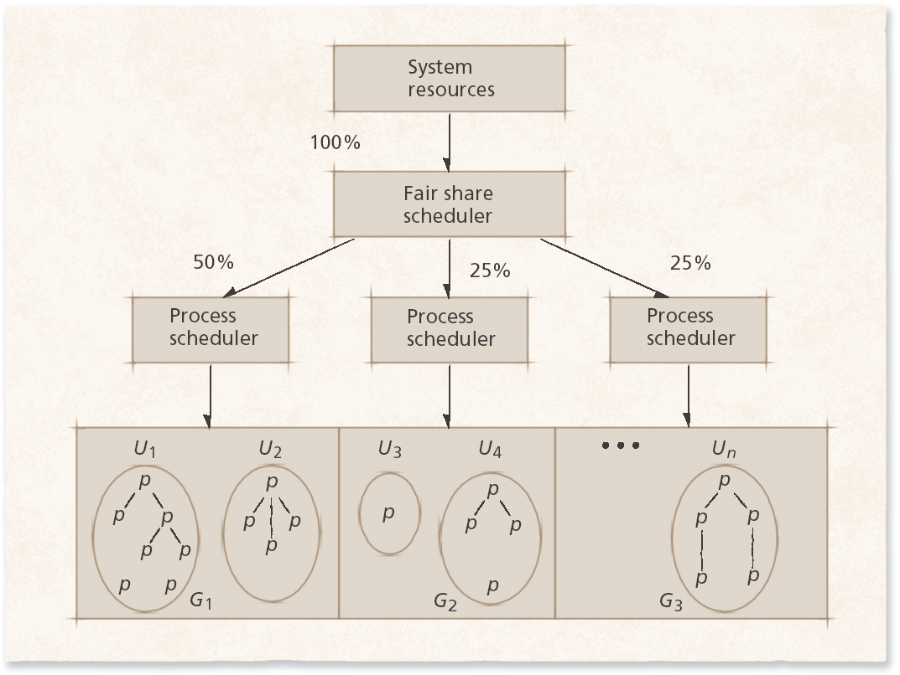
Fair-Share Scheduling
The user community is divided into a set of fair-share groups and a fraction of the processor resource is allocated to each group.

Slide 42
Fair-Share Scheduling
Scheduling is done on the basis of priority.
The fair-share groups are prioritized by how close they are to achieving their fair share.
  Groups doing poorly receive higher priority
  Groups doing well receive lower priority
Objectives:
  To give fewer resources to users who have had more than their fair share and
  To give more to those who have had less than their fair share

