Slide 1
EE2203 Modelling Techniques
Week 3
Nonlinear Optimization

Slide 2
Nonlinear optimization examples
Example: Revenue maximization
demand volume = func(price)
revenue = func(price * demand volume)
∴ revenue = func(price²)
nonlinear problem

Slide 3
Coastal Telephone Company (CTC) is a regional supplier of long-distance telephone services. CTC is trying to determine the optimal pricing structure for its daytime and evening long distance calling rates. The daytime price applies from 8:00 am to 6:00 pm, and the evening price applies the rest of the time. With the help of a consultant, the company has estimated the average demand for phone lines (per minute) as follows:
Daytime Lines Demanded = 600 – 5000 * Day Price + 300 *
Evening Price
Evening Lines Demanded = 400 + 600 * Day Price – 2500 *
Evening Price
CTC wants to find prices that maximize its revenue.

Slide 4
Decision variables:
day price DP
evening price EP
Objective:
total revenue
Measure of performance:
maximum total revenue
Calculations:
daytime lines demanded DD
evening lines demanded ED
Total revenue = 600*DD*DP + 840*ED*EP

Slide 5
function [DP, EP, RE] = ctc(…)
% [DP, EP, RE] = ctc(…)
% maximization using ??
% input:
% …
% output:
% DP = optimum day price
% EP = optimum evening price
% RE = maximum revenue
…
while (1)
…
DD = 600 - 5000*DP_temp + 300*EP_temp;
ED = 400 + 600*DP_temp - 2500*EP_temp;
RE_temp = 600*DD*DP_temp + 840*ED*EP_temp;
…
end
end

Slide 6
>> [DP, EP, RE] = ctc(…)
DP =
0.0702
EP =
0.0905
RE =
2.8042e+004
>>

Slide 7
Example: Inventory problem
product’s annual demand = D
need to determine quantity to order = Q
number of orders = D/Q
each order cost = K
ordering cost = KD/Q
inventory level varies from 0 to Q, average = Q/2
each product item held in inventory costs h
h is related to holding cost i and item cost c, h = ic
inventory cost = hQ/2
average total cost (ATC) = KD/Q + hQ/2

Slide 8
The Woodstock Appliance Company carries 4 products. The annual demands for these products, the costs, and occupied spaces are summarized in the table:
Product | 1 | 2 | 3 | 4
Demand | 5,000 | 10,000 | 30,000 | 300
Order cost | 400 | 700 | 100 | 250
Holding cost | 10% | 10% | 10% | 10%
Item cost | 500 | 250 | 80 | 1,000
Space | 12 | 25 | 5 | 20
The company has a warehouse of 12,000 square feet. The problem is to find the order quantities that minimize cost while respecting the limit on storage space.

Slide 9
Decision variables:
4 order quantities Q₁ to Q₄
Objective:
average total cost
Measure of performance:
minimize ATC = ATC₁ + ATC₂ + ATC₃ + ATC₄
Constraints:
storage space
each order quantity must be positive

Slide 10
function [Q1, Q2, Q3, Q4, COST] = woodstock(…)
% [Q1, Q2, Q3, Q4, COST] = woodstock(…)
% minimization using ??
% input:
% …
% output:
% Q1 = optimum order quantity of product 1
% Q2 = optimum order quantity of product 2
% Q3 = optimum order quantity of product 3
% Q4 = optimum order quantity of product 4
% COST = minimum total cost
…
while (1)
…
OPY1 = 5000/Q1_temp;
OC1 = OPY1 * 400;
AI1 = Q1_temp/2;
IC1 = 500*0.1*AI1;
AC1 = OC1 + IC1;
…
COST_temp = AC1 + AC2 + AC3 +AC4;
S1 = Q1_temp*12/2;
S2 = Q2_temp*25/2;
S3 = Q3_temp*5/2;
S4 = Q4_temp*20/2;
TS = S1 + S2 + S3 + S4;
if Q1_temp>0 && Q2_temp>0 && Q3_temp>0 && Q4_temp>0 && TS<=12000
…
end
…
end
end

Slide 11
>> [Q1, Q2, Q3, Q4, COST] = woodstock(…)
Q1 =
269
Q2 =
645
Q3 =
784
Q4 =
36
COST =
4.3921e+004
>>

Slide 12
Tips:
to help determine whether the local optimum is also a global optimum, restart at a different set of decision variables and rerun.
if several widely differing starting points lead to the same local optimum, the local optimum is likely to be a global optimum

Slide 13
4.3.4 MATLAB built-in functions
MATLAB has a built-in function, fminbnd, which combines the golden-section search and the parabolic interpolation
[xmin, fval] = fminbnd(function, x1, x2)
xmin and fval are the location and value of the minimum
function is the name of the function
x1 and x2 are the bounds of the interval

Slide 14
the function to be minimized must be continuous
may only give local solutions
often exhibits slow convergence when the solution is on a boundary of the interval

Slide 15
Example
Find the minimum of the function f(x) = x² – sin(x) on the interval [0, 1].
>> f = @(x) x^2-sin(x);
>> [x, f] = fminbnd(f, 0, 1)
x =
0.4502
f =
-0.2325
>>

Slide 16
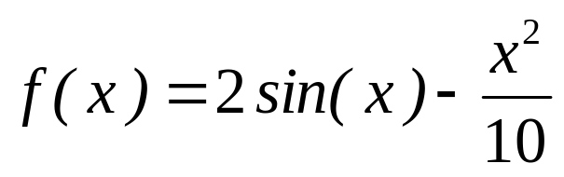
Example
Find the maximum of the function
on the interval [0, 4].
>> f = @(x) -(2*sin(x)- x^2/10);
>> [x, f] = fminbnd(f, 0, 4)
x =
1.4275
f =
-1.7757
>>
Value of the maximum is 1.7757

Slide 17
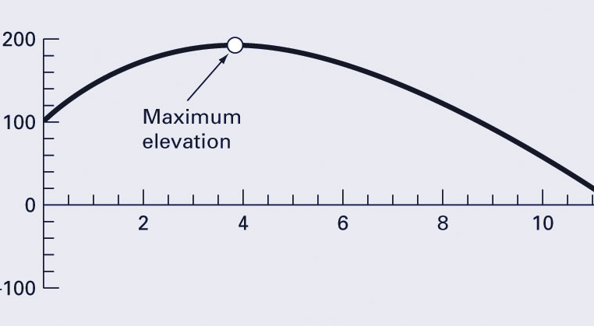
Another example:
Bungee jumper’s altitude

Slide 18
>> g=9.81; v0=55; m=80; c=15; z0=100;
>> z=@(t) –(z0+m/c*(v0+m*g/c)*(1-exp(-c/m*t))-m*g/c*t);
>>[x,f]=fminbnd(z,0,8)
x =
3.8317
f =
-192.8609

Slide 19
>> options = optimset('display', 'iter');
>> fminbnd(z,0,8,options)
Func-count x f(x) Procedure
1 3.05573 -189.759 initial
2 4.94427 -187.19 golden
3 1.88854 -171.871 golden
4 3.87544 -192.851 parabolic
5 3.85836 -192.857 parabolic
6 3.83332 -192.861 parabolic
7 3.83162 -192.861 parabolic
8 3.83166 -192.861 parabolic
9 3.83169 -192.861 parabolic
Optimization terminated:
the current x satisfies the termination criteria using OPTIONS.TolX of 1.000000e-04
ans =
3.8317

Slide 20
MATLAB has a built-in function, fminsearch, which uses the Nelder-Mead method
[xmin, fval] = fminsearch(function, x1, x2)
xmin and fval are the location and value of the minimum
function is the name of the function
x1 and x2 are the bounds of the interval

Slide 21
can often handle discontinuity (non-smooth function), particularly if it does not occur near the solution
may only give local solutions

Slide 22
Example
Find the minimum of the function
in the range -2 ≤ x₁ ≤ 0 and 0 ≤ x₂ ≤ 3.
>> f = @(x) 2+x(1)-x(2)+2*x(1)^2+2*x(1)*x(2)+x(2)^2;
>> [x, f] = fminsearch(f, [-2 3])
x =
-1.0000 1.5000
f =
0.7500
>>

Slide 23
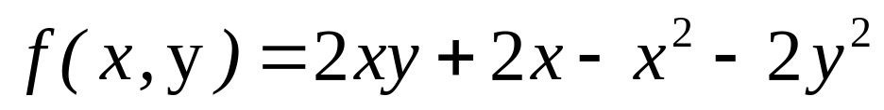
Example
Find the maximum of the function
in the range 0 ≤ x ≤ 3 and 0 ≤ y ≤ 3.
>> f = @(x) -(2*x(1)*x(2)+2*x(1)-x(1)^2-2*x(2)^2);
>> [x, f] = fminsearch(f, [0 3])
x =
2.0000 1.0000
f =
-2.0000
>>
Value of the maximum is 2.0000

Slide 24
Summary
nonlinear optimization examples
optimization using MATLAB built-in functions
Reference
Chapter 7, Applied Numerical Methods with MATLAB for Engineers and Scientists

