Slide 1
CS2311 Computer Programming
Dr. Henry Xu
Lecture 12: File I/O

Slide 2
Outline
Stream
Open File
File I/O
Error Handling

Slide 3
File I/O vs. Console I/O
“Console” refers to “keyboard + screen”
Keyboard input and screen output are volatile
Input file can be used again and again
Useful for debugging especially when volume of data is huge
Allow off-line processing
Output file retains the results after execution

Slide 4

Basic I/O – Keyboard and Screen
Program read input from keyboard (console) or disk storage (file) and write data to screen (console ) or disk storage(file)
Sequence of inputs is conceptually treated as an object called “Stream”
Stream – a flow (sequence) of data
Input stream – a flow of data into your program
Output stream – a flow of data out of your program

Slide 5
Streams
Predefined console streams in C++
  #include <iostream>
  cin : input stream physically linked to the keyboard
  cout: output stream physically linked to the screen
File streams class in C++
  #include <fstream>
  ifstream: stream class for file input
  ofstream: stream class for file output
To declare an objects of class ifstream or ofstream, use
  ifstream fin; // fin is the variable name
  Ofstream fout;// fout is the variable name

Slide 6
ifstream
To declare an ifsteam object
  ifstream fin;
To open a file for reading
  fin.open(“infile.dat”);
To read the file content
  fin >> x; //x is a variable
To close the file
  fin.close();

Slide 7
ofstream
To declare an ofsteam object
  ofstream fout;
To open a file for writing
  fout.open(“myfile.dat”) ;
To write something to the file
  fout << x; //x is a variable
To close the file
  fout.close();
PS: fin.open() and fout.open() refer to different functions

Slide 8
Examples
#include <fstream>
using namespace std;
void main(){
ifstream fin;
ofstream fout;
int x,y,z;
fin.open("input.txt");
fout.open("output.txt");
fin >>x>>y>>z;
fout << “The sum is “<<x+y+z;
fin.close();
fout.close();
}
3 4 7
The sum is 14

Slide 9
Open a file
An open file is represented within a program by a stream (i.e. an object of ifstream or ofstream), and any I/O performed on this stream object will be applied to the file associated with it.
To open a file, use the member function open with the stream object: open(filename, mode);
filename: a string
mode: optional

Slide 10
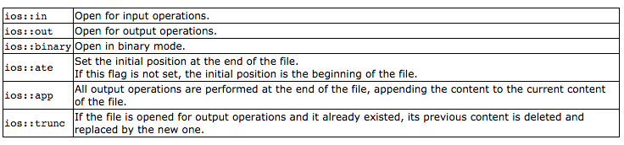
Modes for file I/O
Example:
ofstream fout;
fout.open(image_filename,ios::binary);

Slide 11
Detecting I/O failures
Member function fail() returns true if and only if the previous I/O operation on that stream fails
E.g. file not exists when opening an input stream
PS: one may call function exit() when an I/O operation fails to abort the program execution.
the argument in exit() is returned to the calling party -- usually the OS

Slide 12
Examples
#include <iostream>
#include <fstream>
Using namespace std;
void main(){
ifstream in1, in2;
in1.open(“infile1.dat”);
in2.open(“infile2.dat”);
if (in1.fail()) {
cout << “Input file 1 opening failed.\n”;
exit(1); // 1 stands for error
}
...

Slide 13
Detecting end-of-file (EOF)
Member function eof returns true if and only if we reach the end of the input file (no more data)
  Only for objects of class ifstream
  E.g. fin >> x;
if (!fin.eof()) ...
The expression fin >> x has value 0 if fin has no more data
  E.g. while (fin>> x)
{...}

Slide 14
Examples: file dump (integer only)
#include <iostream>
#include <fstream>
using namespace std;
void main(){
ifstream fin;
int x;
fin.open("input.txt");
while (!fin.eof()){
fin >> x;
cout <<x<<" ";
}
}

Slide 15
Text files
When ios::binary is not set, the file is treated as a text file. All input/output is assumed to be text, and may suffer formatting transformations.
I/O for text files is similar to I/O for console, i.e. through the input/output operators >> and <<
Read:
  fin.get(): get a single character
  fin.getline(char str[], size): read the file line by line

Slide 16
Binary files
When ios::binary is set, all I/O is performed on a binary basis. The byte values are directly used independent of formatting considerations.
Input/output operators may not be efficient for binary files, unless you want to read/write in text format. Specific functions can be used.
fin.read(char* target, int num)
fin.write(const char* source, int num)

Slide 17
Binary files
fin.read(char* target, int num)
target: a pointer to char (1 byte). It represents the address of an array of bytes (a memory block) where the data can be stored.
num: The integer size of the memory block (how many bytes)

Slide 18
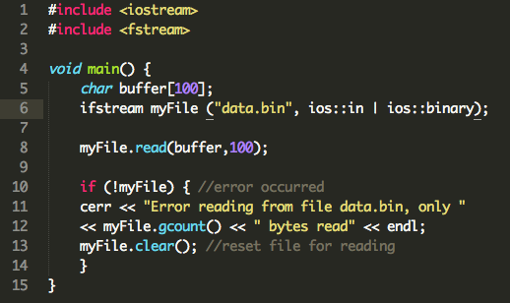
An example of binary file I/O

Slide 19
Examples: file dump (integer only)
#include <iostream>
#include <fstream>
using namespace std;
void main(){
ifstream fin;
int x;
fin.open("input.txt");
while (fin >> x){
cout <<x<<" ";
}
}
return 0 if fin has no more data

Slide 20
Reference Only: I/O Re-directions
A facility offered by many OS’s
Allows the program input and output to be redirected from/to specified files
E.g. suppose you have an executable file hello.exe. If you type:
hello > outfile1.dat
in the MSDOS prompt, the output is written to the file outfile1.dat instead of the screen
Similarly, hello < infile1.dat specifies that the input is from infile1.dat instead keyboard

