Slide 1
GE1202 Managing Your Personal Finance
Lecture 6 (Continue)
Insuring Your Health

Slide 2
Importance of Health Insurance
Two medical systems in HK
  Public medical system
    Low cost
    Huge shortage
  Private medical system
    High cost
    Efficient
A serious illness or accident can involve not only physical pain from sickness and injury, but also economic pain
  Health insurance helps you pay for the costs associated

Slide 3
Private Services
Fees charged by private practitioners in Hong Kong, vary from $100 to $250 or more for a specialist consultation
Most of the cases, it only include the cost of medicine, but separate charges for laboratory test, X-ray exam, etc
Treatment in private hospitals can charges vary from $380 a day for a bed in a general ward to $980 or more for a first class ward
Patients have to pay for all services, such as medicines and dressings, besides the daily charge for doctors visit

Slide 4
Health Insurance Decisions
Evaluate Your Health Care Cost Risk
  Two types of losses that can result from illness or accidents
    Expenses for medical care and rehabilitation
    Loss of income or household services caused by an inability to work.
Determine Available Coverage and Resources
  Public medical system
  Some employers offer employees basic coverage
Choose a Health Insurance Plan
  Compare your needs with the plans offered by difference firms

Slide 5
Components of Hospital Insurance
Part A – Basic hospital insurance
  Covers hospital room and board, other inpatient and outpatient care
  Deductibles apply, amounts vary according to length of stay
Part B- Supplementary medical insurance
  Optional coverage available for a premium
  Covers doctors, surgeons, lab tests, x-rays, and other services, including some home health care

Slide 6
Medical Expense Coverage
Hospitalization
  A hospitalization insurance policy will reimburse you for the cost of your stay
  Usually pay for a portion of
    Daily routine services – room rate, meals, etc
    Ancillary services – laboratory tests, imaging, etc
  May cover some outpatient and out-of-hospital services
    In-home rehabilitation, diagnostic treatment, etc
  Most policies set a limit on the number of days of hospitalization and a maximum dollar amount on ancillary services that they will pay for

Slide 7
Medical Expense Coverage
Surgical Expenses
  Covers the cost of surgery in or out of the hospital
  Pay according to a schedule of benefits
    Reimbursing up to a fixed maximum for a particular surgical procedure
  Not all procedures are covered
    Cosmetic or experimental surgery
Physician Expenses
  Pays physician fees for nonsurgical hospital care
Regular medical expense
  Covers the cost of visits to a doctor’s office or for a doctor’s hospital visits, including consultation with a specialist
  Also covered imaging and laboratory tests performed outside of a hospital

Slide 8
Medical Expense Coverage
Major Medical Insurance
  Provide broad coverage for nearly all types of medical expenses resulting from either illnesses or accidents
  Finance more catastrophic medical costs
  May have lifetime limits
Comprehensive Major Medical Insurance
  Combines basic hospitalization, surgical, and physician expense coverage with major medical protection into a single policy
Dental insurance
  Covers necessary dental care and some dental injuries sustained through accidents
  Maximum limit on most dental policies is often low

Slide 9
Medical Expense Coverage
Insurance companies offer other options that provide limited protection against certain types of perils
  Accident policies
    Pay a specified sum to an insured injured in a certain type of accident
  Sickness policies
    Dread disease policies
    Pay a specified sum for a named disease
  Hospital income policies
    Promise to guarantee a specific daily, weekly, or monthly amount as long as the insured is hospitalized.
Most limited-peril policies should be used only to supplement a comprehensive insurance program if the coverage is not overlapping.

Slide 10
Policy Provisions
Policy provisions can be divided into two groups
  Terms of payment
    Deductibles
    The participation (co-insurance) clause
    The policy’s internal limits
    The coordination of benefits clause
  Terms of coverage
    The persons and places covered
    Cancellation
    Preexisting conditions
    Pregnancy and abortion
    Mental illness
    Rehabilitation coverage
    Continuation of group coverage

Slide 11
Terms of Payment
Deductibles
  The initial amount not covered by an insurance policy
  Determined on a calendar-year basis or on a per-illness or per-accident basis
Participation (Co-insurance)
  The insurer will pay some portion (80 or 90 percent) of the amount of the covered loss in excess of the deductible
  Reduce the incentive for policyholders to fake an illness
  Discourages unnecessary medical expenses

Slide 12
Terms of Payment
Internal Limits
  Control the amounts paid for certain specified expenses, even if the claim does not exceed overall policy limits
    Hospital room and board, surgical fees, mental and nervous conditions, nursing services
Coordination of Benefits
  To prevent the insured from collecting more than 100 percent of covered charges from more than one policy
  Eliminates double payment when coverage provided under more than one policy

Slide 13
Example
A medical insurance policy that specifies $500,000 lifetime limit of protection, a $1,000 deductible, an 80% co-insurance clause, internal limits of $350 per day on hospital room and board, and $6,000 as the maximum payable surgical fee.

Slide 14
Terms of Coverage
Persons and Places Covered
  Individual vs Family members
  Country specific vs worldwide
Cancellation
  Permit cancellation at the insurer’s option at any time
Pre-existing Conditions
  The policy might exclude coverage for physical or mental problems that you had at the time you bought it
  Permanent vs temporary

Slide 15
Terms of Coverage
Pregnancy and abortion
  Special clauses for medical expenses incurred through pregnancy or abortion
Mental illness
  No or reduced benefits for treatment of mental disorders
Rehabilitation Coverage
  Counseling, occupational therapy
  Educational or job training programs
Continuation of group Coverage
  Employee who leaves the insured group voluntarily or involuntarily

Slide 16
Cost Containment Provisions
Preadmission certification
  Approval from your insurer before entering the hospital for a scheduled stay
Continued stay review
  Approval from the insurer for any stay that exceeds the originally approved limits
Second surgical opinions
  Second opinions on specific non- emergency procedures
Waiver of co-insurance
  Waive the co-insurance clause for outpatient procedures
Limitation of insurer’s responsibility
  Limitations on the type and place of medical care for which the insurer will pay

Slide 17
Disability Income Insurance
Disability income insurance
  Provides families with weekly or monthly payments to replace income when the insured is unable to work because of a covered illness, injury, or disease
Social Security in Hong Kong
  Permanent Disability allowance
    HK$1,650 a month (normal rate)
    HK$3,300 a month (higher rate)
  Disability benefit
    HK$3,340 to $5,690 a month for a person living alone
    HK$3,150 to $5,220 if living with other family members
  Benefits are payable only if your disability is expected to last at least one year (or to be fatal), and they don’t begin until you’ve been disabled for at least five months

Slide 18
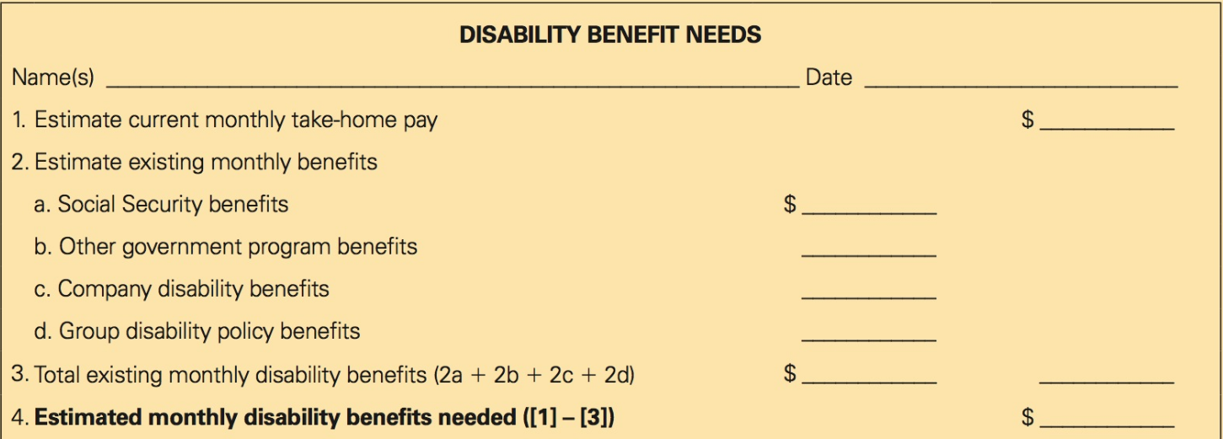
Estimating Your Disability Insurance Needs

Slide 19
Disability Income Insurance Provisions and Costs
Definition of Disability
  Own occupation definition
    Unable to perform the duties of your customary occupation
  Any occupation definition
    Can engage in no gainful employment at all
  Presumptive disability clause
    Presumed totally disabled and may receive full benefits even though he or she still can be employed in some capacity when certain types of losses occur
    Loss of both hands, sight in both eyes, and hearing in both ears

Slide 20
Disability Income Insurance Provisions and Costs
Benefit Amount and Duration
  A flat monthly benefit under individual policy
  A fixed percentage of gross income under group policy
  No policies for the full amount of gross income
    Incentive to fake a disability
  A few months to a lifetime
Probationary Period
  A time delay from the date the policy is issued until benefit privileges are available
  7 to 30 days

Slide 21
Disability Income Insurance Provisions and Costs
Waiting (Elimination) Period
  The period after an insured meets the policy’s eligibility requirements, during which he or she must pay expenses out-of-pocket
  When the waiting period expires, the insured begins to receive benefits
  30 days to a year
  Trade off
    Shorter waiting period vs longer duration of benefits

Slide 22
Disability Income Insurance Provisions and Costs
Renewability
  Guaranteed renewable
    Renew the policy until you reach the age stated in the clause
  Non-cancelable
    Guaranteed renewability
    Stable premium guarantee
    More expensive
Cost-of-living adjustment (COLA)
  The monthly benefit is adjusted upward each year

