Slide 1
EE3114 Systems and Control
Tutorial - 11
Semester A, 2018-19
2018-11-28

Slide 2
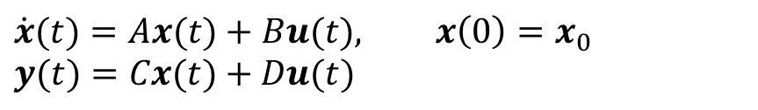

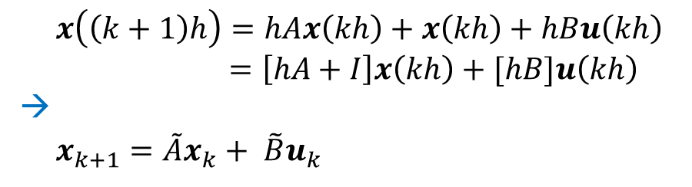
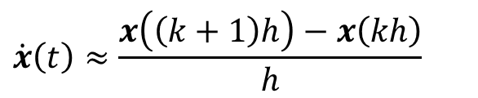
Discrete-Time LTI Systems
$$\dot{x}(t)=Ax(t)+Bu(t), x\left(0\right)=x_{0}$$
$$y(t)=Cx(t)+Du(t)$$
t
0 h 2h 3h kh (k+1)h
$$\dot{x}\left(t\right)≈\frac{x\left(\left(k+1\right)h\right)−x\left(kh\right)}{h}$$
$x\left(\left(k+1\right)h\right)=hAx\left(kh\right)+x\left(kh\right)+hBu\left(kh\right)$
$=\left[hA+I\right]x\left(kh\right)+[hB]u\left(kh\right)$
→
$x_{k+1}=\tilde{A}x_{k}+ {\tilde{B}u}_{k}$
Easily:
$y_{k}=\tilde{C}x_{k}+\tilde{D}u_{k}=Cx_{k}+Du_{k}$

Slide 3

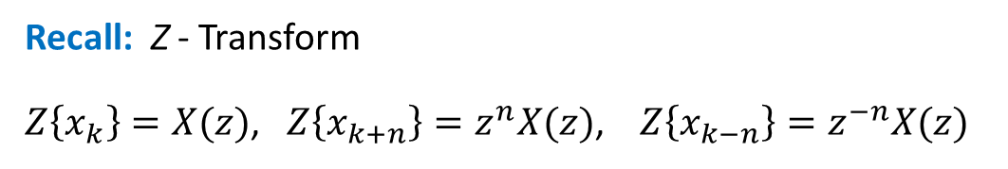
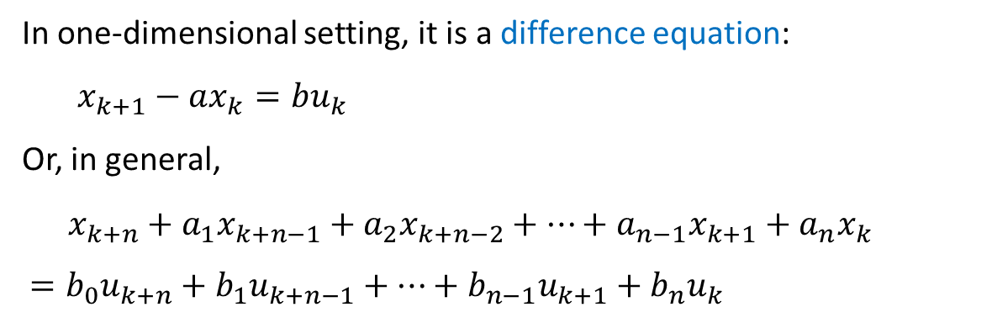
Difference Equations
$$x_{k+1}=\tilde{A}x_{k}+ {\tilde{B}u}_{k}$$
In one-dimensional setting, it is a difference equation:
$x_{k+1}−ax_{k}={bu}_{k}$
Or, in general,
$$x_{k+n}+a_{1}x_{k+n−1}+a_{2}x_{k+n−2}+⋯+a_{n−1}x_{k+1}+a_{n}x_{k}$$
$$=b_{0}u_{k+n}+b_{1}u_{k+n−1}+⋯+b_{n−1}u_{k+1}+b_{n}u_{k}$$
Recall: Z - Transform
$Z\left\{x_{k}\right\}=X(z)$, $Z\left\{x_{k+n}\right\}=z^{n}X(z)$, $Z\left\{x_{k−n}\right\}=z^{−n}X(z)$
$$z^{n}X\left(z\right)+a_{1}z^{n−1}X\left(z\right)+⋯+a_{n−1}zX\left(z\right)+a_{n}X\left(z\right)=b_{0}z^{n}U\left(z\right)+⋯+b_{n}U(z)$$
Transfer Function: $G\left(z\right)=\frac{X(z)}{U(z)}=\frac{b_{0}z^{n}+b_{1}z^{n−1}+⋯+b_{n−1}z+b_{n}}{z^{n}+a_{1}z^{n−1}+⋯+a_{n−1}z+a_{n}}$

Slide 4
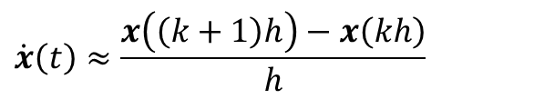

0 h 2h 3h kh (k+1)h
$$\dot{x}\left(t\right)≈\frac{x\left(\left(k+1\right)h\right)−x\left(kh\right)}{h}$$
Exercise:
Convert the following one-dimensional differential equation to a difference equation:
$$\ddot{x}\left(t\right)+2\dot{x}\left(t\right)−x\left(t\right)=u(t)$$
(10 minutes)

Slide 5
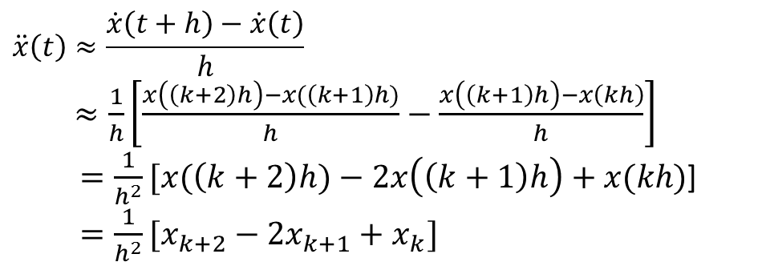

0 h 2h 3h kh (k+1)h
$$\dot{x}\left(t\right)≈\frac{x\left(\left(k+1\right)h\right)−x\left(kh\right)}{h}$$
Exercise:
Convert the following one-dimensional differential equation to a difference equation:
$$\ddot{x}\left(t\right)+2\dot{x}\left(t\right)−x\left(t\right)=u(t)$$
Solution:
$$\ddot{x}\left(t\right)≈\frac{\dot{x}\left(t+h\right)−\dot{x}\left(t\right)}{h}$$
$≈\frac{1}{h}\left[\frac{x\left(\left(k+2\right)h\right)−x(\left(k+1\right)h)}{h}−\frac{x\left(\left(k+1\right)h\right)−x\left(kh\right)}{h}\right]$
$=\frac{1}{h^{2}}[x(\left(k+2\right)h)−2x\left(\left(k+1\right)h\right)+x(kh)$]
$=\frac{1}{h^{2}}[x_{k+2}−2x_{k+1}+x_{k}]$

Slide 6

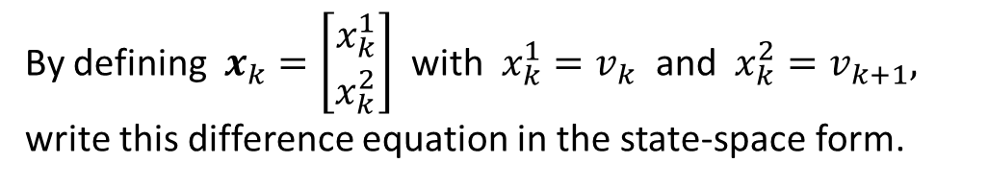
Exercise: Consider the following difference equation:
$$v_{k+2}+v_{k+1}+v_{k}=u_{k}$$
By defining $x_{k}=\left[\begin{matrix}x_{k}^{1} \\ x_{k}^{2}\end{matrix}\right]$ with $x_{k}^{1}=v_{k}$ and $x_{k}^{2}=v_{k+1},$ write this difference equation in the state-space form.
(5 minutes)

Slide 7

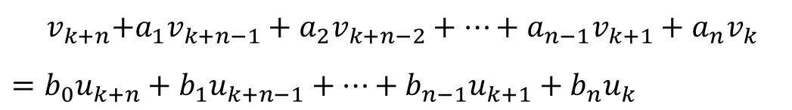
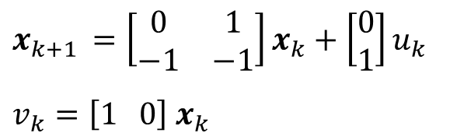
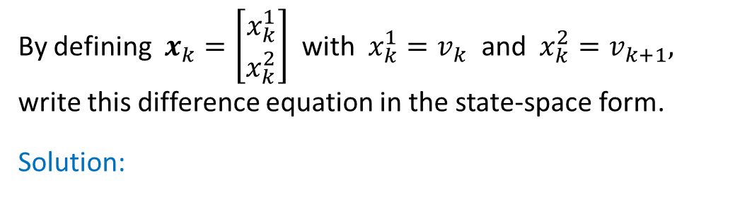
Exercise: Consider the following difference equation:
$$v_{k+2}+v_{k+1}+v_{k}=u_{k}$$
By defining $x_{k}=\left[\begin{matrix}x_{k}^{1} \\ x_{k}^{2}\end{matrix}\right]$ with $x_{k}^{1}=v_{k}$ and $x_{k}^{2}=v_{k+1},$ write this difference equation in the state-space form.
Solution:
$$x_{k+1 }=\left[\begin{matrix}0 & 1 \\ −1 & −1\end{matrix}\right]x_{k}+\left[\begin{matrix}0 \\ 1\end{matrix}\right]u_{k}$$
$$v_{k}=\left[1 0\right]{ x}_{k}$$
Next, consider the following general difference equation:
$${ v}_{k+n}+a_{1}v_{k+n−1}+a_{2}v_{k+n−2}+⋯+a_{n−1}v_{k+1}+a_{n}v_{k}$$
$$=b_{0}u_{k+n}+b_{1}u_{k+n−1}+⋯+b_{n−1}u_{k+1}+b_{n}u_{k}$$

Slide 8
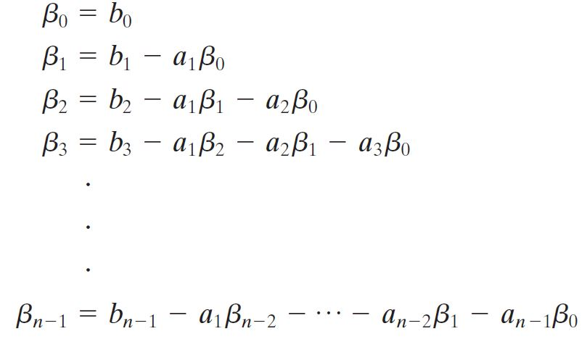
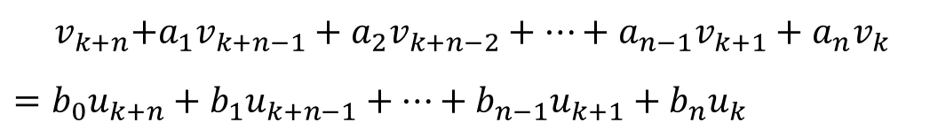
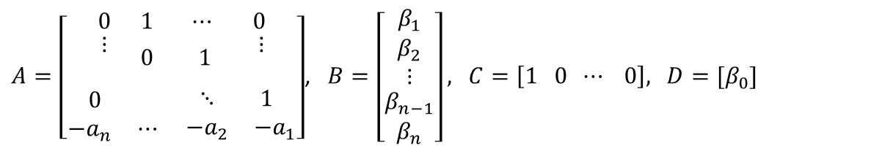
General difference equation:
$${ v}_{k+n}+a_{1}v_{k+n−1}+a_{2}v_{k+n−2}+⋯+a_{n−1}v_{k+1}+a_{n}v_{k}$$
$$=b_{0}u_{k+n}+b_{1}u_{k+n−1}+⋯+b_{n−1}u_{k+1}+b_{n}u_{k}$$
State-Space Canonical form:
$A=\left[\begin{aligned}\begin{matrix}0 & 1 \\ \begin{aligned}⋮ \\ \end{aligned} & 0\end{matrix} \begin{matrix}⋯ & 0 \\ 1 & \begin{aligned} ⋮ \\ \end{aligned}\end{matrix} \\ \begin{matrix} 0 & \\ −a_{n} & ⋯\end{matrix} \begin{matrix}⋱ & 1 \\ −a_{2} & −a_{1}\end{matrix}\end{aligned}\right]$, $B=\left[\begin{aligned}\begin{matrix}β_{1} \\ β_{2}\end{matrix} \\ ⋮ \\ \begin{matrix}β_{n−1} \\ β_{n}\end{matrix}\end{aligned}\right],$ $C=\left[1 0 ⋯ 0\right],$ $D=[β_{0}]$

Slide 9
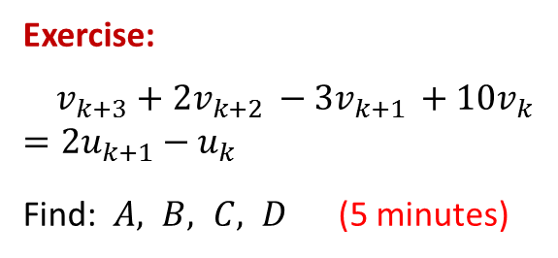
General difference equation:
$${ v}_{k+n}+a_{1}v_{k+n−1}+a_{2}v_{k+n−2}+⋯+a_{n−1}v_{k+1}+a_{n}v_{k}$$
$$=b_{0}u_{k+n}+b_{1}u_{k+n−1}+⋯+b_{n−1}u_{k+1}+b_{n}u_{k}$$
State-Space Canonical form:
$A=\left[\begin{aligned}\begin{matrix}0 & 1 \\ \begin{aligned}⋮ \\ \end{aligned} & 0\end{matrix} \begin{matrix}⋯ & 0 \\ 1 & \begin{aligned} ⋮ \\ \end{aligned}\end{matrix} \\ \begin{matrix} 0 & \\ −a_{n} & ⋯\end{matrix} \begin{matrix}⋱ & 1 \\ −a_{2} & −a_{1}\end{matrix}\end{aligned}\right]$, $B=\left[\begin{aligned}\begin{matrix}β_{1} \\ β_{2}\end{matrix} \\ ⋮ \\ \begin{matrix}β_{n−1} \\ β_{n}\end{matrix}\end{aligned}\right],$ $C=\left[1 0 ⋯ 0\right],$ $D=[β_{0}]$
Exercise:
$v_{k+3}+2v_{k+2 }−3v_{k+1 }+10v_{k}$
$=2u_{k+1}−u_{k}$
Find: $A, B, C, D$ (5 minutes)

Slide 10
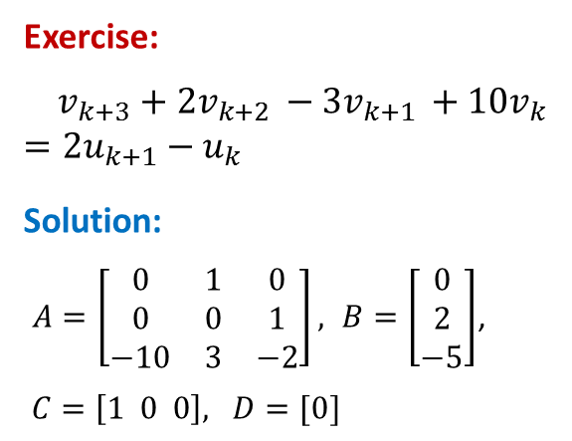
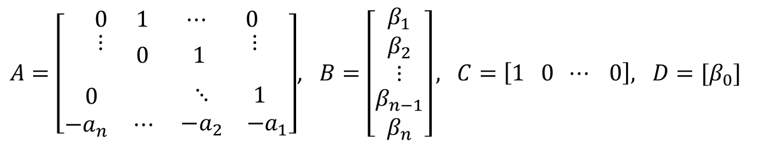
General difference equation:
$${ v}_{k+n}+a_{1}v_{k+n−1}+a_{2}v_{k+n−2}+⋯+a_{n−1}v_{k+1}+a_{n}v_{k}$$
$$=b_{0}u_{k+n}+b_{1}u_{k+n−1}+⋯+b_{n−1}u_{k+1}+b_{n}u_{k}$$
State-Space Canonical form:
$A=\left[\begin{aligned}\begin{matrix}0 & 1 \\ \begin{aligned}⋮ \\ \end{aligned} & 0\end{matrix} \begin{matrix}⋯ & 0 \\ 1 & \begin{aligned} ⋮ \\ \end{aligned}\end{matrix} \\ \begin{matrix} 0 & \\ −a_{n} & ⋯\end{matrix} \begin{matrix}⋱ & 1 \\ −a_{2} & −a_{1}\end{matrix}\end{aligned}\right]$, $B=\left[\begin{aligned}\begin{matrix}β_{1} \\ β_{2}\end{matrix} \\ ⋮ \\ \begin{matrix}β_{n−1} \\ β_{n}\end{matrix}\end{aligned}\right],$ $C=\left[1 0 ⋯ 0\right],$ $D=[β_{0}]$
Exercise:
$v_{k+3}+2v_{k+2 }−3v_{k+1 }+10v_{k}$
$=2u_{k+1}−u_{k}$
Solution:
$A=\left[\begin{matrix}0 & 1 & 0 \\ 0 & 0 & 1 \\ −10 & 3 & −2\end{matrix}\right], B=\left[\begin{matrix}0 \\ 2 \\ −5\end{matrix}\right]$,
$C=\left[1 0 0\right],$ $D=[0]$

Slide 11
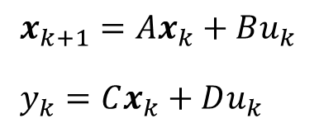

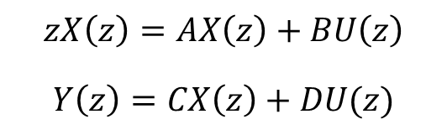
Consider SISO LTI system:
$x_{k+1}=Ax_{k}+Bu_{k}$
$y_{k}=Cx_{k}+Du_{k}$
Z - Transform →
$$zX\left(z\right)=AX\left(z\right)+BU\left(z\right)$$
$$Y\left(z\right)=CX\left(z\right)+DU(z)$$
Exercise: Find Transfer Function $G_{1}\left(z\right)=\frac{X(z)}{U(z)}= ?$
and Transfer Function $G_{2}\left(z\right)=\frac{Y(z)}{U(z)}= ?$ (5 minutes)

Slide 12
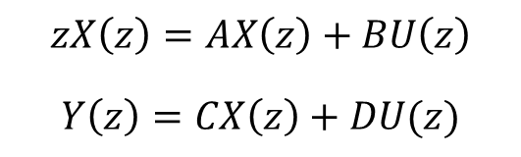
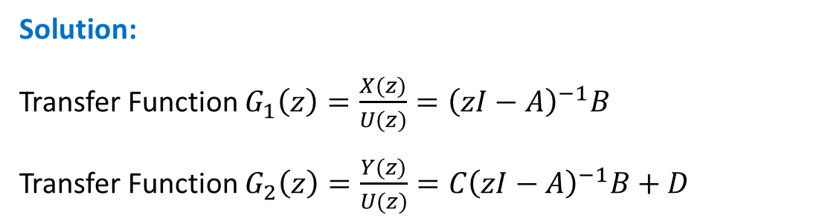
$$zX\left(z\right)=AX\left(z\right)+BU\left(z\right)$$
$$Y\left(z\right)=CX\left(z\right)+DU(z)$$
Solution:
Transfer Function $G_{1}\left(z\right)=\frac{X(z)}{U(z)}={\left(zI−A\right)}^{−1}B$
Transfer Function $G_{2}\left(z\right)=\frac{Y(z)}{U(z)}=C{\left(zI−A\right)}^{−1}B+D$
Stability:
Continuous-time LTI systems: Poles are inside LHP in s-plane
Discrete-time LTI systems: Poles are inside unit circle in z-plane

Slide 13

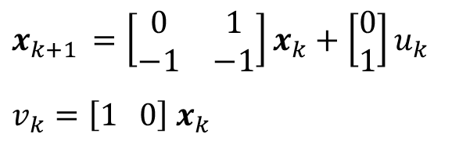
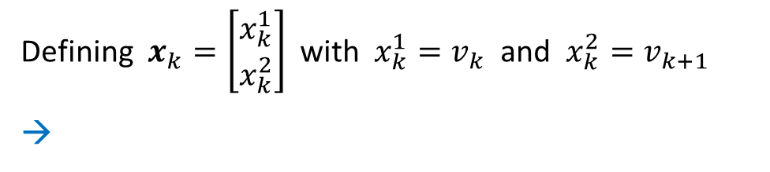
Recall:
$$v_{k+2}+v_{k+1}+v_{k}=u_{k}$$
Defining $x_{k}=\left[\begin{matrix}x_{k}^{1} \\ x_{k}^{2}\end{matrix}\right]$ with $x_{k}^{1}=v_{k}$ and $x_{k}^{2}=v_{k+1}$
→
$$x_{k+1 }=\left[\begin{matrix}0 & 1 \\ −1 & −1\end{matrix}\right]x_{k}+\left[\begin{matrix}0 \\ 1\end{matrix}\right]u_{k}$$
$$v_{k}=\left[1 0\right]{ x}_{k}$$
Exercise: Is this system stable? (10 minutes)

Slide 14
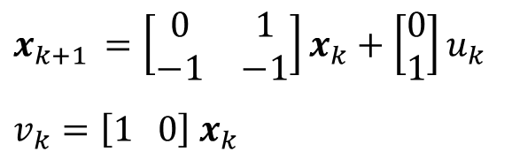


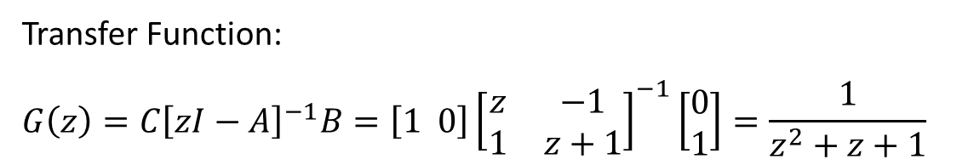
Solution:
$$x_{k+1 }=\left[\begin{matrix}0 & 1 \\ −1 & −1\end{matrix}\right]x_{k}+\left[\begin{matrix}0 \\ 1\end{matrix}\right]u_{k}$$
$$v_{k}=\left[1 0\right]{ x}_{k}$$
Transfer Function:
$$G\left(z\right)={C\left[zI−A\right]}^{−1}B=\left[1 0\right]{\left[\begin{matrix}z & −1 \\ 1 & z+1\end{matrix}\right]}^{−1}\left[\begin{matrix}0 \\ 1\end{matrix}\right]=\frac{1}{z^{2}+z+1}$$
Or
$$v_{k+2}+v_{k+1}+v_{k}=u_{k}$$
→ $z^{2}V+zV+V=U$ → $\frac{V}{U}=\frac{1}{z^{2}+z+1}$
Poles: $p_{1,2}=−\frac{1}{2}±j\frac{\sqrt{3}}{2}$ → $\left| p_{1,2} \right|$ > 1 → unstable
Note: For continuous-time LTI systems, these are stable poles !

Slide 15
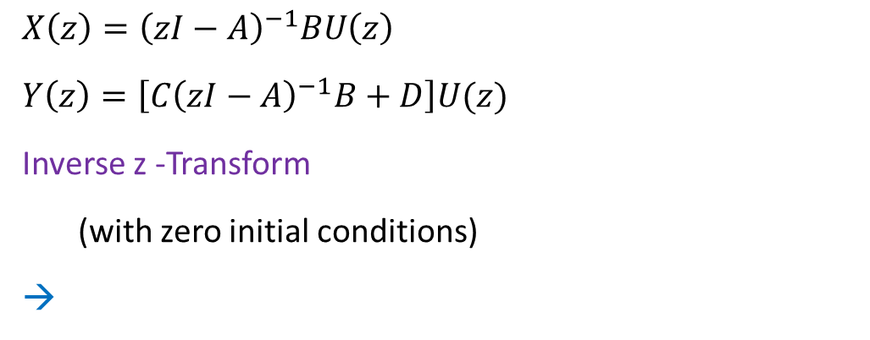
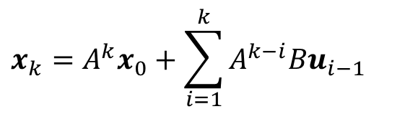
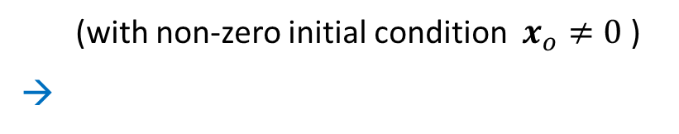
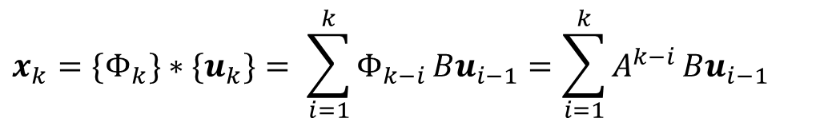
Consider:
$$X\left(z\right)={\left(zI−A\right)}^{−1}BU\left(z\right)$$
$Y\left(z\right)=\left[C{\left(zI−A\right)}^{−1}B+D\right]U(z)$
Inverse z -Transform
(with zero initial conditions)
→
$$x_{k}=\{Φ_{k}\}∗{\{u}_{k}\}= \sum_{i=1}^{k}{Φ_{k−i }{Bu}_{i−1}=\sum_{i=1}^{k}{A^{k−i}}Bu_{i−1}}$$
(convolution)
(with non-zero initial condition $x_{o}≠0$ )
→
$$x_{k}=A^{k}x_{0}+\sum_{i=1}^{k}{A^{k−i}Bu_{i−1}}$$

Slide 16

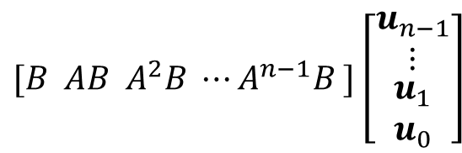
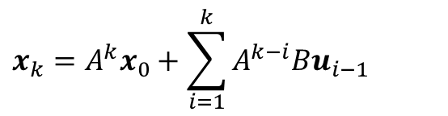
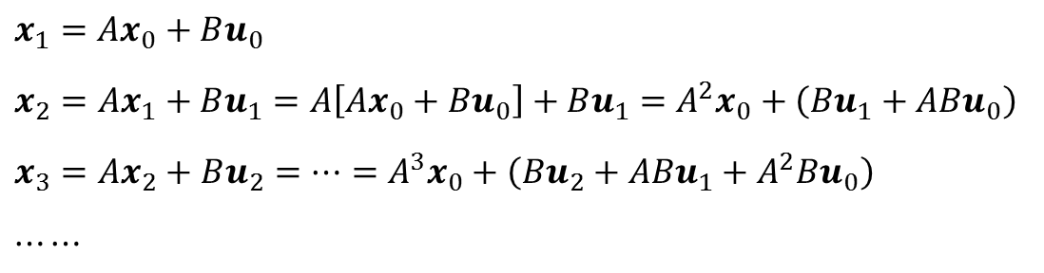
In fact:
$$x_{k+1}=Ax_{k}+Bu_{k}$$
$$x_{1}=Ax_{0}+Bu_{0}$$
$$x_{2}=Ax_{1}+Bu_{1}=A\left[Ax_{0}+Bu_{0}\right]+Bu_{1}=A^{2}x_{0}+\left(Bu_{1}+ABu_{0}\right)$$
$$x_{3}=Ax_{2}+Bu_{2}=⋯=A^{3}x_{0}+\left(Bu_{2}+ABu_{1}+A^{2}Bu_{0}\right)$$
$$⋯⋯$$
$$x_{k}=A^{k}x_{0}+\sum_{i=1}^{k}{A^{k−i}Bu_{i−1}}$$
Note:
$[B AB A^{2}B ⋯A^{n−1}B ]\left[\begin{aligned}\begin{matrix}u_{n−1} \\ ⋮\end{matrix} \\ \begin{matrix}u_{1} \\ u_{0}\end{matrix}\end{aligned}\right]$
Controllability condition
%MatLab
co = ctrb (A,B)

Slide 17
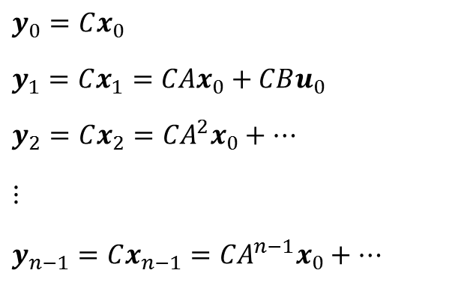
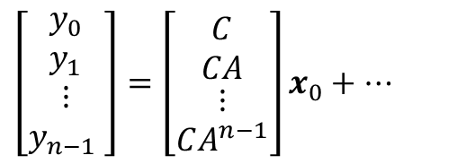
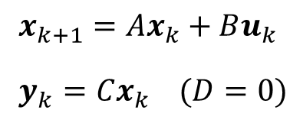
$x_{k+1}=Ax_{k}+Bu_{k}$
$y_{k}=Cx_{k} (D=0)$
Similarly:
$$y_{0}=Cx_{0}$$
$$y_{1}=Cx_{1}=CAx_{0}+CBu_{0}$$
$$y_{2}=Cx_{2}={CA}^{2}x_{0}+⋯$$
$$⋮$$
$$y_{n−1}=Cx_{n−1}={CA}^{n−1}x_{0}+⋯$$
$$\left[\begin{aligned}\begin{matrix}y_{0} \\ y_{1}\end{matrix} \\ \begin{matrix}⋮ \\ y_{n−1} \end{matrix}\end{aligned}\right]=\left[\begin{aligned}\begin{matrix}C \\ CA\end{matrix} \\ \begin{matrix}⋮ \\ CA^{n−1}\end{matrix}\end{aligned}\right]x_{0}+⋯$$
Observability condition
%MatLab
ob = obsv (A,C);

Slide 18
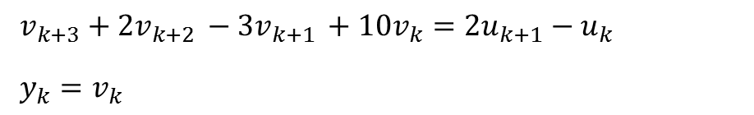
Exercise:
Verify the controllability and observability of the following discrete-time LTI system: (10 minutes)
$v_{k+3}+2v_{k+2 }−3v_{k+1 }+10v_{k}=2u_{k+1}−u_{k}$
$y_{k}=v_{k}$

Slide 19
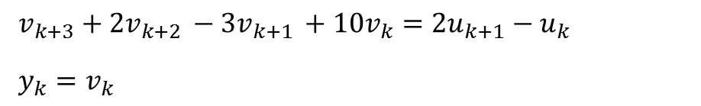
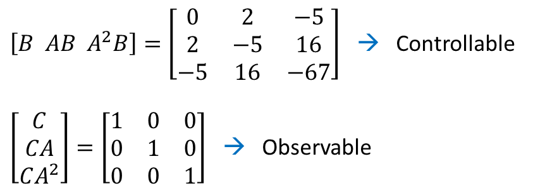
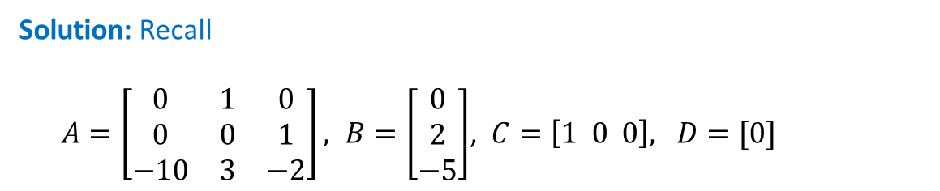
Exercise:
Verify the controllability and observability of the following discrete-time LTI system: (10 minutes)
$v_{k+3}+2v_{k+2 }−3v_{k+1 }+10v_{k}=2u_{k+1}−u_{k}$
$y_{k}=v_{k}$
Solution: Recall
$A=\left[\begin{matrix}0 & 1 & 0 \\ 0 & 0 & 1 \\ −10 & 3 & −2\end{matrix}\right], B=\left[\begin{matrix}0 \\ 2 \\ −5\end{matrix}\right]$, $C=\left[1 0 0\right],$ $D=[0]$
$\left[B AB A^{2}B\right]=\left[\begin{matrix}0 & 2 & −5 \\ 2 & −5 & 16 \\ −5 & 16 & −67\end{matrix}\right]$ → Controllable
$\left[\begin{matrix}C \\ CA \\ CA^{2}\end{matrix}\right]=\left[\begin{matrix}1 & 0 & 0 \\ 0 & 1 & 0 \\ 0 & 0 & 1\end{matrix}\right]$ → Observable

Slide 20
END

